Slide 1

POL2016 Political Theory –I
Aniruddha Kumar Baro

Slide 2
Why do we need Political Theory?

Slide 3
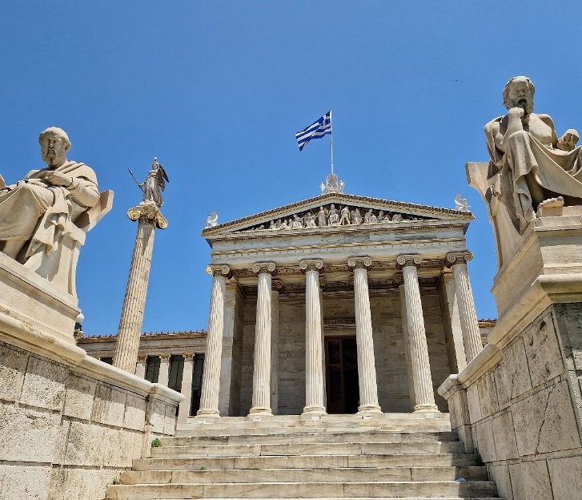
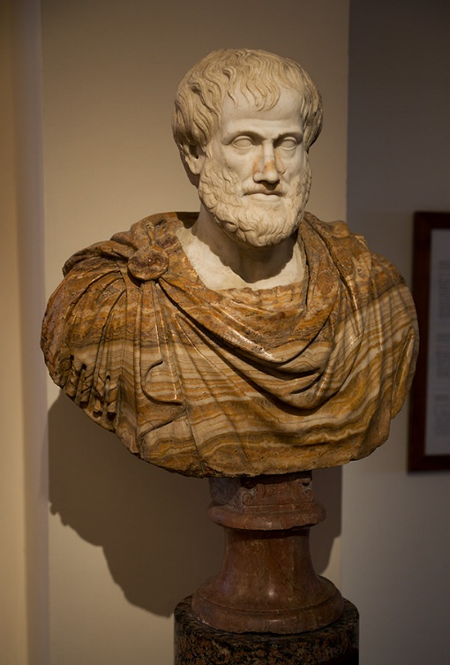
What is Political Theory?
Political Theory is:
  A systematic reflection on politics
  Normative + Analytical inquiry
  Study of concepts like justice, liberty, equality, power, state
Classic Definitions:
  Plato – Justice as harmony
  Aristotle – Politics as pursuit of the good life
  John Rawls – Justice as fairness
  Hannah Arendt – Politics as action and public space

Slide 4
Political Theory vs Political Science
Political Theory
  Normative
  What ought to be?
  Justice, freedom
  Philosophical
Political Science
  Empirical
  What is?
  Voting, institutions
  Scientific
👉 Political theory provides moral direction to political science.

Slide 5
Why Do We Need Political Theory? (Overview)
To understand political concepts
To evaluate political institutions
To guide public policy
To critique power and domination
To imagine alternative futures

Slide 6
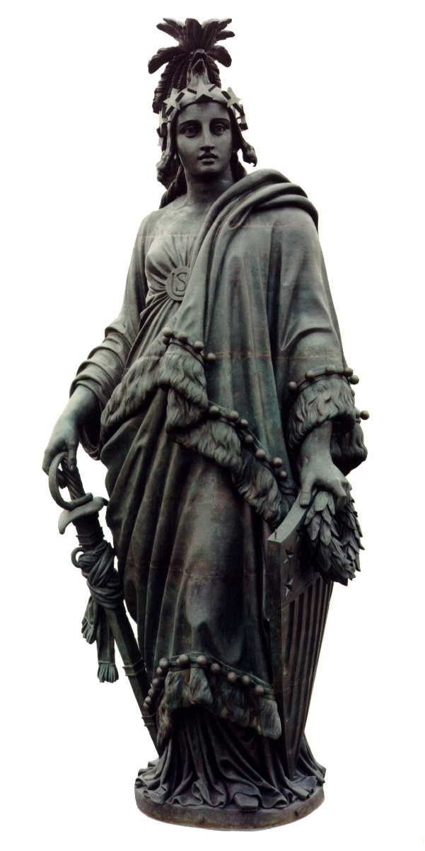
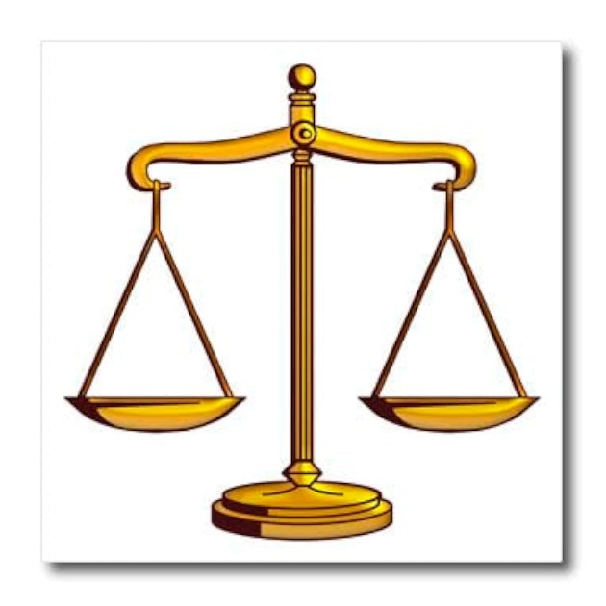
1️⃣ Clarifying Political Concepts
Concepts like:
  Justice
  Liberty
  Equality
  Democracy
Political theory asks:
  What kind of liberty? Negative or Positive?
  Equality of what? Opportunity or outcome?
👉 Without theory, concepts remain vague.

Slide 7
2️⃣ Normative Guidance – What Ought to Be?
Political theory provides:
  Ethical standards
  Moral evaluation of laws
  Standards for legitimacy
Example:
  John Rawls → Difference Principle
  Robert Nozick → Minimal State
👉 Helps evaluate welfare state policies.

Slide 8
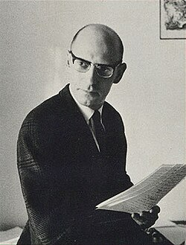
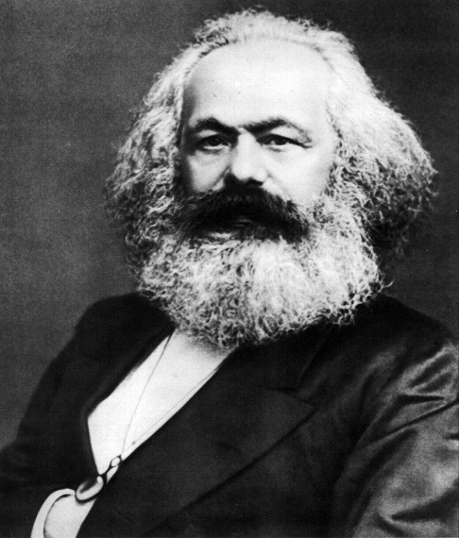
3️⃣ Critiquing Power and Domination
Karl Marx → Class domination
Michel Foucault → Power and discourse
Political theory reveals:
  Hidden structures of power
  Ideology
  Structural inequality
Example:
Debates on surveillance, caste hierarchy, patriarchy.

Slide 9
4️⃣ Interpreting Political Events
Political theory helps analyze:
  Rise of nationalism
  Identity politics
  Constitutional crises
Example:
  Is nationalism inclusive or exclusionary?
  Is majoritarianism democratic?

Slide 10
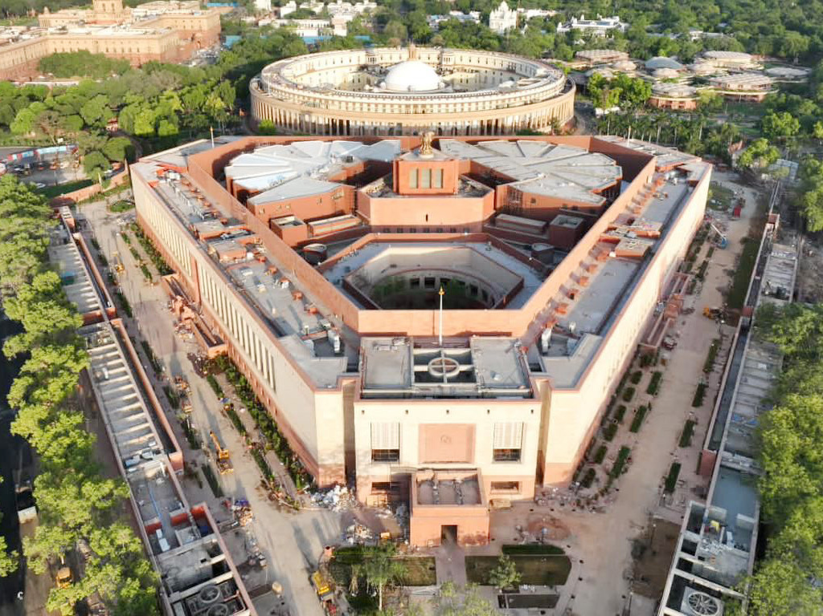
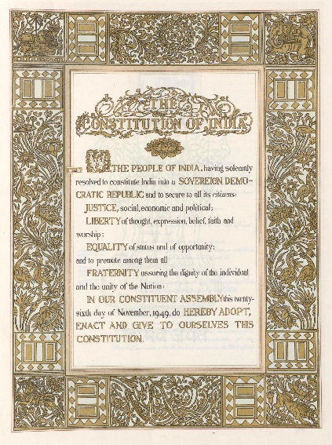
5️⃣ Guiding Constitutionalism & Democracy
Foundations of justice
Rule of law
Fundamental rights
👉 The Constitution embodies political theory in practice.

Slide 11
Political Theory and Indian Context
Debates on secularism
Social justice and reservation
Citizenship debates
Federalism
Thinkers:
  B. R. Ambedkar – Constitutional morality
  M. K. Gandhi – Swaraj
  Jawaharlal Nehru – Democratic socialism

Slide 12
Political Theory as Imagination
Political theory:
  Imagines ideal societies
  Questions status quo
  Creates utopias and alternatives
Example:
  Plato’s ideal state
  Marx’s classless society
  Feminist political theory

Slide 13
Contemporary Relevance
Political theory helps understand:
  Climate justice
  Digital surveillance
  AI and governance
  Identity and multiculturalism
Question:
👉 Can democracy survive digital capitalism?

Slide 14
Criticism of Political Theory
Too abstract
Detached from reality
Eurocentric bias
Response:
  Revival of contextual political theory
  Postcolonial and subaltern approaches

Slide 15


