Slide 1

POL2016 Political Theory –I
Aniruddha Kumar Baro

Slide 2
Introduction
Course objective:
  This paper is a core paper that intends to introduce students to themes, concepts and debates in Political Theory.
  It seeks to develop new insights among students on the relevance of political ideas, political traditions and concepts in understanding the crisis, change and continuity that marks the politics in contemporary world.
  It starts with the explanation about the relevance of political theory and offers insights on the idea of state, power, nationalism, globalisation and democracy.

Slide 3
Course outcome
  The paper remains useful for students in developing ideas on politics which is helpful in providing theoretical insights and perspectives to students if they wish to pursue research programme.
  The paper has utility for students preparing for UGC NET-JRF exams, SLET exams and other competitive exams like civil services.

Slide 4
POL2016 Political Theory –I
Unit 1: Political Theory: An Introduction
  1 What is Political theory?
  2 Why do we need Political Theory?
  3 Decline of Political Theory
Unit 2: Nation and State
  1. Nation, State and Sovereignty
  2. National Self-determination
  3. State and globalization

Slide 5
Unit 3: Understanding Power
  1. Different dimensions: Power as decision making, power as agenda setting, power as thought control
  2. Ideology and power
  3. Power as subject: Foucauldian perspective
Unit 4: Democracy
  1. Procedural vs. Substantive Conceptions of Democracy
  2. Liberal democracy: issues and perspectives
  3. Democracy and Citizenship

Slide 6
Unit 1: Political Theory: An Introduction
  1 What is Political theory?
  2 Why do we need Political Theory?
  3 Decline of Political Theory

Slide 7
What is Political Theory?
Systematic study of political ideas and concepts
  State, Power, Authority, Justice, Rights, Equality, Freedom
  Combines philosophy, history and empirical analysis

Slide 8
Definitions by Thinkers
George Sabine – disciplined investigation of political problems
  David Held – network of political concepts and generalizations
  Andrew Heywood – normative and empirical analysis of politics

Slide 9
Nature of Political Theory
Normative – What ought to be?
  Justice, Rights, Equality
Empirical – What is?
  Political institutions, behavior
Analytical – Clarification of concepts
  What do we mean by freedom? equality?
Example: Article 14 – Equality before Law
Political theory asks:
  Is formal equality enough?
  Should there be affirmative action?
Political Theory vs Philosophy vs Political Science
  Political Philosophy – abstract & normative: Plato, Aristotle
  Political Theory – normative + empirical: Rawls, Marx, Gandhi
  Political Science – scientific & empirical: Behavioralists

Slide 10
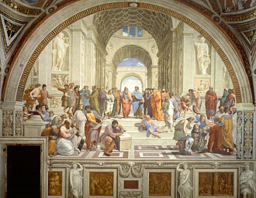
Historical Evolution of Political Theory
Ancient Political Theory
Plato – Justice in Republic
Aristotle – Man is a political animal
Focus: Virtue, ideal state, ethics.

Slide 11
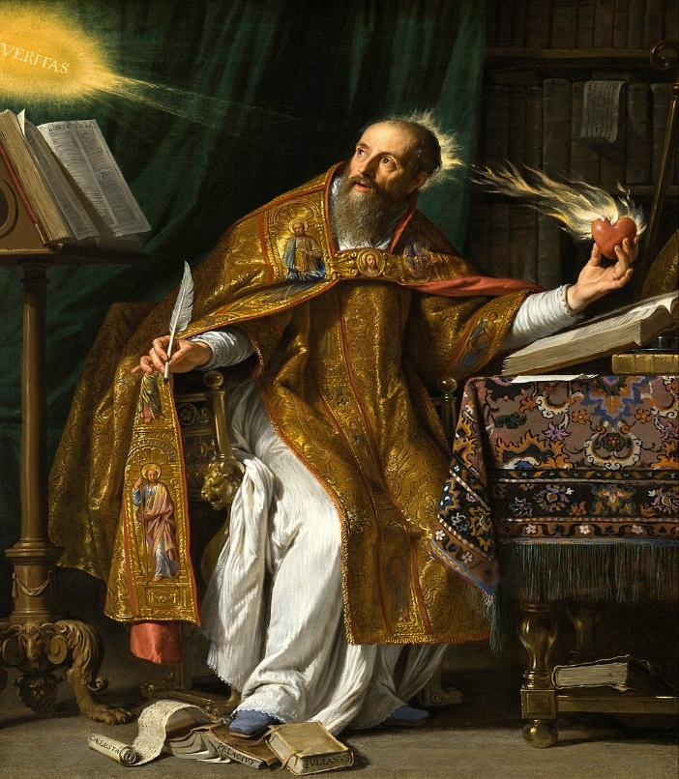
Medieval Political Theory
Augustine of Hippo – City of God
Thomas Aquinas – Natural Law
Focus: Religion and politics.

Slide 12
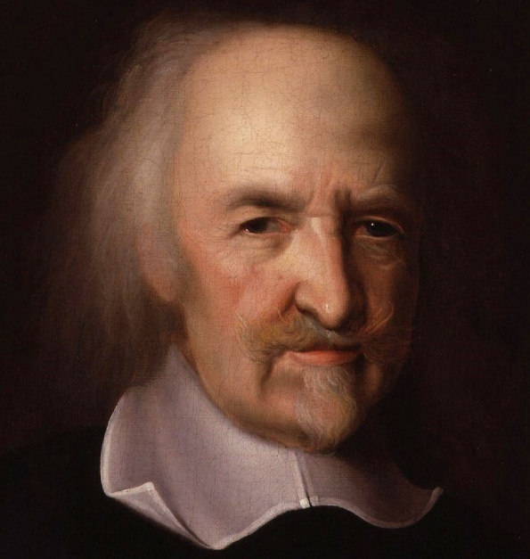
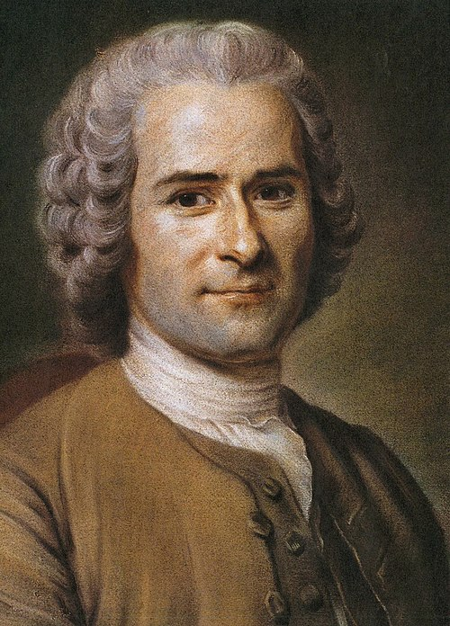
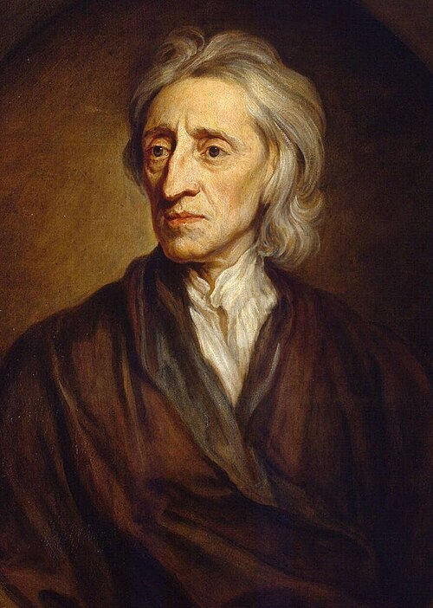
Modern Political Theory
Thomas Hobbes – Absolute sovereignty
John Locke – Natural rights
Jean-Jacques Rousseau – General will
Focus: Social contract, sovereignty, rights.

Slide 13
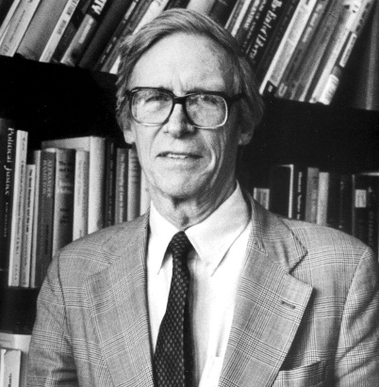
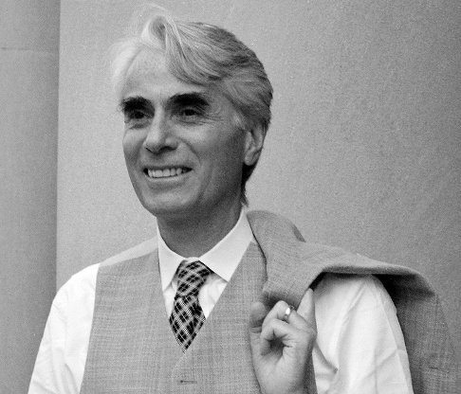
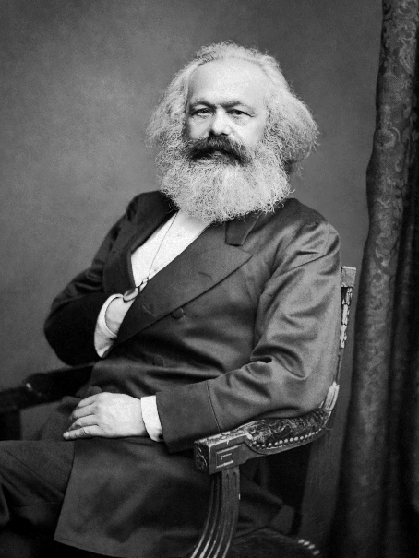
Contemporary Political Theory
John Rawls – Justice as Fairness
Robert Nozick – Libertarianism
Karl Marx – Class & State
Mahatma Gandhi – Swaraj
Focus: Justice, equality, liberty, democracy.

Slide 14
Key Concepts in Political Theory
Justice
Equality
Liberty
Rights
Power
Sovereignty
Democracy
Example (Indian Context):
  Article 19 – Freedom
  Article 21 – Right to Life
  Article 39(b) – Directive Principles (economic justice)
Political theory helps us interpret these articles.

Slide 15
Why Study Political Theory?
Develops critical thinking
Clarifies political concepts
Evaluates public policy
Connects theory with constitutional practice
Helps in NET/JRF & civil services preparation
Example:
Debate on Uniform Civil Code → Liberty vs Equality vs Secularism.

Slide 16
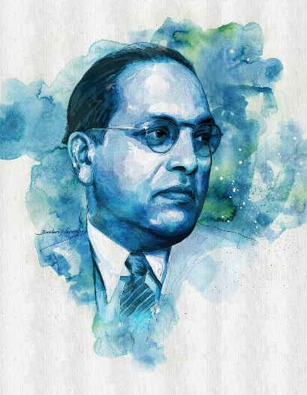
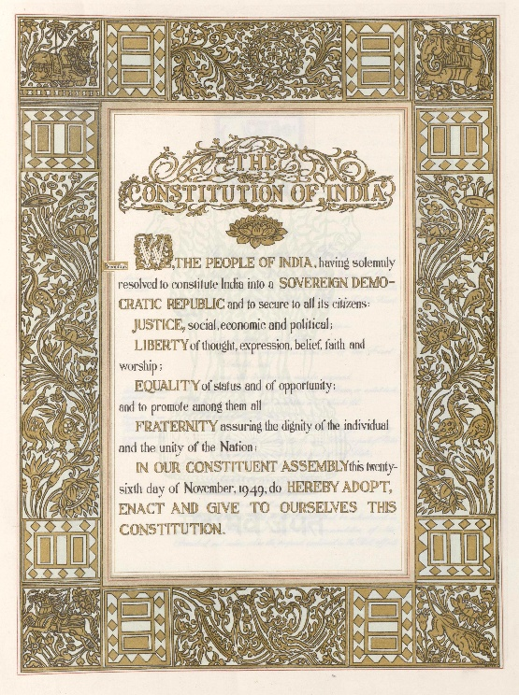
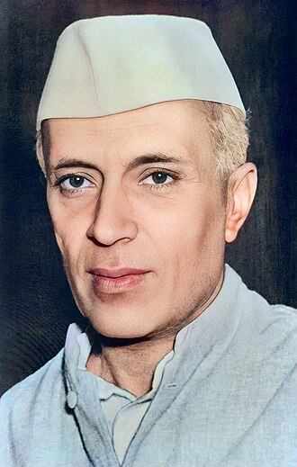
Political Theory in Indian Context
B. R. Ambedkar – Constitutional morality
Jawaharlal Nehru – Democratic socialism
Indian Political Theory combines:
  Liberalism
  Social justice
  Secularism
  Constitutionalism

Slide 17
Normative vs Empirical Debate
Behavioral Revolution (1950s) → Political Science should be value-free
Post-behavioralism → Reintroduced values
Political Theory:
  Is not dead
  Is not purely abstract
  Is essential for democracy
  Connects ideas with institutions
It provides intellectual foundation of political life.

Slide 18


