Slide 1
Question of Identity: Naga Nationalism

Slide 2
Understanding Identity Politics
What is Identity?
  Collective sense of belonging
  Based on ethnicity, language, culture, religion, territory
What is Ethno-Nationalism?
  Nationalism rooted in ethnic identity
  Demand for self-determination
  Protection of cultural and territorial rights
Theoretical Link
  Primordialism – Identity is ancient and emotional
  Constructivism – Identity is socially constructed
  Instrumentalism – Identity used for political mobilisation

Slide 3

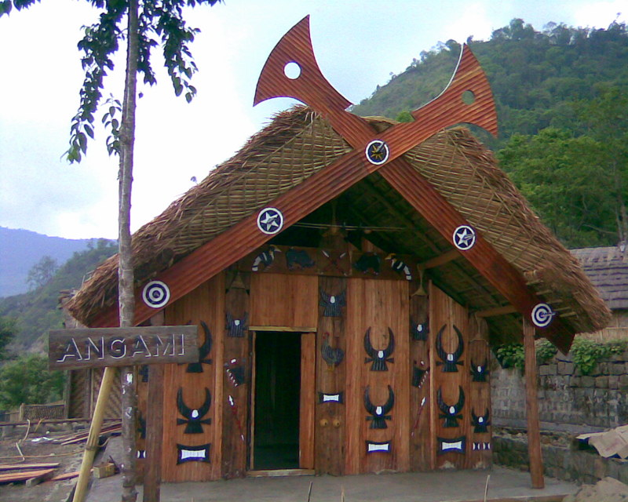
Who Are the Nagas?
Comprise about 17 major tribes and many sub-tribes
Spread across:
  Nagaland
  Manipur (hill districts)
  Assam
  Arunachal Pradesh
  Parts of Myanmar
Strong tribal traditions and customary laws
Christianity as dominant religion

Slide 4
Historical Roots of Naga Nationalism
Colonial Period
  Limited British administrative penetration
  Excluded Areas policy
  1929: Naga Club memorandum to Simon Commission
Pre-Independence Development
  Formation of Naga National Council
  Leadership of A.Z. Phizo
14 August 1947
  Declaration of Naga Independence

Slide 5
Post-1947 Insurgency
1951: Naga plebiscite (claimed 99% support for independence)
Formation of underground:
  Naga Federal Government
  Naga Federal Army
1950s–60s: Armed conflict with Indian state
1963: Creation of Nagaland state (partial accommodation)

Slide 6
Shillong Accord & Split
1975: Shillong Accord
  Section of NNC accepted Indian Constitution
  Agreed to surrender arms
Reaction
  Rejection by radical faction
  Formation of National Socialist Council of Nagaland (NSCN)
Later split into:
  NSCN-IM (Isak-Muivah)
  NSCN-K (Khaplang)

Slide 7
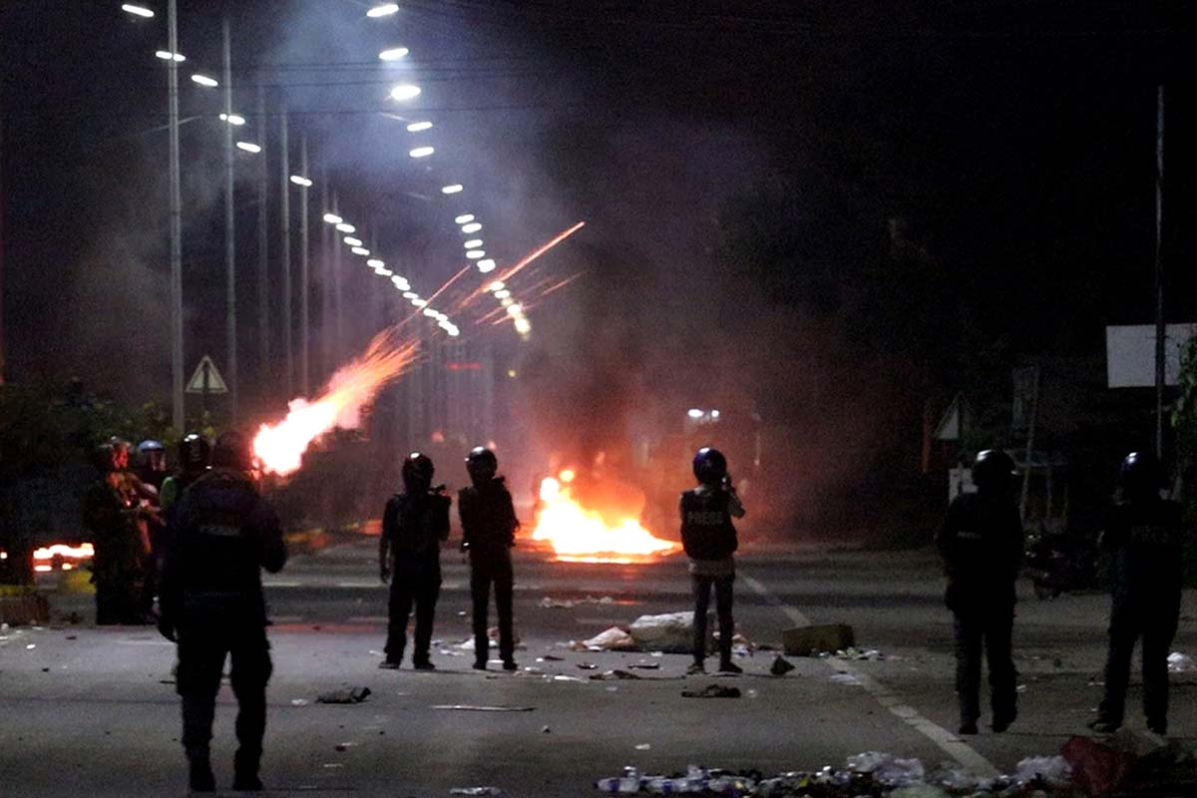
The Idea of “Greater Nagalim”
Core Demand
  Integration of all Naga-inhabited areas into one political unit.
Includes parts of:
  Manipur
  Assam
  Arunachal Pradesh
  Myanmar
Why Controversial?
  Territorial integrity of neighboring states threatened
  Meitei, Assamese, Arunachali opposition

Slide 8
Ceasefire and Peace Process
  1997: Ceasefire between GoI and NSCN-IM
  2001: Ceasefire extended “without territorial limits”
  Massive protests in Manipur (18 June 2001 uprising)
Current Status
  Ongoing negotiations
  Demand for:
    Separate flag
    Separate constitution
    Greater autonomy

Slide 9
Identity vs State Sovereignty
Naga Perspective
  “We are Nagas by birth, Indians by accident.”
  Ethnic self-determination
  Protection of land and culture
Indian State Perspective
  Unity and territorial integrity
  Federal accommodation
  Constitutional framework (Article 371A)

Slide 10
Inter-Ethnic Conflicts
Naga assertion triggered conflicts with:
  Kukis (Manipur)
  Meiteis (Manipur)
  Karbis (Assam)
Concept:
  Ethno-territorial competition
This shows:
  Identity politics is not just Centre vs State, but also Tribe vs Tribe.

Slide 11
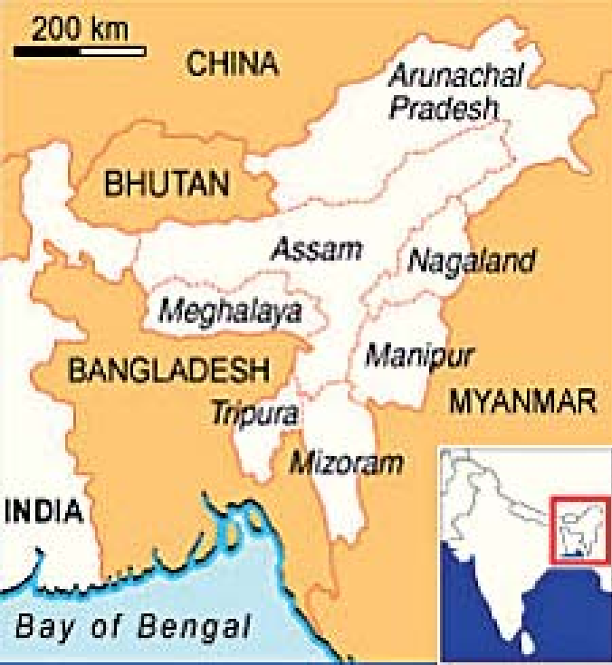
Foreign Dimensions
  Myanmar bases
  Alleged support networks in Bangladesh (historical phases)
  Trans-border ethnic linkages
Geopolitical Importance
  Chicken’s Neck corridor
  Border sensitivity

Slide 12
Theoretical Analysis
1. Ethno-Symbolism (Anthony D. Smith)
  Myth of common ancestry
  Shared memories
2. Self-Determination Theory
  UN principle
  Internal vs external self-determination
3. Federalism & Asymmetrical Autonomy
  Article 371A
  Sixth Schedule provisions

Slide 13
Has Identity Politics Declined?
Violence reduced compared to 1990s
Civil society role
Church mediation
Negotiated federalism
But:
  Demand for integration remains sensitive
  Periodic tensions persist

