Slide 1

POL060304: Politics in Northeast India (Optional)
Aniruddha Kumar Baro

Slide 2
Introduction
Course objective:
  This course is designed to introduce students to the general perceptions about politics in Northeast India.
  It would also give them an introduction to colonial experience in Northeast India.
  It attempts to highlight the different ethnic movements in different parts of the Northeast India and contemporary politics in Northeast India.

Slide 3
Course outcome
  It will help to better appreciate key concepts that offer an understanding about political development in Northeast India.
  Students will be in a position to comprehend the meaning of political development in Northeast India.
  This course will help the students to comprehend the trajectory of ethnic movement in Northeast India and the issues addressed.
  It will lead to analysing and understanding the importance of Issues of Northeast India in certain key aspects.

Slide 4
POL060304: Politics in Northeast India (Optional)
Unit-I: Colonial Policy- Annexation and Administration
  Geo-Strategic Location and Socio-Cultural Diversity.
  Expansion and Consolidation of Colonial Rule.
  Excluded and Partially Excluded areas: Inner Line.
  Anti-Colonial revolts (Phulaguri Dhewa and Patharughat) and Freedom Struggle.
Unit-II: Post-Colonial developments
  Immigration and Problem of Refugees.
  Question of Identity: Naga Nationalism.
  Sixth Schedule.
  Re-organisation of Northeast India.

Slide 5
Unit-III: Political developments in Assam
  Language Politics.
  Assam Movement.
  Bodo Movement.
  Rise of insurgency: ULFA and NDFB.
Unit-IV: Changing nature of state politics in Assam
  Emergence of Regional Parties: AGP.
  Formation of Autonomous Councils: Rabha and Mising.
  Citizenship: NRC and CAA.

Slide 6
Unit-II: Post-Colonial developments
  Immigration and Problem of Refugees.
  Question of Identity: Naga Nationalism.
  Sixth Schedule.
  Re-organisation of Northeast India.

Slide 7
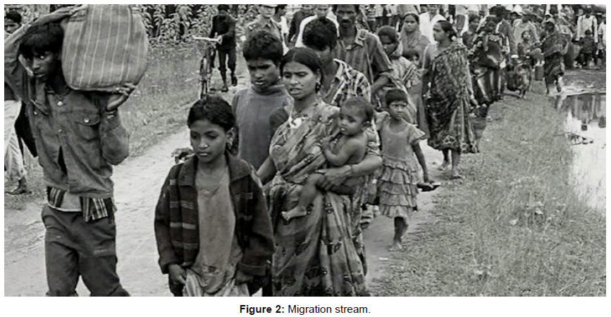
Conceptual Clarification
Key Terms
  Migration: Movement of people across a border irrespective of legal status
  Refugee: A person forced to flee due to war, conflict, persecution, or natural disaster
  Immigrant (legal/illegal): Crosses border for work/economic reasons, may lack documents
  Post-colonial context: Changes after colonial rule ends (British India → Independent India)
  Include an image like this of migrants/refugees in Assam:

Slide 8
Colonial Roots of Migration
✔ British encouraged labour migration to Assam tea gardens and agricultural lands, creating early migration streams.
✔ Language and administration policies favoured Bengali, marginalising local Assamese.
Theory: Colonial State Theory — Colonisers manipulate populations to serve economic interests, often reshaping identity and demographics (e.g., labour migrants in Assam).
Example: “Line System” (1920) tried to regulate settlement but failed.

Slide 9
Partition & Refugee Influx (1947)
Impact of Partition
Millions of people moved after 1947, including large numbers into Assam.
Social tension escalated as Assamese feared resource competition and cultural dilution.
Case: 1948 Guwahati riots — ethnic rioting targeting Bengali Hindus as ‘outsiders’.
Theory: Post-Colonial Identity Formation — Emerging states struggle between inclusive nationalism vs. protection of indigenous identity.

Slide 10
1971 Bangladesh War & Refugee Crisis
The 1971 Bangladesh Liberation War caused an unprecedented influx of refugees into Assam and other northeastern states.
Around 10 million refugees crossed into India, overwhelming administrative systems.
Theory: Push-Pull Model — War, persecution push people out; opportunities and safety in Assam pull them in.

Slide 11
Assam Movement (1979-1985) & Assam Accord
The Assam Movement was a mass agitation against illegal immigration, spearheaded by Assamese students and groups.
Assam Accord (1985) set March 24, 1971 as the citizenship cut-off for recognition.
Why it matters: It institutionalised a legal frame to distinguish genuine citizens from ‘illegal immigrants’.

Slide 12
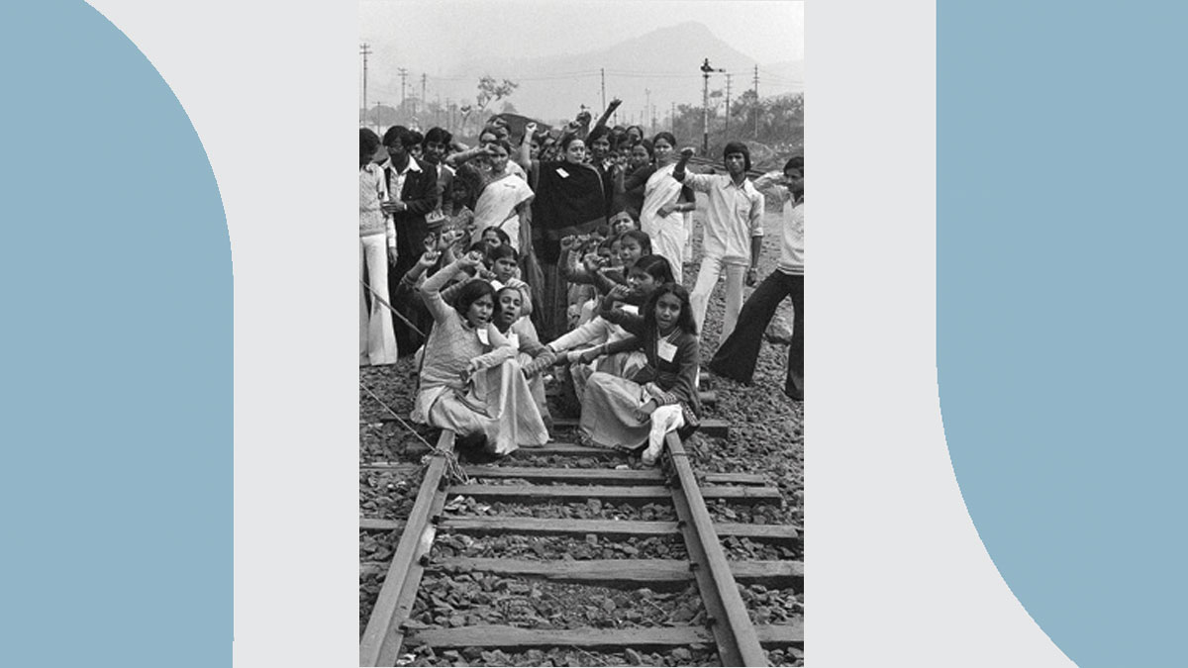
The Assam Agitation (1979–1985)
Led by:
All Assam Students' Union (AASU)
All Assam Gana Sangram Parishad
Core Demand:
Detection, deletion and deportation of illegal immigrants.
Result: Assam Accord

Slide 13
Key Provisions of Assam Accord (1985)
Cut-off date: 24 March 1971
Detection and deportation process
Constitutional, legislative safeguards for Assamese people
Illegal Migrants (IMDT) Act, 1983
  Applicable only in Assam
  Burden of proof on accuser
Struck down in 2005 by:
  Supreme Court of India
Debate:
  Was IMDT protective or ineffective?

Slide 14
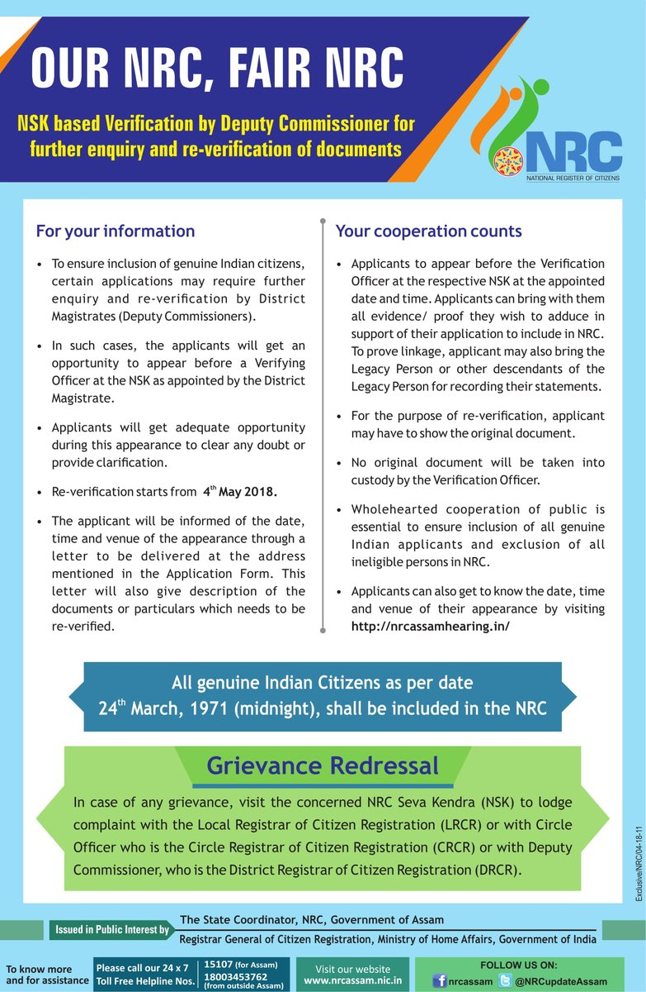
National Register of Citizens (NRC)
First prepared in 1951
Updated process (2013–2019)
Final NRC published in 2019
Issues:
  Documentation problems
  Statelessness concerns
  Human rights debates

Slide 15
NRC, CAA and Contemporary Issues
National Register of Citizens (NRC) – Process fuelled by fear of undocumented migration.
Excluded nearly 1.9 million people from the final NRC list.
Citizenship Amendment Act (2019) adds complexity by prioritising certain religious groups.
Theory: Security vs. Human Rights Debate — States frame migration as a security threat; activists highlight humanitarian obligations.

Slide 16
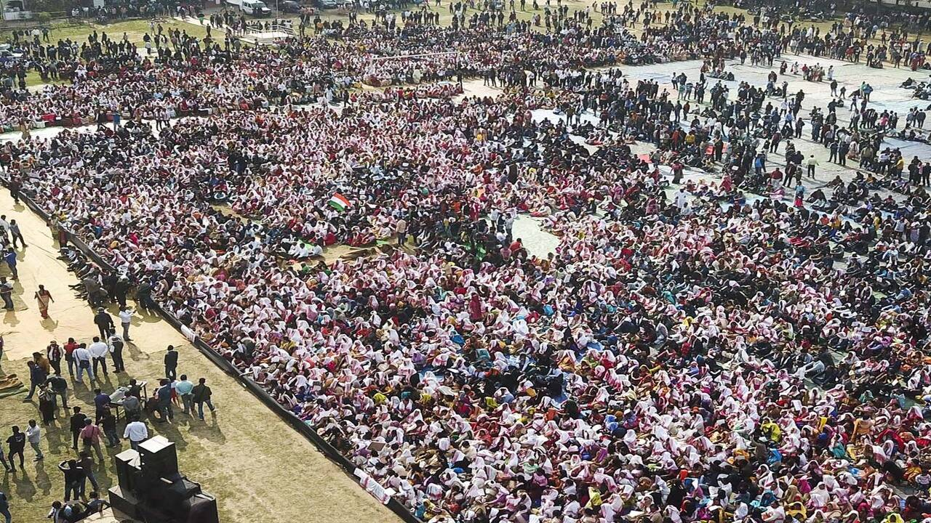
Citizenship Amendment Act (CAA), 2019
Passed by Parliament in 2019
Provides citizenship to persecuted minorities from:
Pakistan
Bangladesh
Afghanistan
Excludes Muslims.
Triggered protests in Assam and Northeast.
Citizenship Amendment Act

Slide 17
Socio-Economic Impacts
  Land pressure and competition for resources.
  Strain on public services and jobs.
  Electoral politics — migration becomes a vote-bank issue.
Conflict & Violence
Examples of ethnic tension:
  Goreswar Massacre (1960) — Ethnic violence against Bengali settlers.
  Silapathar Massacre (1983) — Targeted Bengali refugee settlers.
  North Kamrup Violence (1980) — Clash between Assamese and immigrant villages.
These show how migration and identity politics can escalate into violence when unaddressed.

Slide 18
Recent News Context
Assam has deported several suspected undocumented migrants to Bangladesh since 2024.
Deportation operations are politically and electorally charged.
Assam’s immigration issues are rooted in colonial policies and post-independence geopolitics.
Tension between human rights and security persists.
Policy tools like Assam Accord, NRC, CAA reflect competing narratives of identity, citizenship, and belonging.

