Slide 1

POL060304: Politics in Northeast India (Optional)
Aniruddha Kumar Baro

Slide 2
Introduction
Course objective:
  This course is designed to introduce students to the general perceptions about politics in Northeast India.
  It would also give them an introduction to colonial experience in Northeast India.
  It attempts to highlight the different ethnic movements in different parts of the Northeast India and contemporary politics in Northeast India.

Slide 3
Course outcome
  It will help to better appreciate key concepts that offer an understanding about political development in Northeast India.
  Students will be in a position to comprehend the meaning of political development in Northeast India.
  This course will help the students to comprehend the trajectory of ethnic movement in Northeast India and the issues addressed.
  It will lead to analysing and understanding the importance of Issues of Northeast India in certain key aspects.

Slide 4
POL060304: Politics in Northeast India (Optional)
Unit-I: Colonial Policy- Annexation and Administration
  Geo-Strategic Location and Socio-Cultural Diversity.
  Expansion and Consolidation of Colonial Rule.
  Excluded and Partially Excluded areas: Inner Line.
  Anti-Colonial revolts (Phulaguri Dhewa and Patharughat) and Freedom Struggle.
Unit-II: Post-Colonial developments
  Immigration and Problem of Refugees.
  Question of Identity: Naga Nationalism.
  Sixth Schedule.
  Re-organisation of Northeast India.

Slide 5
Unit-III: Political developments in Assam
  Language Politics.
  Assam Movement.
  Bodo Movement.
  Rise of insurgency: ULFA and NDFB.
Unit-IV: Changing nature of state politics in Assam
  Emergence of Regional Parties: AGP.
  Formation of Autonomous Councils: Rabha and Mising.
  Citizenship: NRC and CAA.

Slide 6
Unit-II: Post-Colonial developments
  Immigration and Problem of Refugees.
  Question of Identity: Naga Nationalism.
  Sixth Schedule.
  Re-organisation of Northeast India.

Slide 7
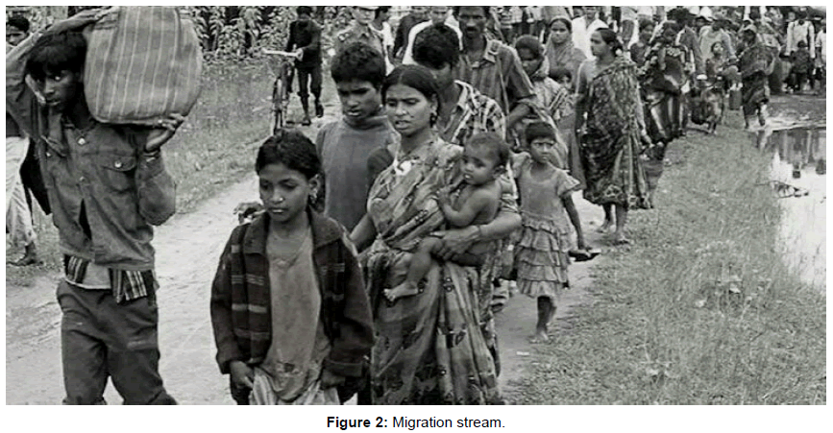
Conceptual Clarification
Key Terms
  Migration: Movement of people across a border irrespective of legal status
  Refugee: A person forced to flee due to war, conflict, persecution, or natural disaster
  Immigrant (legal/illegal): Crosses border for work/economic reasons, may lack documents
  Post-colonial context: Changes after colonial rule ends (British India → Independent India)
  Include an image like this of migrants/refugees in Assam:

Slide 8
Colonial Roots of Migration
✔ British encouraged labour migration to Assam tea gardens and agricultural lands, creating early migration streams.
✔ Language and administration policies favoured Bengali, marginalising local Assamese.
Theory: Colonial State Theory — Colonisers manipulate populations to serve economic interests, often reshaping identity and demographics (e.g., labour migrants in Assam).
Example: “Line System” (1920) tried to regulate settlement but failed.

Slide 9
Partition & Refugee Influx (1947)
Impact of Partition
Millions of people moved after 1947, including large numbers into Assam.
Social tension escalated as Assamese feared resource competition and cultural dilution.
Case: 1948 Guwahati riots — ethnic rioting targeting Bengali Hindus as ‘outsiders’.
Theory: Post-Colonial Identity Formation — Emerging states struggle between inclusive nationalism vs. protection of indigenous identity.

Slide 10
1971 Bangladesh War & Refugee Crisis
The 1971 Bangladesh Liberation War caused an unprecedented influx of refugees into Assam and other northeastern states.
Around 10 million refugees crossed into India, overwhelming administrative systems.
Theory: Push-Pull Model — War, persecution push people out; opportunities and safety in Assam pull them in.

Slide 11
Assam Movement (1979-1985) & Assam Accord
The Assam Movement was a mass agitation against illegal immigration, spearheaded by Assamese students and groups.
Assam Accord (1985) set March 24, 1971 as the citizenship cut-off for recognition.
Why it matters: It institutionalised a legal frame to distinguish genuine citizens from ‘illegal immigrants’.

Slide 12
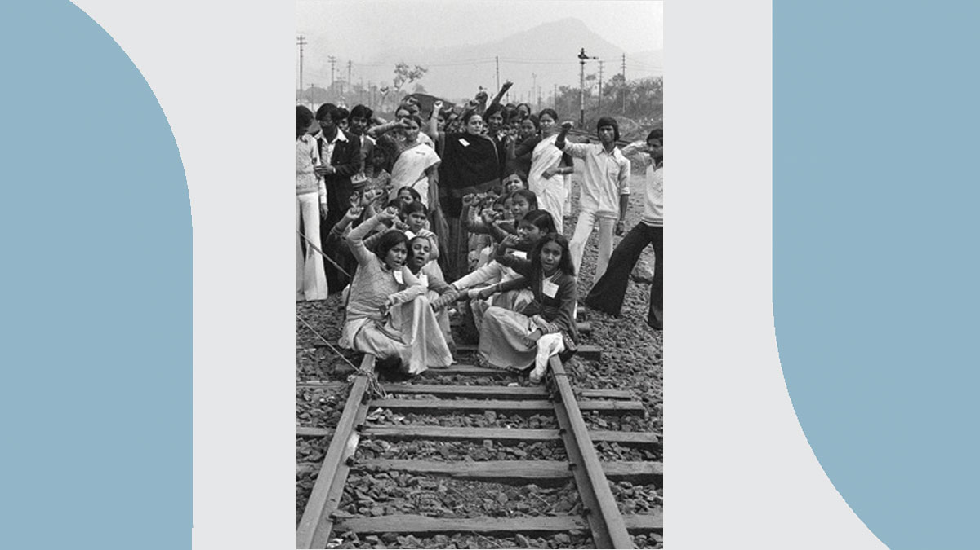
The Assam Agitation (1979–1985)
Led by:
All Assam Students' Union (AASU)
All Assam Gana Sangram Parishad
Core Demand:
Detection, deletion and deportation of illegal immigrants.
Result: Assam Accord

Slide 13
Key Provisions of Assam Accord (1985)
Cut-off date: 24 March 1971
Detection and deportation process
Constitutional, legislative safeguards for Assamese people
Illegal Migrants (IMDT) Act, 1983
  Applicable only in Assam
  Burden of proof on accuser
Struck down in 2005 by:
  Supreme Court of India
Debate:
  Was IMDT protective or ineffective?

Slide 14
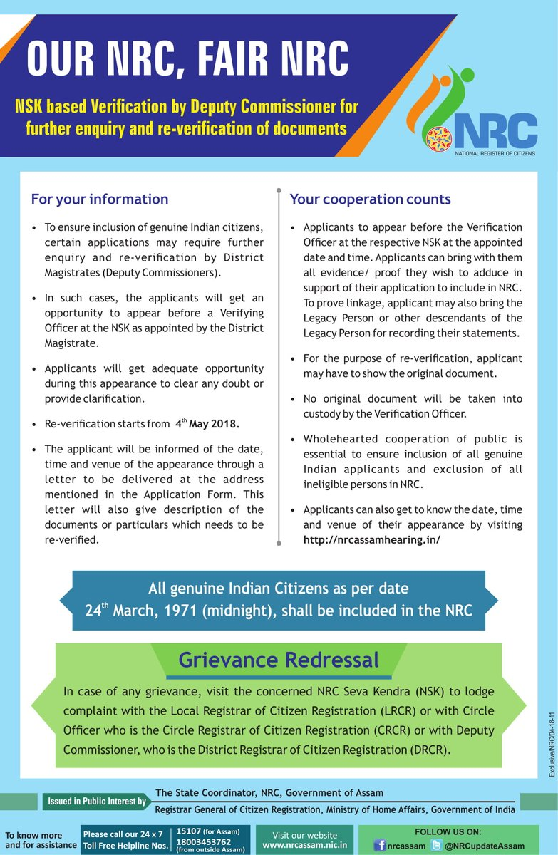
National Register of Citizens (NRC)
First prepared in 1951
Updated process (2013–2019)
Final NRC published in 2019
Issues:
  Documentation problems
  Statelessness concerns
  Human rights debates

Slide 15
NRC, CAA and Contemporary Issues
National Register of Citizens (NRC) – Process fuelled by fear of undocumented migration.
Excluded nearly 1.9 million people from the final NRC list.
Citizenship Amendment Act (2019) adds complexity by prioritising certain religious groups.
Theory: Security vs. Human Rights Debate — States frame migration as a security threat; activists highlight humanitarian obligations.

Slide 16
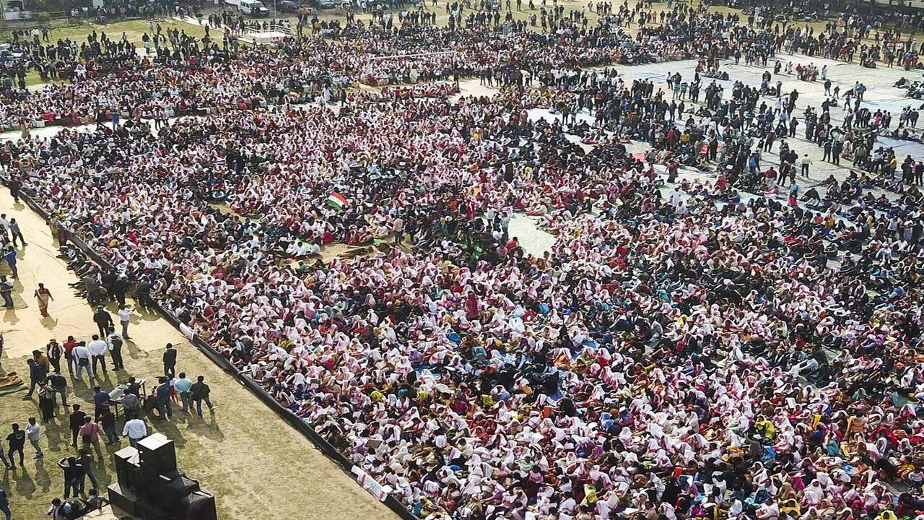
Citizenship Amendment Act (CAA), 2019
Passed by Parliament in 2019
Provides citizenship to persecuted minorities from:
Pakistan
Bangladesh
Afghanistan
Excludes Muslims.
Triggered protests in Assam and Northeast.
Citizenship Amendment Act

Slide 17
Socio-Economic Impacts
  Land pressure and competition for resources.
  Strain on public services and jobs.
  Electoral politics — migration becomes a vote-bank issue.
Conflict & Violence
Examples of ethnic tension:
  Goreswar Massacre (1960) — Ethnic violence against Bengali settlers.
  Silapathar Massacre (1983) — Targeted Bengali refugee settlers.
  North Kamrup Violence (1980) — Clash between Assamese and immigrant villages.
These show how migration and identity politics can escalate into violence when unaddressed.

Slide 18
Recent News Context
Assam has deported several suspected undocumented migrants to Bangladesh since 2024.
Deportation operations are politically and electorally charged.
Assam’s immigration issues are rooted in colonial policies and post-independence geopolitics.
Tension between human rights and security persists.
Policy tools like Assam Accord, NRC, CAA reflect competing narratives of identity, citizenship, and belonging.

Slide 19
Question of Identity: Naga Nationalism

Slide 20
Understanding Identity Politics
What is Identity?
  Collective sense of belonging
  Based on ethnicity, language, culture, religion, territory
What is Ethno-Nationalism?
  Nationalism rooted in ethnic identity
  Demand for self-determination
  Protection of cultural and territorial rights
Theoretical Link
  Primordialism – Identity is ancient and emotional
  Constructivism – Identity is socially constructed
  Instrumentalism – Identity used for political mobilisation

Slide 21


Who Are the Nagas?
Comprise about 17 major tribes and many sub-tribes
Spread across:
  Nagaland
  Manipur (hill districts)
  Assam
  Arunachal Pradesh
  Parts of Myanmar
Strong tribal traditions and customary laws
Christianity as dominant religion

Slide 22
Historical Roots of Naga Nationalism
Colonial Period
  Limited British administrative penetration
  Excluded Areas policy
  1929: Naga Club memorandum to Simon Commission
Pre-Independence Development
  Formation of Naga National Council
  Leadership of A.Z. Phizo
14 August 1947
  Declaration of Naga Independence

Slide 23
Post-1947 Insurgency
1951: Naga plebiscite (claimed 99% support for independence)
Formation of underground:
  Naga Federal Government
  Naga Federal Army
1950s–60s: Armed conflict with Indian state
1963: Creation of Nagaland state (partial accommodation)

Slide 24
Shillong Accord & Split
1975: Shillong Accord
  Section of NNC accepted Indian Constitution
  Agreed to surrender arms
Reaction
  Rejection by radical faction
  Formation of National Socialist Council of Nagaland (NSCN)
Later split into:
  NSCN-IM (Isak-Muivah)
  NSCN-K (Khaplang)

Slide 25
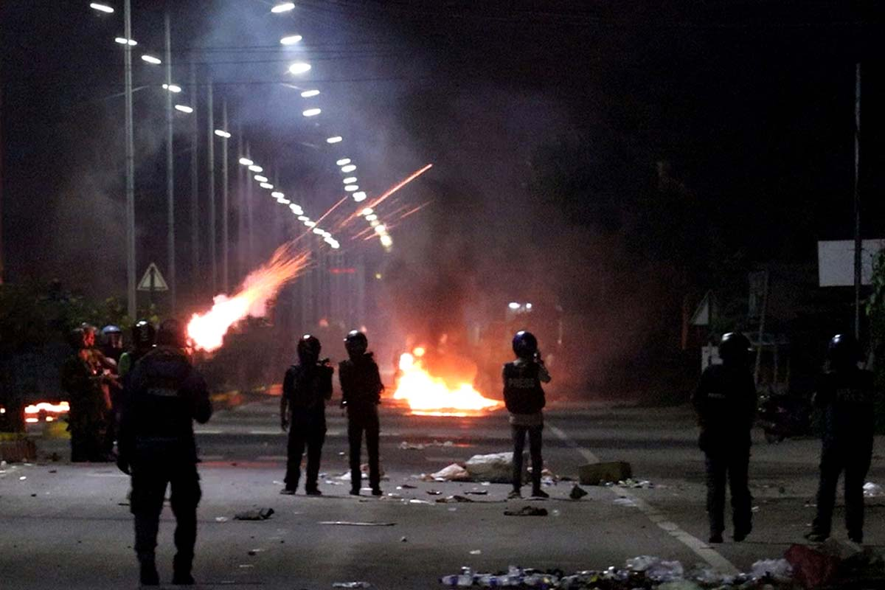
The Idea of “Greater Nagalim”
Core Demand
  Integration of all Naga-inhabited areas into one political unit.
Includes parts of:
  Manipur
  Assam
  Arunachal Pradesh
  Myanmar
Why Controversial?
  Territorial integrity of neighboring states threatened
  Meitei, Assamese, Arunachali opposition

Slide 26
Ceasefire and Peace Process
  1997: Ceasefire between GoI and NSCN-IM
  2001: Ceasefire extended “without territorial limits”
  Massive protests in Manipur (18 June 2001 uprising)
Current Status
  Ongoing negotiations
  Demand for:
    Separate flag
    Separate constitution
    Greater autonomy

Slide 27
Identity vs State Sovereignty
Naga Perspective
  “We are Nagas by birth, Indians by accident.”
  Ethnic self-determination
  Protection of land and culture
Indian State Perspective
  Unity and territorial integrity
  Federal accommodation
  Constitutional framework (Article 371A)

Slide 28
Inter-Ethnic Conflicts
Naga assertion triggered conflicts with:
  Kukis (Manipur)
  Meiteis (Manipur)
  Karbis (Assam)
Concept:
  Ethno-territorial competition
This shows:
  Identity politics is not just Centre vs State, but also Tribe vs Tribe.

Slide 29
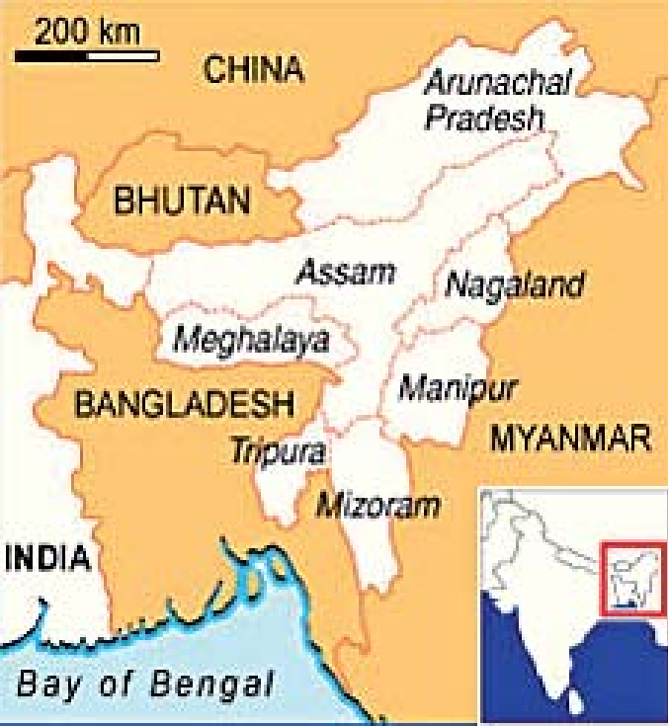
Foreign Dimensions
  Myanmar bases
  Alleged support networks in Bangladesh (historical phases)
  Trans-border ethnic linkages
Geopolitical Importance
  Chicken’s Neck corridor
  Border sensitivity

Slide 30
Theoretical Analysis
1. Ethno-Symbolism (Anthony D. Smith)
  Myth of common ancestry
  Shared memories
2. Self-Determination Theory
  UN principle
  Internal vs external self-determination
3. Federalism & Asymmetrical Autonomy
  Article 371A
  Sixth Schedule provisions

Slide 31
Has Identity Politics Declined?
Violence reduced compared to 1990s
Civil society role
Church mediation
Negotiated federalism
But:
  Demand for integration remains sensitive
  Periodic tensions persist

Slide 32
Sixth Schedule

Slide 33
Sixth Schedule of the Indian Constitution
Autonomous District Councils & Tribal Self-Governance
  Constitutional Law
  Indian Federalism
  Tribal Autonomy

Slide 34
Background
Why Sixth Schedule?
  Special protection for tribal areas in Northeast India
  Historical isolation during colonial rule
  Concern over exploitation of tribal land and culture
Constitutional Basis
  Articles 244(2) and 275(1)
  Part X of the Constitution

Slide 35
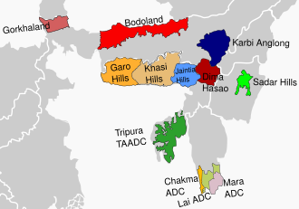
Areas Covered Under Sixth Schedule
The Sixth Schedule applies to:
  Assam
  Meghalaya
  Tripura
  Mizoram

Slide 36
What is an Autonomous District Council (ADC)?
Definition:
  A constitutional body with legislative, executive, and judicial powers in specified areas.
Structure:
  30 members
    26 elected
    4 nominated by Governor

Slide 37
Legislative Powers of ADCs
ADCs can make laws on:
  Land use and land transfer
  Forest management (excluding reserved forests)
  Shifting cultivation
  Village administration
  Inheritance of property
  Marriage and social customs
Example:
  Khasi Hills ADC regulating traditional land in Meghalaya.

Slide 38
Judicial Powers
Establish village courts
Trial of certain civil and criminal cases
Based on customary law
Example:
  Garo Hills ADC village courts applying tribal customary practices.

Slide 39
Financial Powers
ADCs can:
  Levy taxes on land
  Collect tolls
  Tax on markets
  Receive grants-in-aid from Union Government
Example:
  Bodoland Territorial Council receives central funds.

Slide 40
Major Autonomous Councils
In Assam:
  Karbi Anglong Autonomous Council
  Dima Hasao Autonomous Council
  Bodoland Territorial Council
In Meghalaya:
  Khasi Hills ADC
  Jaintia Hills ADC
  Garo Hills ADC
In Tripura:
  Tripura Tribal Areas Autonomous District Council (TTAADC)
In Mizoram:
  Chakma ADC
  Lai ADC
  Mara ADC

Slide 41
Diagram – Power Distribution
Feature | State Government | ADC
Police | Yes | No
Land Laws | Limited | Yes
Customary Law | No | Yes
Tax Collection | Yes | Yes (limited)
Judiciary | Regular Courts | Village Courts

Slide 42
Difference Between Fifth & Sixth Schedule
Fifth Schedule | Sixth Schedule
Central India | Northeast India
Governor has more control | ADCs have more autonomy
No legislative councils | Legislative & judicial powers

Slide 43
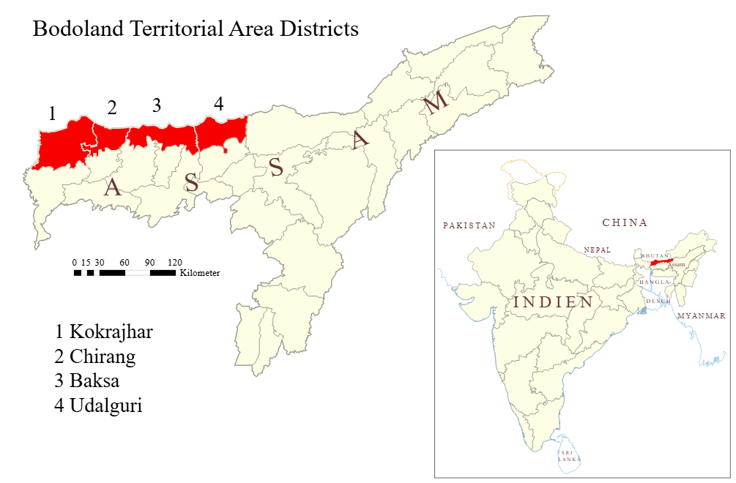
Example – Bodoland Territorial Council
Created after Bodo Accord (2003)
40-member council
Significant autonomy within Assam
Explain:
  Example of negotiated federalism
  Identity-based autonomy

Slide 44
Importance of Sixth Schedule
Protects tribal identity
Prevents land alienation
Encourages decentralization
Maintains peace through accommodation
Criticism
  Overlapping jurisdiction conflicts
  Corruption & elite capture
  Demand for separate statehood continues
  Exclusion of non-tribal minorities
Example:
  Karbi Anglong autonomy movement
  Inter-ethnic tensions in BTC areas

Slide 45
Sixth Schedule & Identity Politics
Link with your earlier lecture on:
  Naga nationalism
  Ethno-federalism
  Sub-nationalism
Concept:
  Sixth Schedule is India’s model of asymmetrical federalism.
Recent Developments
  2020 Bodo Accord
  Expansion of Bodoland Territorial Region
  Demand for inclusion of more areas under Sixth Schedule

Slide 46
Theoretical Analysis
Asymmetrical Federalism
  Different states enjoy different powers
Multicultural Constitutionalism
  Protection of minority identities
Consociational Democracy
  Power-sharing model
Conclusion
Sixth Schedule is:
  ✔ A constitutional experiment
  ✔ A conflict management tool
  ✔ A recognition of diversity
But:
⚠ It is not a permanent solution to ethnic conflicts.

Slide 47
Re-organisation of Northeast India

Slide 48
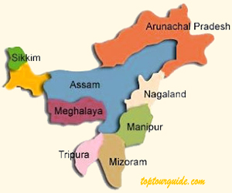
Introduction
Northeast India consists of eight states.
Often called the Seven Sisters (Assam, Arunachal Pradesh, Nagaland, Manipur, Mizoram, Tripura, Meghalaya) plus Sikkim.
The region is characterized by:
  Ethnic diversity
  Linguistic diversity
  Tribal communities
  Strategic international borders
📍 Borders with: China, Bhutan, Myanmar, Bangladesh and Nepal.

Slide 49
Post-Independence Situation
After Indian Independence
  Most of Northeast India was part of Assam.
  Several tribal communities demanded:
    Political autonomy
    Cultural recognition
    Separate statehood.
Main causes of reorganisation:
  Ethnic identity movements
  Administrative convenience
  Political demands for autonomy

Slide 50
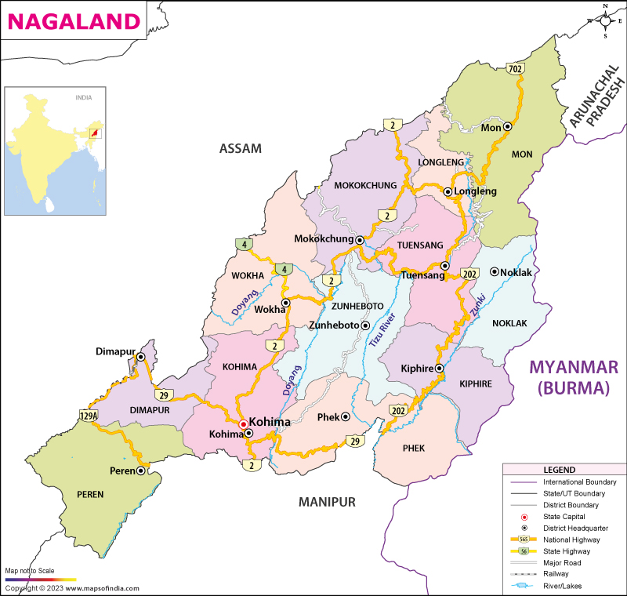
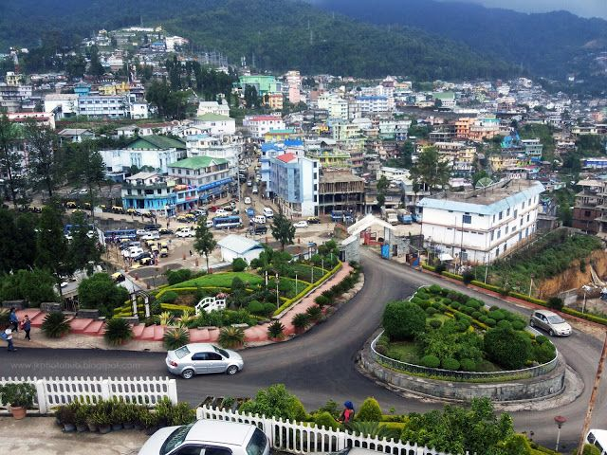
Creation of Nagaland (1963)
  Strong Naga nationalist movement.
  Led by leaders such as A. Z. Phizo.
  Demand for self-determination.
Outcome:
  Nagaland became a separate state in 1963.
Special constitutional provision:
  Article 371A
This protects:
  Naga customary law
  Religious practices
  Land ownership.

Slide 51
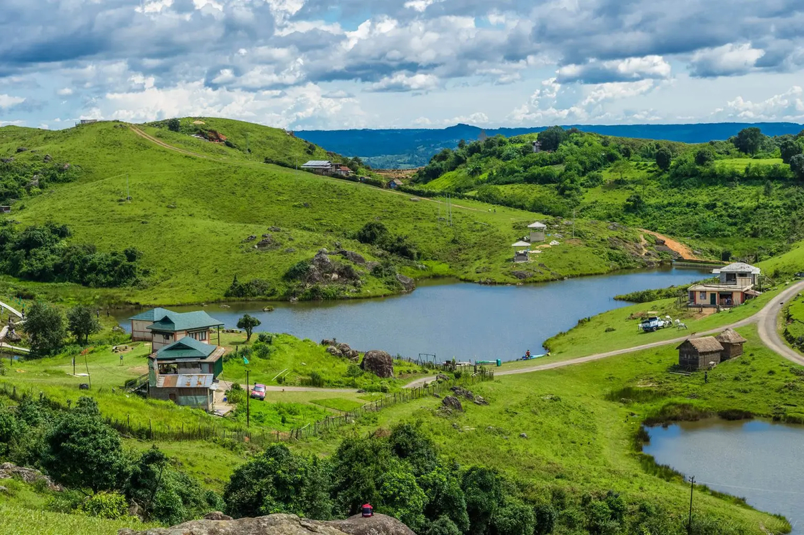

Creation of Meghalaya (1972)
Demand raised by:
  Khasi
  Jaintia
  Garo communities.
Movement led by Williamson A. Sangma.
Key stages:
  Autonomous State within Assam (1970)
  Full statehood in 1972
Thus Meghalaya became a separate state.

Slide 52
Creation of Manipur and Tripura (1972)
Both were earlier Union Territories.
In 1972, they became full states:
  Manipur
  Tripura
Reasons:
  Democratic aspirations
  Administrative needs
  Cultural identity.

Slide 53

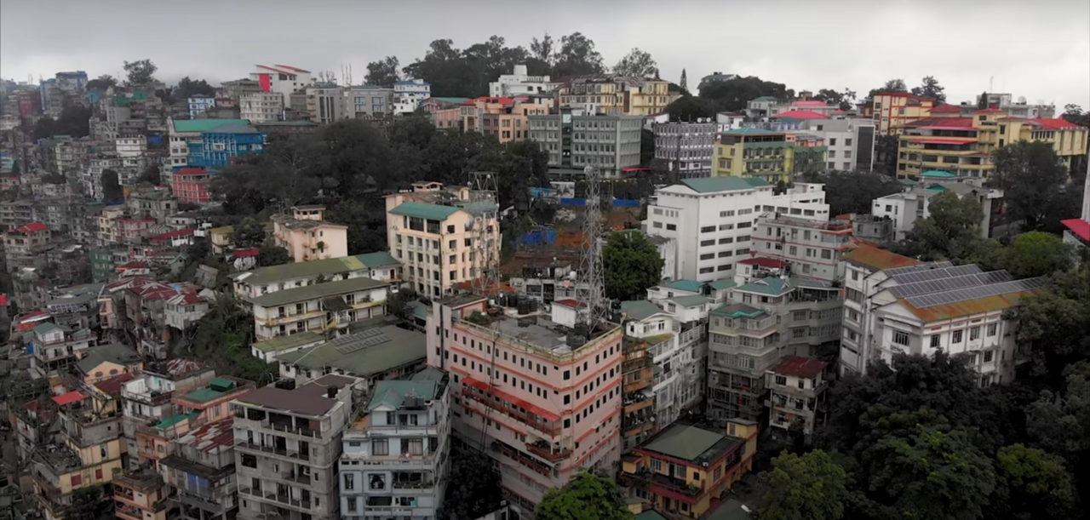
Creation of Mizoram (1987)
The Mizo National Front (MNF) insurgency demanded independence.
Important event:
  Mizoram Peace Accord
Signed between:
  Government of India
  Mizo National Front
Outcome:
  Mizoram became a state in 1987.

Slide 54
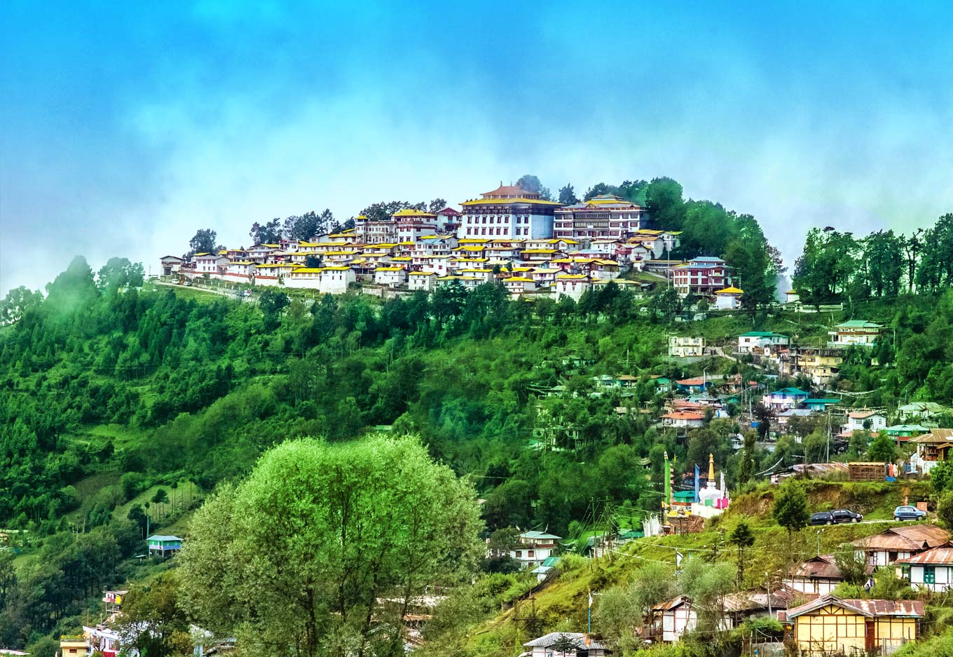
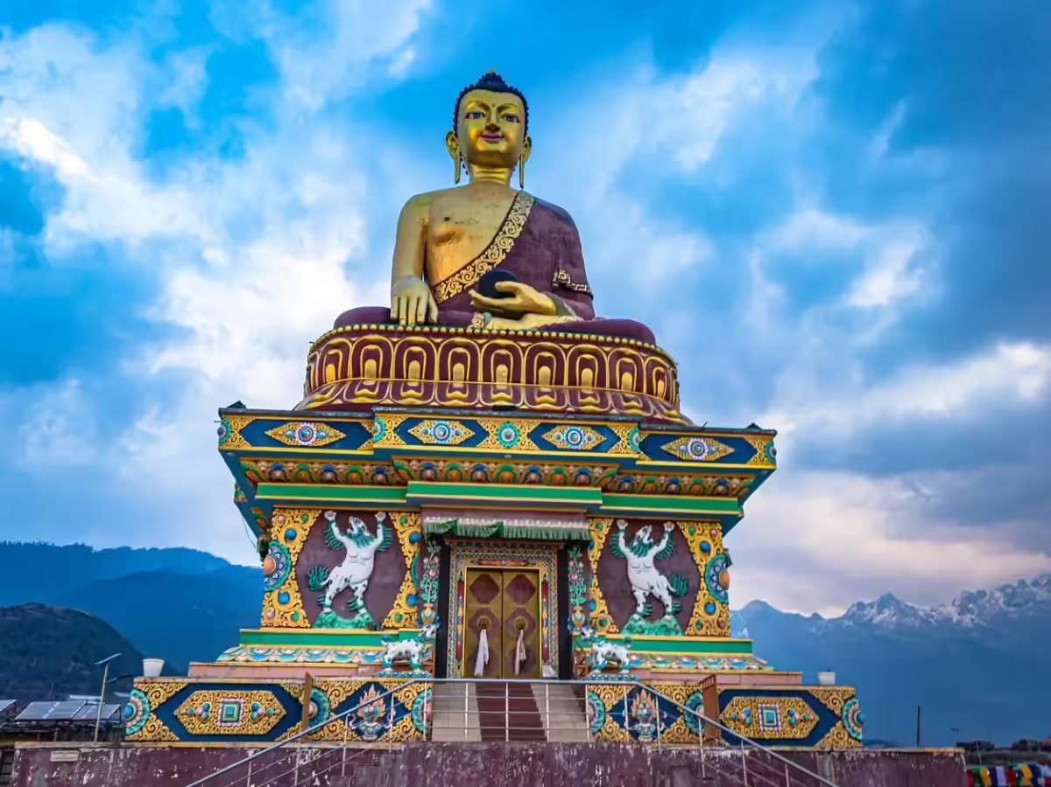
Creation of Arunachal Pradesh (1987)
Earlier known as North East Frontier Agency (NEFA).
Key developments:
  Became Union Territory in 1972.
  Became full state in 1987.
Today it is known as Arunachal Pradesh.

Slide 55
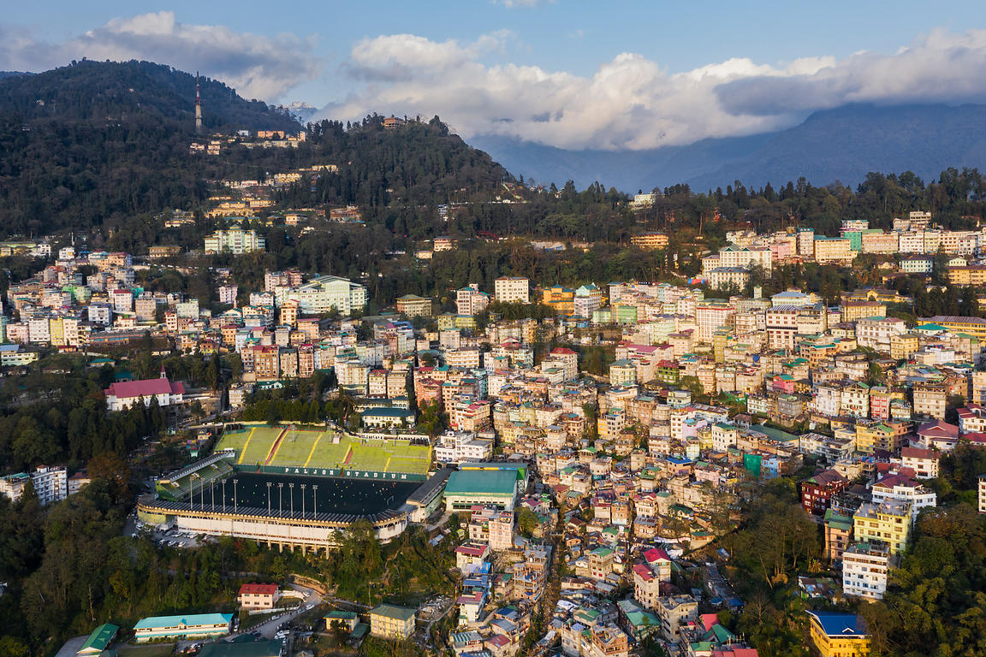
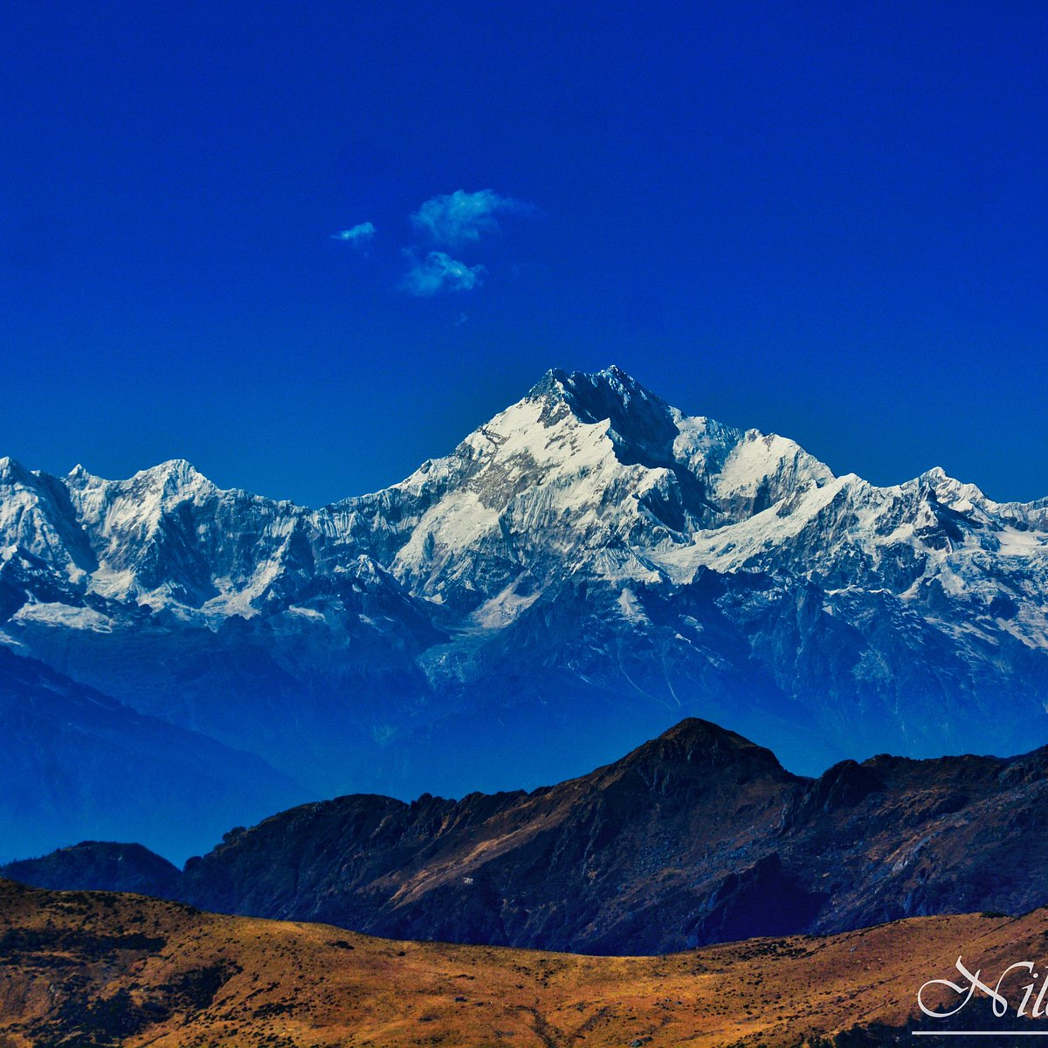
Inclusion of Sikkim (1975)
Earlier an independent kingdom ruled by the Chogyal.
After political changes:
  Referendum held in 1975.
  Sikkim joined India.
Thus Sikkim became the 22nd state of India.

Slide 56
Major Reasons for Reorganisation
Ethnic identity movements
Demand for self-governance
Cultural protection
Administrative efficiency
Insurgency and conflict resolution

Slide 57
Impact of Reorganisation
Positive impacts:
  Recognition of ethnic identities
  Greater political representation
  Regional development
  Improved governance.
However challenges remain:
  Ethnic conflicts
  Insurgency
  Border disputes
  Development gaps.

Slide 58
Continuing Issues in Northeast India
Key challenges:
  Ethnic tensions
  Autonomy demands
  Migration issues
  Development disparities
Example:
  Autonomous movements in Assam and Manipur.

Slide 59
Conclusion
The reorganisation of Northeast India was a complex political process aimed at:
  Managing ethnic diversity
  Promoting regional stability
  Integrating the region with India.
Despite challenges, it remains a significant example of federal flexibility in India.

Slide 60


