Slide 1
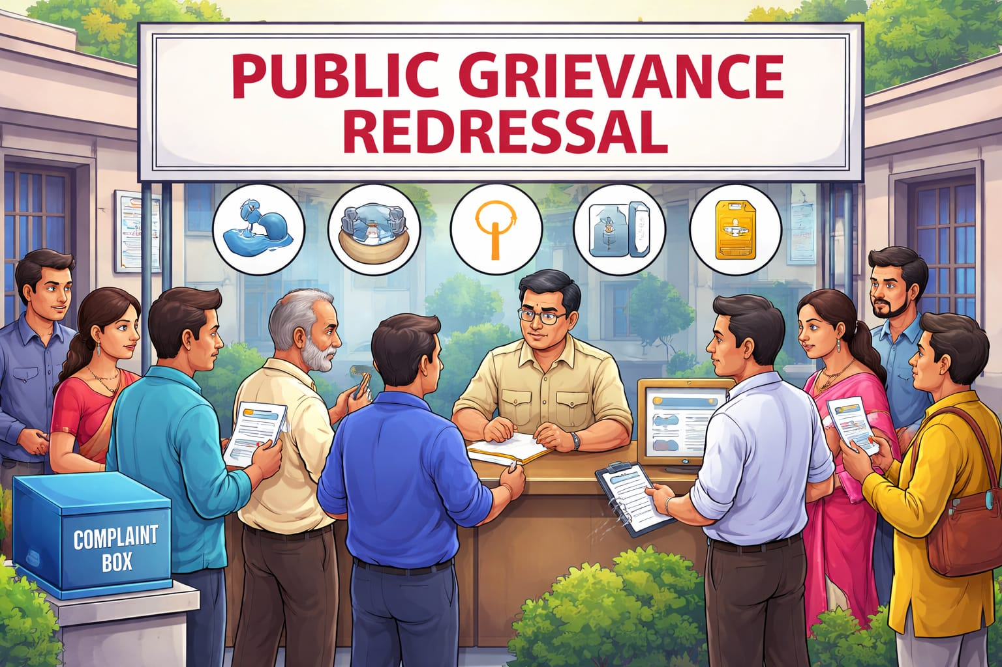
REDRESSAL OF PUBLIC GRIEVANCES
Public Grievance Redressal means the process through which
citizens can complain about problems
in public services and get them resolved by the
government or public authorities.
🔹 Simple Meaning
It is a system where people can:
Report issues (like delay, corruption, poor service)
File complaints against government departments
Seek solutions or justice
Examples
Delay in getting a ration card or Aadhaar
Poor service in government hospitals
Corruption in offices
Problems in water supply, electricity, roads

Slide 2

🔹 Mechanisms in India
Some important grievance redressal systems:
Lokpal
Lokayuktas
Citizens Charter
RTI (Right to Information)
LOKPAL
Evolution of Lokpal in India:
The basic idea of Lokpal is borrowed from the office of Ombudsman.
The idea of an ombudsman started in Sweden in 1809.
In India, this idea was first suggested by Ashok Kumar Sen in the 1960s.
The terms Lokpal and Lokayukta were given by L. M. Singhvi.
The word “Lokpal” is derived from Sanskrit, where “Lok” means people and “Pal” means protector. Therefore, Lokpal means “protector of the people.”

Slide 3
Structure of Lokpal
Lokpal is a multi-member body.
It has:
1 Chairperson
Maximum 8 members
Tenure:
5 years or up to 70 years of age
Appointment:
Done by the President of India
Selection Committee includes:
Prime Minister (Chairperson)
Speaker of Lok Sabha
Leader of Opposition
Chief Justice of India (or nominee)
One eminent jurist

Slide 4
Main Objectives of Lokpal:
To fight corruption
Lokpal aims to prevent and control corruption in public offices.
To empower citizens
It gives strength to people so they can raise their voice against corruption without fear.
To build public confidence
Lokpal helps increase trust in the working of government and administration.
To ensure accountability
It makes public officials responsible for their actions, including the Prime Minister (with certain safeguards).
Powers and Functions of Lokpal
Covers all public servants
All categories of public officials come under the supervision of Lokpal.
Control over investigation agencies
Lokpal has the power of superintendence and direction over agencies like the CBI in cases referred to them.

Slide 5
Power to sanction prosecution
Lokpal can approve legal action against corrupt public servants.
Establishment of Special Courts
Special courts are set up to quickly handle and decide cases referred by Lokpal.
Lokayukta in States
Every state must establish a Lokayukta
According to the Lokpal and Lokayuktas Act, 2013, it is compulsory for every state to create a Lokayukta.
👉 This ensures that corruption at the state level is also checked.
First state to establish Lokayukta
Maharashtra (1972) was the first state in India to set up Lokayukta.
👉 It became a model for other states to follow.
Time limit for establishment
States were required to set up Lokayukta within 1 year (365 days) of the Act.
👉 This was done to ensure quick implementation of anti-corruption measures.
Powers differ from state to state
The powers and functions of Lokayukta are not the same everywhere.
👉 This is because each state makes its own law, so structure, authority, and powers may vary.

