Slide 1
BUDGET CYCLE IN INDIA
The term “Budget” is not explicitly mentioned in the Constitution of India. Instead, the Constitution uses the term “Annual Financial Statement” under Article 112.
The Annual Financial Statement refers to a detailed statement of the estimated receipts and expenditures of the Government of India for a financial year (April 1 to March 31).
Budgetary Process in India
The budgetary process in India is a continuous cycle that ensures proper management of public finances. It includes four major stages:
1. Preparation of Budget
The budget is prepared by the Ministry of Finance in consultation with various ministries and departments. Each department submits estimates of its expected income and expenditure.
2. Enactment of Budget
The budget is presented before both Houses of Parliament. It is discussed and examined in detail, and the Lok Sabha votes on demands for grants. Budgetary Process in India
3. Execution of Budget
After approval, the budget is implemented by different ministries and departments. Funds are allocated and spent according to the approved plan. The Ministry of Finance supervises the process to ensure financial discipline.

Slide 2
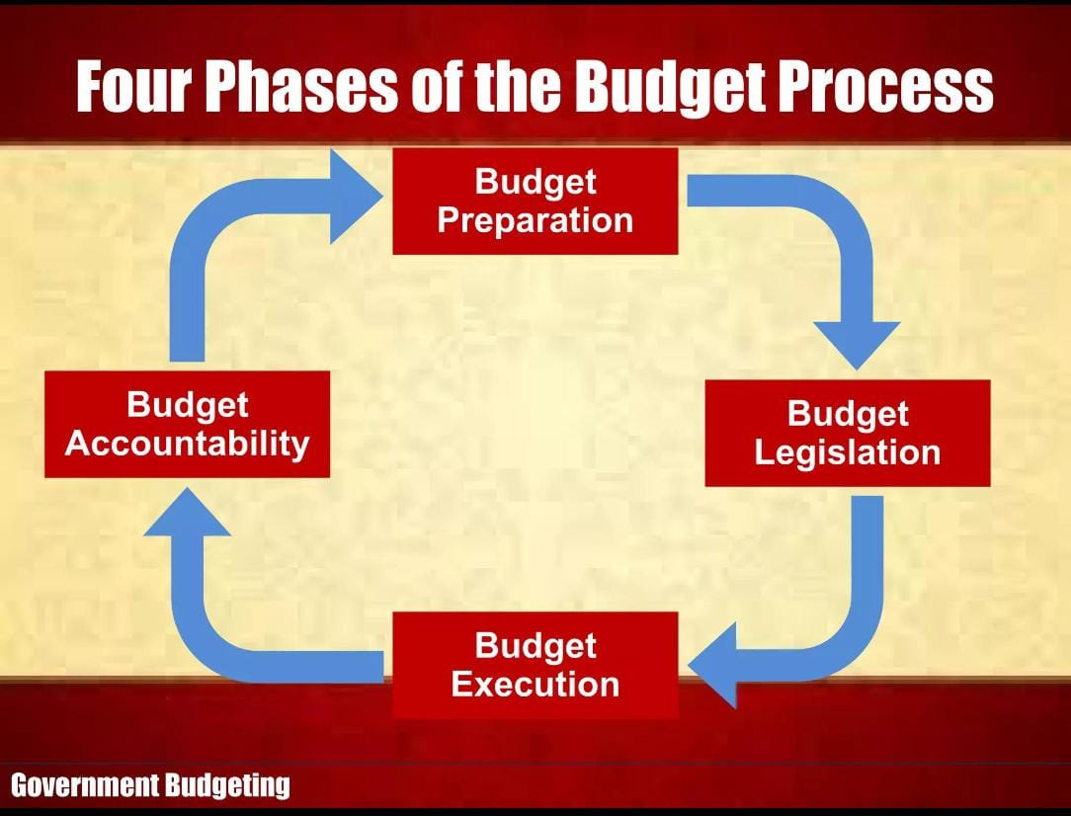
4. Budgetary Control
This stage ensures accountability and proper use of public funds. The Comptroller and Auditor General (CAG) audits government expenditure, and the Public Accounts Committee reviews the audit reports to check misuse or irregularities.
STAGES OF BUDGET PREPARATION IN INDIA
In budget preparation –
Ministry of Finance plays a decisive and central role in the entire process
Budget Division (Department of Economic Affairs) acts as the nodal agency for coordination and compilation

Slide 3
NITI Aayog provides inputs on developmental priorities and planning
CAG supplies past expenditure data and audit reports for accuracy
Stages of Budget Preparation in India
Preparation of Preliminary Estimates
→ Local officers at various levels prepare initial estimates of expected revenue and expenditure for the coming financial year
Scrutiny by Head of Department
→ Departmental heads carefully examine these estimates, make necessary changes, and ensure they align with departmental priorities
Pruning by Finance Ministry
→ The Ministry of Finance reviews all proposals, reduces excessive demands, and ensures financial discipline and proper allocation of resources
Scrutiny by Accountant General
→ The Accountant General checks the accuracy of figures, verifies accounts, and ensures compliance with financial rules
Approval by the Cabinet
→ The final budget is reviewed and approved by the Cabinet, making it ready for presentation in Parliament

Slide 4
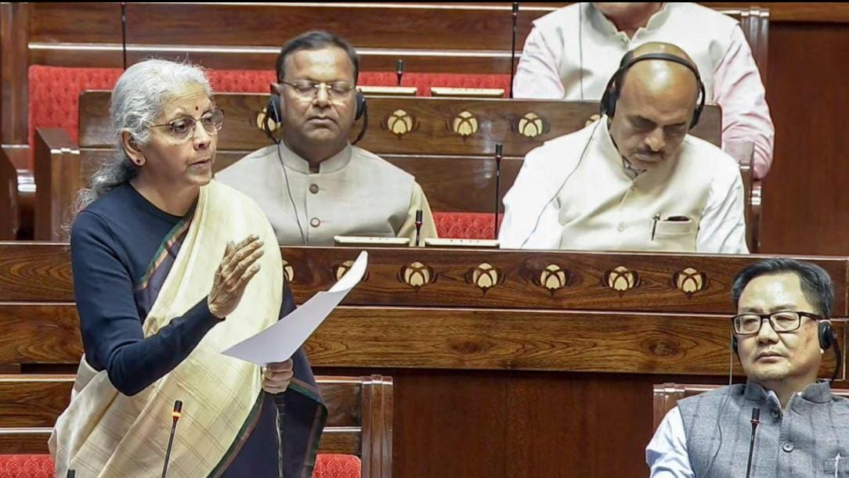
Thus, the budget-making process in India is a lengthy and detailed procedure, and the final budget is presented in Parliament, beginning with the Budget Speech of the Finance Minister.
Stages of Passing the Budget in India
Introduction in Parliament
→ The budget is presented in the Lok Sabha by the Finance Minister through the Budget Speech, along with the Annual Financial Statement
General Discussion
→ Members of Parliament discuss the overall policies and principles of the budget without going into detailed.

Slide 5
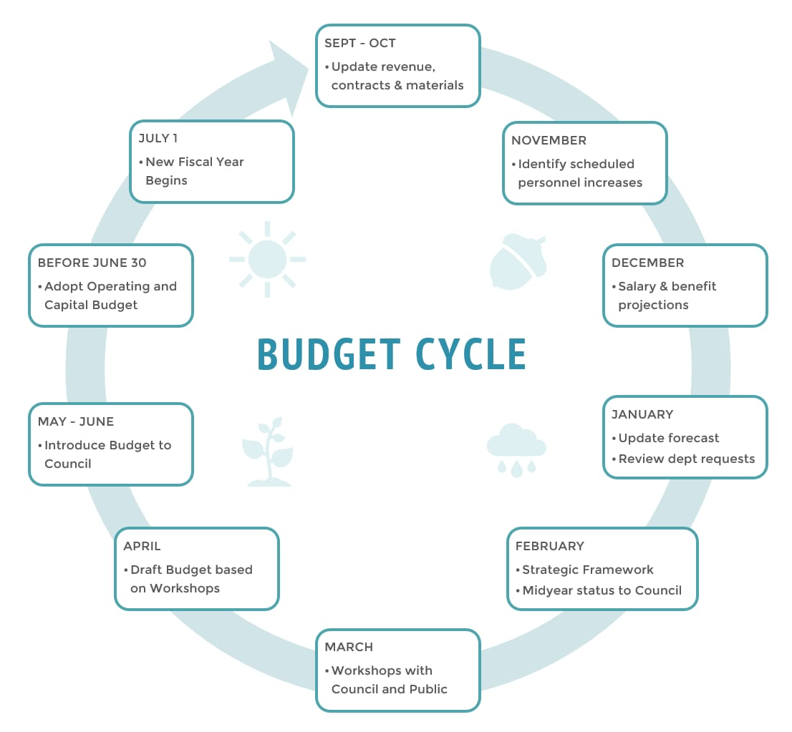
Voting on Demands for Grants
→ The Lok Sabha discusses and votes on demands for grants ministry-wise; only Lok Sabha has the power to vote
Appropriation Bill
→ After voting, the Appropriation Bill is introduced to authorize the government to withdraw funds from the Consolidated Fund of India
Procedure in Rajya Sabha
→ The Rajya Sabha discusses the budget but cannot vote on demands for grants; it can only make recommendations
President’s Assent
→ After both Houses pass the bills, they are sent to the President for approval, after which the budget becomes law.

