Slide 1

VARIOUS APPROACHES OF BUDGETING:

Slide 2
1. Incremental Approach of Budgeting
Incremental budgeting is a method in which the current year’s budget is prepared by taking the previous year’s budget as a base and making small adjustments or increments according to new requirements.”
New Budget = Last year budget + Small changes {Incremental}
The incremental approach is the most common method as widely used in government and not for profit organization.
Incremental budgeting is a method in which the previous year’s actual budget figures are used as a base, and a fixed percentage is added or reduced to prepare the current year’s budget, considering factors like inflation and policy changes.

Slide 3
0
ADVANTAGES:
1. ✅ Easy to Implement9
The incremental approach is relatively easy to implement because it is based on financial records of previous years, which are already available. This reduces the need for fresh calculations.
2. ✅ Simplifies the Budget Process
This approach simplifies the budgeting process by focusing only on the changes (increments or decreases) in the previous budget items instead of preparing a completely new budget.
DISADVANTAGES:
1. ❌ No Critical Review
The approach does not involve detailed evaluation of each budget item, so mistakes of previous years may be repeated.
2.❌ Overdependence on Past Data
The approach depends too much on previous records, which may not be relevant in present conditions.
Notes:
*

Slide 4
0
2.ACTIVITY BASED APPROACH:
Activity-based approach is a top-down budgeting approach.
Activity-Based Budgeting is an approach where the budget is prepared based on the activities or tasks that need to be performed.
Budget = What work needs to be done + How much it will cost
advantages
1. ✅ Provides Efficiency and Clarity
The activity-based approach improves efficiency by linking every function and department with their respective spending, thereby providing a clear and complete picture of the organization.
2.✅ Identifies Non-Value Activities
This approach helps in easily identifying non-value-added activities or functions, which can then be corrected or eliminated to improve efficiency and reduce unnecessary costs.

Slide 5
DISADVANTAGES
1. ❌ Increases Workload
The activity-based approach increases workload due to the need for detailed analysis of each activity, which may also require structural changes in the organization.
2. ❌ Requires High Resources
This approach requires a large amount of manpower and financial resources, making it costly and difficult to implement.
3.ROLLING /CONTINUOUS APPROACH:
Rolling budgeting is a method in which the budget is continuously updated by adding a new time period as the current period ends
👉 In simple words:
Budget is not fixed — it is regularly revised by adding a new period and removing the past one

Slide 6
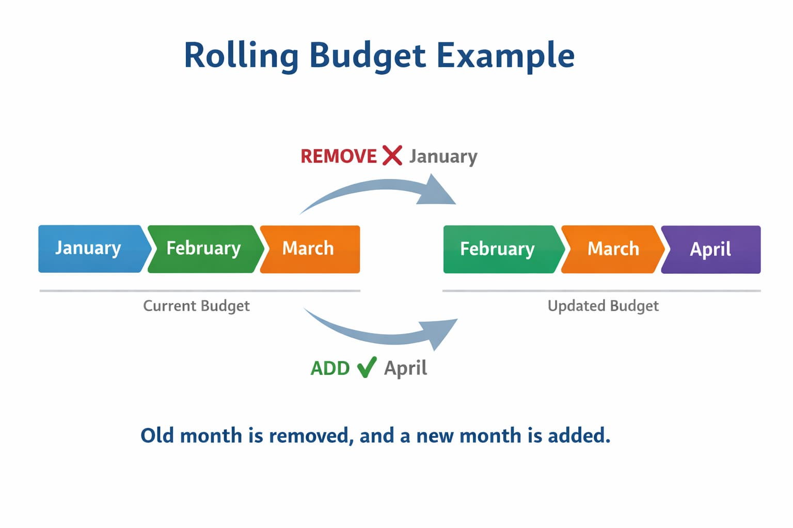
Simple Example of Rolling Budget
Suppose I make a budget for 3 months:
👉 January, February, March
👉 When January ends:
January is removed ❌
April is added ✅
✔ Now the budget becomes:
👉 February, March, April
👉 When February ends:
February is removed ❌
May is added ✅
/
✔ Now the budget becomes:
👉 March, April, May

Slide 7
0
ADVANTAGES:
1. ✅ Flexible and Up-to-date
The budget is regularly updated, so it reflects current economic conditions and needs.
2. ✅ Better Planning
Helps in better decision-making as it considers recent changes and future expectations.
DISADVANTAGES:
1. ❌ Time-Consuming
Regular updating of the budget requires more time and effort.
2. ❌ Costly
It needs continuous monitoring and resources, making it expensive.

Slide 8

0
4.MINIMAL LEVEL APPROACH:
Minimal level budgeting is an approach in which the budget is prepared by allocating only the minimum required funds to carry out essential activities.
👉 In simple words:
Spend only what is absolutely necessary (minimum level)
ADVANTAGES
1. ✅ Saves Money
This approach reduces unnecessary expenses and helps in saving financial resources.
2. ✅ Focus on Essentials
Only important and necessary activities are funded, ensuring efficient use of resources.
Disadvantages
1. ❌ Neglects Development
Too much focus on minimum spending may ignore growth and development activities.
2. ❌ Reduces Quality
Limited funds may affect the quality of services and performance.

Slide 9
/
5.ZERO-BASED BUDGTEING approach:
Originated in the USA and was created in 1969 by Peter A. Pyhrr, a manager of a private industry.
It was introduced in USA by President Jimmy Carter in 1978.
Zero-Based Budgeting is an approach in which every item of expenditure must be justified from zero, without considering the previous year’s budget.
Zero-Based Budgeting involves a complete examination of all activities. It starts from a fresh base instead of following the incremental approach, which depends on previous expenditure. In this method, the budget for the next year begins from zero, rather than taking the current budget as the starting point.
Advantages:
1. ✅ Eliminates Wasteful Spending
Unnecessary expenses are removed because every cost must be justified.
2. ✅ Better Resource Allocation
Funds are given only to important and productive activities.

Slide 10

Disadvantages:
1.❌ High Cost
Preparing the budget from zero requires a lot of time, analysis, and manpower, which increases administrative cost
2. ❌ Not Suitable for Large Organizations
In big organizations, it becomes very difficult to review and justify every activity every year.

