Slide 1

Concept of Ecofeminism
Prepared by Dr. Parismita Bhagawati, Asst. Professor, Department of Political Science, Pandu College
(as digital teaching material for Semester: 6th Semester
Course Name: POL060204: Feminism: Theory and Practice; Unit II)

Slide 2
1. The Core Philosophy: The "Logic of Domination"
The central argument of ecofeminism is that the same mindset that allows humans to exploit the Earth is the one that allows men to exploit women. It isn’t just a coincidence; it’s a shared system of oppression.
Dualisms and Hierarchies
Ecofeminism identifies "Order Dualities"—pairs of opposites where one is always viewed as superior.
The Dominant: Male, Culture, Logic, West, White, Human.
The Subjugated: Female, Nature, Emotion, East, Black, Environment.
How calling the Earth "Mother Nature" can be a double-edged sword. Does it honor the earth, or does it justify "using" the earth just as domestic labor is often used?

Slide 3
Scholar | Key Contribution | Recommended Work
Françoise d’Eaubonne | Coined the term "Ecofeminism" (1974). Argued that overpopulation and destruction of resources are driven by male-centered power. | Le Féminisme ou la Mort
Vandana Shiva | Focuses on "Maldevelopment." She argues that modern "progress" is actually a patriarchal project that destroys biodiversity and indigenous knowledge. | Staying Alive: Women, Ecology, and Development

Slide 4
Karen Warren | Developed the "Logic of Domination" framework. She argues that any movement to end one form of oppression must include the others. | Ecofeminist Philosophy
Alice Walker | Connects the spiritual and racial aspects (Womanism) to the land and the animal kingdom. | Living by the Word

Slide 5
Françoise d’Eaubonne: The "Feminism or Death" Warning
Concept: She argued that the patriarchal "management" of the world leads to two dead ends: overpopulation (controlling women's bodies) and resource destruction (controlling nature).
Present-Day Example: The Global Reproductive Justice Movement. D’Eaubonne’s idea that women must control their own bodies to save the planet is mirrored today in how organizations like the UN Population Fund link women's education and reproductive rights directly to climate resilience. If women are empowered to choose their family size, global carbon footprints decrease naturally—not through "population control," but through "women's liberation."

Slide 6
The "Logic of Domination" (Karen Warren)
Warren argues that the problem isn't that we notice differences (like Male vs. Female), but that we apply a Value Hierarchy to them.
The Concept: If A is different from B, and A is "higher" than B, then A has the right to exploit B.
The Problem: Once you decide that "Reason" is superior to "Nature," you justify strip-mining a mountain because the mountain "doesn't think." This same logic was used to justify denying women the vote because they were seen as "emotional" rather than "rational."
Conceptualizing it: It is a pyramid scheme of worth.

Slide 7
Vandana Shiva is one of the most influential voices in ecofeminism, specifically representing the "Global South" perspective.To conceptualize the problem through her eyes, you have to understand that she views modern industrial capitalism not as "progress," but as a patriarchal war against the Earth.
Here are her four pillars for conceptualizing the crisis:
1. "Maldevelopment" (The Death of the Feminine Principle)
Shiva argues that modern development is actually "maldevelopment."
The Concept: Traditional societies viewed nature as Prakriti—a living, feminine, creative force. Modernity views nature as "dead matter" to be used for profit.
The Problem: When we move from "nature-based" economies to "market-based" ones, we devalue the work of women (who gather, provide, and nurture) and prioritize the work of men (who extract, sell, and destroy).
The Core Idea: Development is a masculine project that colonizes the feminine capacity of the Earth to regenerate itself.

Slide 8
2. "Monocultures of the Mind"
This is perhaps her most famous conceptual framework.
The Concept: The patriarchal mind cannot handle "diversity." It wants everything to be the same so it can be controlled and measured.
The Problem: This leads to "monocultures"—planting only one crop (like soy or corn), speaking only one language, or having only one way of thinking about the economy.
The Core Idea: We have lost the "intelligence of the forest." By destroying biodiversity, we are destroying the very variety that allows life to survive shocks like climate change or disease.

Slide 9
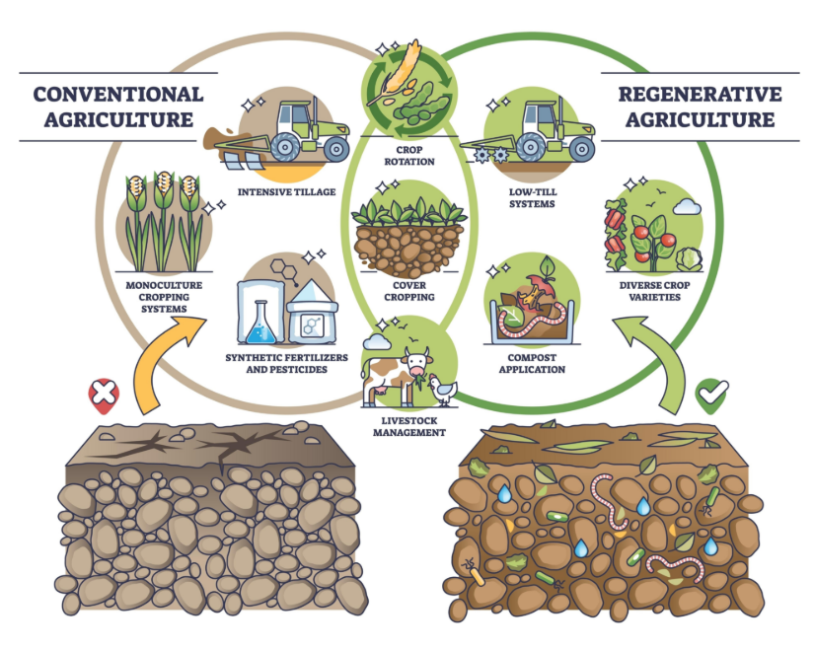

Slide 10
3. "Biopiracy" and the Colonization of Life
Shiva conceptualizes the patenting of seeds and life forms as the "ultimate enclosure."
The Concept: For centuries, women farmers saved seeds and shared them freely. Now, corporations "tinker" with a seed in a lab and claim they "invented" it.
The Problem: This turns a common gift of nature into private property. It forces farmers (mostly women in the Global South) into debt because they can no longer save seeds; they must buy them every year from the "Master" (the corporation).
The Core Idea: Life itself is being "colonized" through patents.

Slide 11
4. "Earth Democracy" (The Solution)
To fix the problem, Shiva proposes a shift in how we conceptualize our place in the world.
The Concept: We are not "masters" of the Earth; we are members of the Earth family.
The Problem: Our current laws prioritize "corporate rights" over "human rights" or "nature's rights."
The Core Idea: We need a democracy that includes all species. Justice for women and justice for the environment are the same thing: reclaiming the "Commons" (water, seeds, air) from private control.

