Slide 1

POL060304: Politics in Northeast India (Optional)
Aniruddha Kumar Baro

Slide 2
Introduction
Course objective:
  This course is designed to introduce students to the general perceptions about politics in Northeast India.
  It would also give them an introduction to colonial experience in Northeast India.
  It attempts to highlight the different ethnic movements in different parts of the Northeast India and contemporary politics in Northeast India.

Slide 3
Course outcome
  It will help to better appreciate key concepts that offer an understanding about political development in Northeast India.
  Students will be in a position to comprehend the meaning of political development in Northeast India.
  This course will help the students to comprehend the trajectory of ethnic movement in Northeast India and the issues addressed.
  It will lead to analysing and understanding the importance of Issues of Northeast India in certain key aspects.

Slide 4
POL060304: Politics in Northeast India (Optional)
Unit-I: Colonial Policy- Annexation and Administration
  Geo-Strategic Location and Socio-Cultural Diversity.
  Expansion and Consolidation of Colonial Rule.
  Excluded and Partially Excluded areas: Inner Line.
  Anti-Colonial revolts (Phulaguri Dhewa and Patharughat) and Freedom Struggle.
Unit-II: Post-Colonial developments
  Immigration and Problem of Refugees.
  Question of Identity: Naga Nationalism.
  Sixth Schedule.
  Re-organisation of Northeast India.

Slide 5
Unit-III: Political developments in Assam
  Language Politics.
  Assam Movement.
  Bodo Movement.
  Rise of insurgency: ULFA and NDFB.
Unit-IV: Changing nature of state politics in Assam
  Emergence of Regional Parties: AGP.
  Formation of Autonomous Councils: Rabha and Mising.
  Citizenship: NRC and CAA.

Slide 6
Unit-I: Colonial Policy- Annexation and Administration
  Geo-Strategic Location and Socio-Cultural Diversity.
  Expansion and Consolidation of Colonial Rule.
  Excluded and Partially Excluded areas: Inner Line.
  Anti-Colonial revolts (Phulaguri Dhewa and Patharughat) and Freedom Struggle.

Slide 7
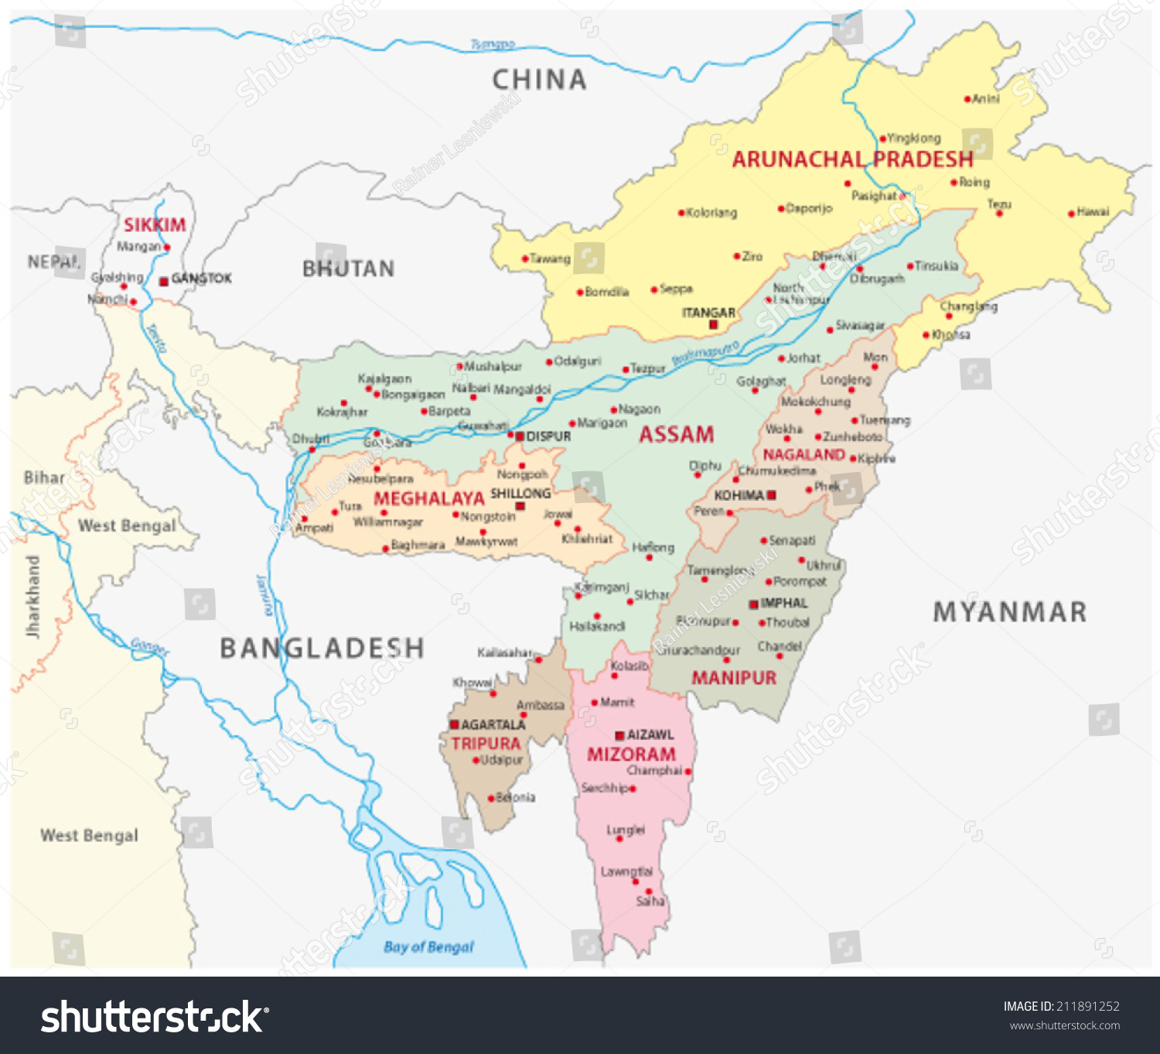

Slide 8
Geo-Strategic Location
Gateway to Southeast Asia: proximity to Burma, Tibet, Bhutan, Bangladesh
Buffer Zone: between British India and China/Myanmar
Military Importance:
  Used as base during World War II (e.g., Stilwell Road, Imphal Campaign)
Trade Routes:
Brahmaputra Valley as corridor for tea, oil, timber exports
Cross-border trade with Burma and Tibet

Slide 9
Socio-Cultural Diversity
Ethnic Mosaic:
  Bodo, Khasi, Naga, Mizo, Manipuri, Tripuri, Assamese, and many others
Languages: Tibeto-Burman, Indo-Aryan, Austroasiatic families
Religions: Hinduism, Christianity, Islam, Animism
Colonial Impact:
Spread of Christianity via missionaries (esp. in hills)
Western education introduced (Cotton College, missionary schools)
Cultural resistance through literature, folklore, and uprisings

Slide 10
Resistance Movements
Tribal Uprisings:
  Khasi resistance (U Tirot Sing, 1830s)
  Naga resistance (19th century onwards)
  Lushai raids and British expeditions
Valley Movements:
  Manipur rebellion (1891)
  Assam’s peasant uprisings (Phulaguri Dhawa, 1861)
Cultural Assertion:
Assamese language movement against Bengali imposition (1836–1873)

Slide 11
Colonial Annexation in Northeast India
Treaty of Yandabo (1826) → Assam annexed after First Anglo-Burmese War
Expansion into Hills: Khasi Hills (1830s), Naga Hills (1850s), Lushai Hills (1890s)
Manipur: brought under indirect British control after Anglo-Manipur War (1891)
Tripura: princely state under British paramountcy
Arunachal frontier: gradual consolidation through “Inner Line Regulation” (1873)

Slide 12
Expansion and Consolidation of Colonial Rule.
Administrative Models:
  Assam: Chief Commissioner’s Province (1874)
  Hill areas: “Excluded” & “Partially Excluded” under Government of India Act (1935)
Inner Line Permit System (1873) → restricted outsider entry into tribal areas
Revenue & Tea Plantations:
  Introduction of tea industry (1830s onwards)
  Migration of laborers from Central India
Policing & Military Posts: frontier stations to control resistance

Slide 13
Legacy of Colonial Policy
Administrative Fragmentation → “Excluded Areas” policy shaped post-independence autonomy demands
Migration & Demography → tea labor influx altered social fabric
Education & Christianity → new identities and political consciousness
Strategic Frontier → continues to influence India’s security and foreign policy

Slide 14
Early Expansion (1820s–1850s)
  Anglo-Burmese Wars (1824–1826): Treaty of Yandabo brought Assam under British control.
  Annexation of Khasi Hills (1830s): Resistance led by Tirot Sing.
  Manipuri & Cachar integration: Through treaties and military campaigns.
  Goal: Secure trade routes and buffer against Burma.

Slide 15
Administrative Experiments
Inner Line Regulation (1873): Restricted entry of outsiders into tribal areas.
Frontier Policy: Differentiated plains (direct rule) vs. hill (indirect rule)
District Administration: Deputy Commissioners wielded judicial, executive, and revenue powers.
Impact: Reinforced isolation of hill tribes, sowing seeds of later autonomy demands.

Slide 16
Annexation of Assam
Initial British administration through Company officials.
End of Ahom rule
Introduced:
  New land revenue system
  Western-style administration
Assam formally became a British province later

Slide 17
Expansion into Hill Areas
British faced resistance from hill tribes
Adopted:
  Military expeditions
  Political agents system
Hills brought under indirect rule rather than full annexation

Slide 18
Policy of Non-Intervention
British followed a policy of:
  Minimum interference in tribal customs
  Isolation of hill areas from plains
Aim: Maintain peace and reduce administrative costs
Inner Line Regulation (1873)
  Restricted movement of outsiders into tribal areas
  Protected tribal societies from exploitation
  Still relevant in present-day Northeast India

Slide 19
Consolidation of Colonial Rule
Establishment of:
  Civil administration
  Police and judiciary
Infrastructure development:
  Roads
  Railways
  River transport
Economic Transformation
Introduction of plantation economy:
  Tea plantations in Assam
Exploitation of: Timber, Oil
Integration of Northeast into colonial economy

Slide 20
Administrative Reorganization
Creation of:
  Assam Province (1874)
Frontier areas governed separately
Special administrative arrangements for hill districts

Slide 21
Excluded and Partially Excluded areas: Inner Line.
British colonial administration adopted special policies for tribal areas
Certain regions were kept outside normal provincial administration
These were classified as:
  Excluded Areas
  Partially Excluded Areas

Slide 22
Background
Tribal regions had:
  Distinct culture and customs
  Traditional self-governing institutions
British feared:
  Resistance to direct administration
  Administrative difficulties in hilly and forest areas

Slide 23
Government of India Act, 1935
Legal basis for Excluded and Partially Excluded Areas
Introduced special administrative arrangements
Objective:
  Protect tribal interests
  Maintain colonial control
What are Excluded Areas?
  Areas completely excluded from provincial administration
  Provincial legislature had no authority over these areas
  Governor ruled directly on behalf of the British Crown

Slide 24
Features of Excluded Areas
No elected representatives in provincial legislature
Laws of province did not automatically apply
Governor had full legislative and executive powers
Tribes governed through customary laws
Examples of Excluded Areas
  Naga Hills
  Lushai Hills (Mizoram)
  North-East Frontier Tracts (present Arunachal Pradesh)

Slide 25
What are Partially Excluded Areas?
Areas partially under provincial control
Provincial laws applied only with Governor’s approval
Tribal representatives were present in legislature
Features of Partially Excluded Areas
  Governor had special discretionary powers
  Limited role of provincial legislature
  Customary laws and tribal practices protected
Examples of Partially Excluded Areas
  Garo Hills
  Khasi and Jaintia Hills
  Mikir Hills
  Parts of Chotanagpur Plateau

Slide 26
Role of the Governor
Governor acted as:
  Agent of British government
Could:
  Modify or exclude laws
  Override provincial decisions
Central figure in administration of tribal areas
Objectives of the Policy
  Prevent exploitation of tribal people
  Maintain law and order
  Protect colonial economic interests
  Avoid political mobilization in tribal regions

Slide 27
Criticism of the System
Kept tribal areas politically isolated
Denied democratic participation
Strengthened colonial control rather than tribal autonomy
Impact on Northeast India
  Reinforced administrative separation
  Created distinct political identity
  Influenced post-independence autonomy arrangements

Slide 28
Transition After Independence
Excluded & Partially Excluded Areas abolished
Replaced by:
  Fifth Schedule
  Sixth Schedule of Indian Constitution
Sixth Schedule
  Applies mainly to Northeast India
  Introduced Autonomous District Councils
  Greater self-governance for tribal areas

Slide 29
Anti-Colonial revolts (Phulaguri Dhewa and Patharughat) and Freedom Struggle
Anti-colonial resistance in India began long before 1857.
Assam witnessed early peasant revolts against British colonial policies.
Two significant uprisings:
  Phulaguri Dhewa (1861)
  Patharughat Uprising (1894)
These revolts reflected:
  Peasant resistance
  Economic exploitation
  Assertion of indigenous rights

Slide 30
Colonial Administration in Assam
British annexed Assam in 1826 (Treaty of Yandabo).
Introduction of:
  New land revenue system
  Cash taxation
  Commercialization of agriculture
Disruption of traditional socio-economic structure.
Impact:
  Burden on peasants
  Loss of customary rights
  Growing resentment

Slide 31
PHULAGURI DHEWA (1861): Background of Phulaguri Revolt
Location: Phulaguri, Nagaon district
Year: 1861
British imposed:
  Taxes on betel nut and paan
  Increased revenue demands
Immediate Cause:
  Opposition to new taxation policies.

Slide 32
Causes of the Revolt
Heavy taxation
Exploitation by British officials
Disruption of local economy
Lack of political representation
Peasants organized a raij mel (people’s assembly).

Slide 33
Course of Events
September 1861:
  Large gathering of peasants
British officials tried to suppress meeting.
Clash occurred.
One British officer killed.
Brutal suppression followed.

Slide 34
Nature of Phulaguri Dhewa
  First organized peasant revolt in Assam.
  Non-cooperation with British taxation.
  Demonstrated collective rural resistance.
Significance of Phulaguri Revolt
  Marked beginning of peasant political consciousness.
  Highlighted economic roots of anti-colonialism.
  Inspired future movements in Assam.

Slide 35
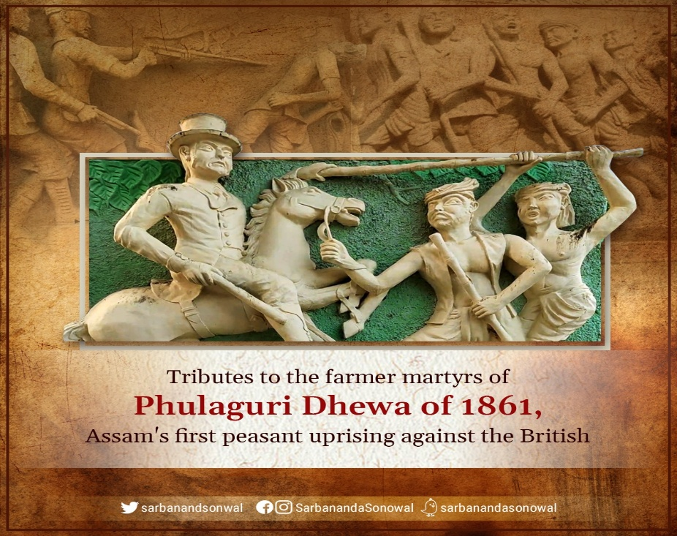
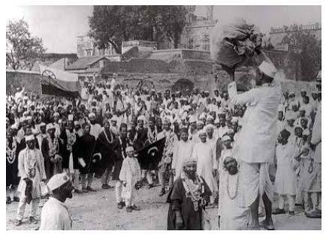

Slide 36
PATHARUGHAT UPRISING (1894): Background of Patharughat Uprising
Location: Patharughat, Darrang district
Year: 1894
British increased land revenue drastically.
Revenue increase: 70%–80% in some areas.

Slide 37
Causes of the Uprising
Sharp rise in land tax
Agrarian distress
Exploitation by colonial administration
Famine-like conditions
Peasants refused to pay enhanced revenue.

Slide 38
The Incident (28 January 1894)
Thousands gathered at Patharughat.
Peaceful protest.
British police opened fire.
Result:
  Around 140 peasants killed (unofficial estimates higher).
Often called:
  “Jallianwala Bagh of Assam”

Slide 39
Nature of the Movement
Peasant-based uprising.
Largely non-violent before firing.
Spontaneous but organized resistance.
Significance of Patharughat
  Major episode of agrarian resistance.
  Demonstrated brutality of colonial state.
  Strengthened anti-British sentiments in Assam.

Slide 40
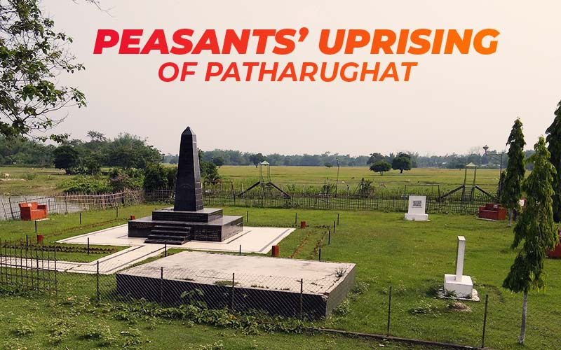

Slide 41
Freedom Struggle in Assam
Rise of Political Consciousness
  Assam Association (1903)
  Emergence of middle-class leadership
  Participation in Indian National Congress
Leaders:
  Tarun Ram Phukan
  Nabin Chandra Bordoloi
Analytical Question:
Was Assamese nationalism dependent on the all-India Congress?

Slide 42
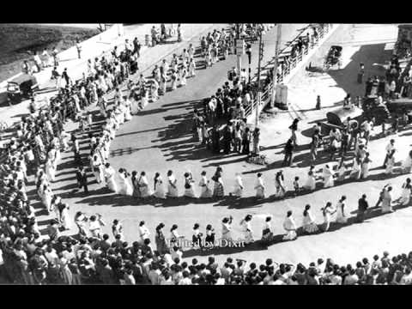
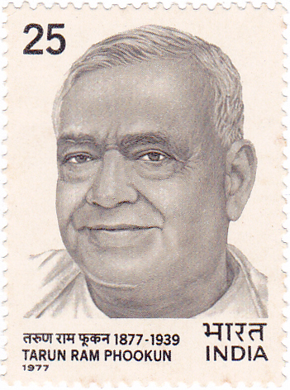
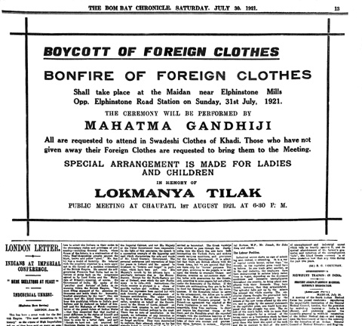
Non-Cooperation Movement (1920–22)
Boycott of foreign goods
Students leaving government schools
Spread of Gandhian ideology

Slide 43
Civil Disobedience Movement (1930–34)
Salt Satyagraha in Assam
Village-level mobilization
Women’s participation increased
Significance:
  Transition from elite politics → mass politics

Slide 44
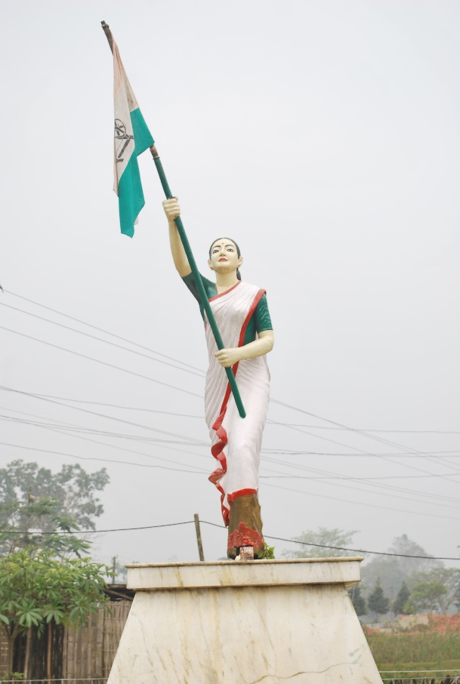
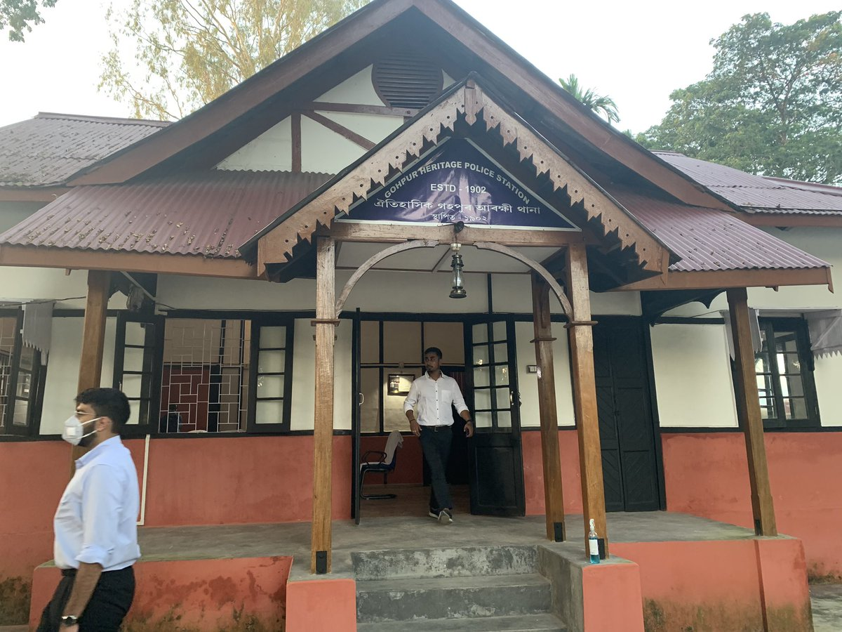
Quit India Movement (1942)
Mass protests across districts
Kanaklata Barua – Martyred at Gohpur
Mukunda Kakati – Shot by police
Analytical Theme:
Youth radicalization in Assam.

Slide 45
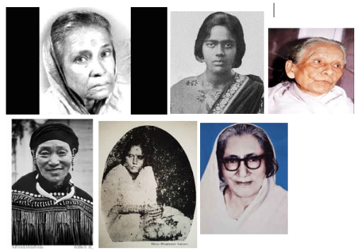
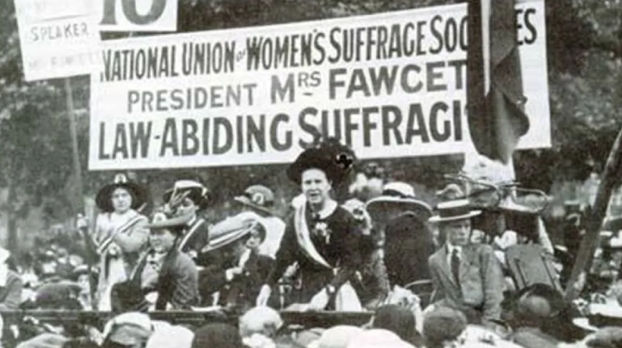
Role of Women
Bhogeswari Phukanani
Kanaklata Barua
Participation in picketing & flag marches
Gender Analysis:
National movement transformed gender roles in Assamese society.

Slide 46
Tea Garden Labour & Subaltern Politics
Plantation economy under British
Migrant labour exploitation
Political awakening among workers
Subaltern perspective:
Freedom struggle was not only middle-class but also labour-based.

Slide 47
Press, Literature & Cultural Nationalism
Role of Assamese newspapers
Literary nationalism
Cultural assertion against colonial dominance
Relevant Thinkers:
  Sajal Nag
  H. K. Barpujari

Slide 48
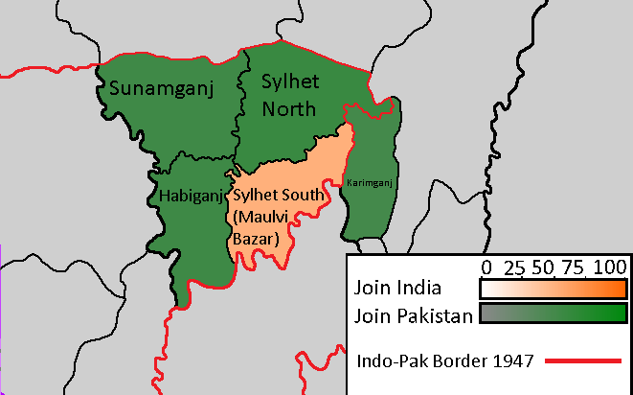
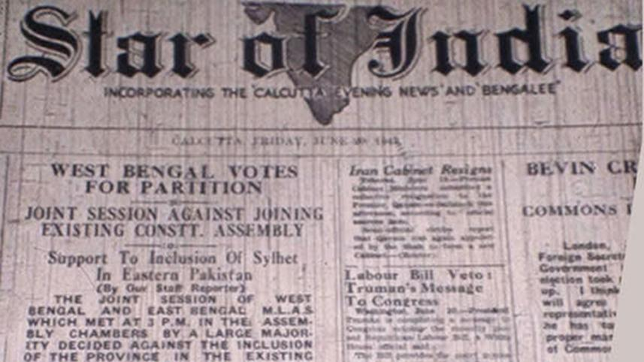
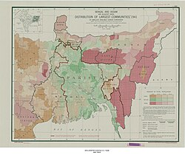
Sylhet Referendum (1947)
Sylhet voted to join East Pakistan
Altered Assam’s demography
Long-term political consequences

Slide 49


