Slide 1

POL040204: Political Theory: Concepts and Debates
Aniruddha Kumar Baro

Slide 2
Global Justice

Slide 3
What is Global Justice?
Justice beyond the boundaries of the nation-state
Concerns fairness in global distribution of:
  Wealth
  Resources
  Opportunities
  Rights
Linked with globalization, inequality, climate change, migration
📌 Core Question:
Do we owe justice only to fellow citizens, or to all human beings?

Slide 4
Why Study Global Justice?
Rising global inequality
Climate crisis
Refugee crisis
Global capitalism
International institutions (UN, IMF, WTO)
Example: Wealth gap between Global North & Global South

Slide 5
Background – From National to Global Justice
Traditional theories (Plato, Aristotle, Rawls) focused on justice within a state.
Modern globalization challenges this:
  Economic interdependence
  International trade
  Transnational corporations
  Global governance institutions

Slide 6
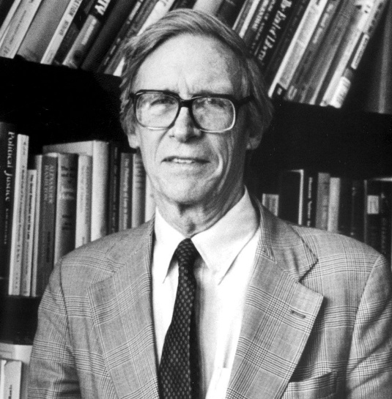
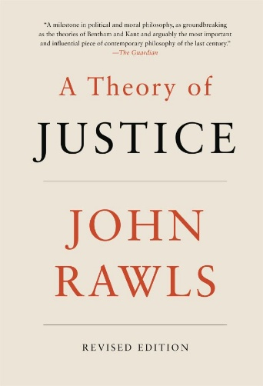
🧠 Key Thinkers of Global Justice
John Rawls
Major Work: The Law of Peoples (1999)
Justice applies primarily within states
International society should be governed by:
  Human rights
  Non-aggression
  Duty of assistance
🔎 Rawls rejects strong global redistribution.
He supports helping "burdened societies" but not global equality.

Slide 7
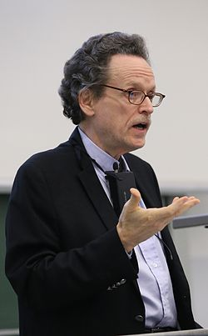
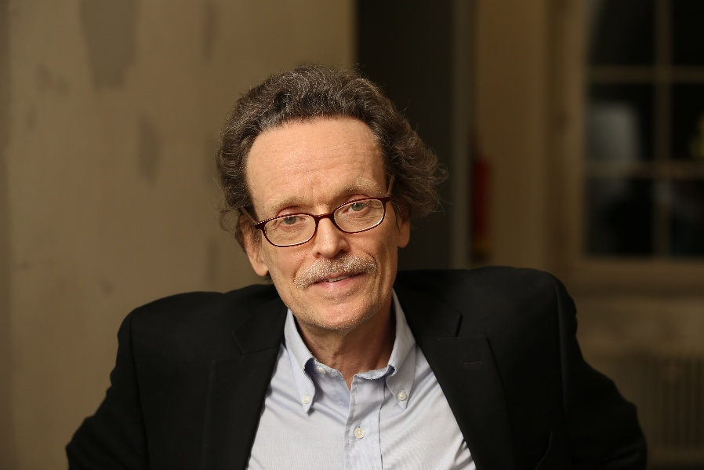
Thomas Pogge
Critic of Rawls
Argues global institutions harm the poor
Wealthy countries contribute to poverty
📌 Idea:
We have negative duties not to harm others through unjust global systems.

Slide 8
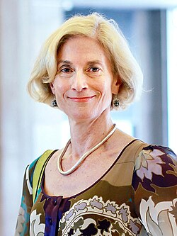
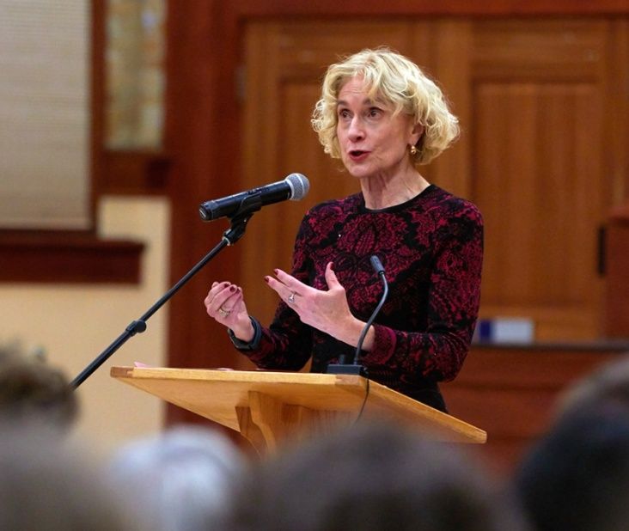
Martha Nussbaum
apabilities Approach
Justice means ensuring:
  Education
  Health
  Political participation
  Dignity
Justice should be universal and human-centered.

Slide 9

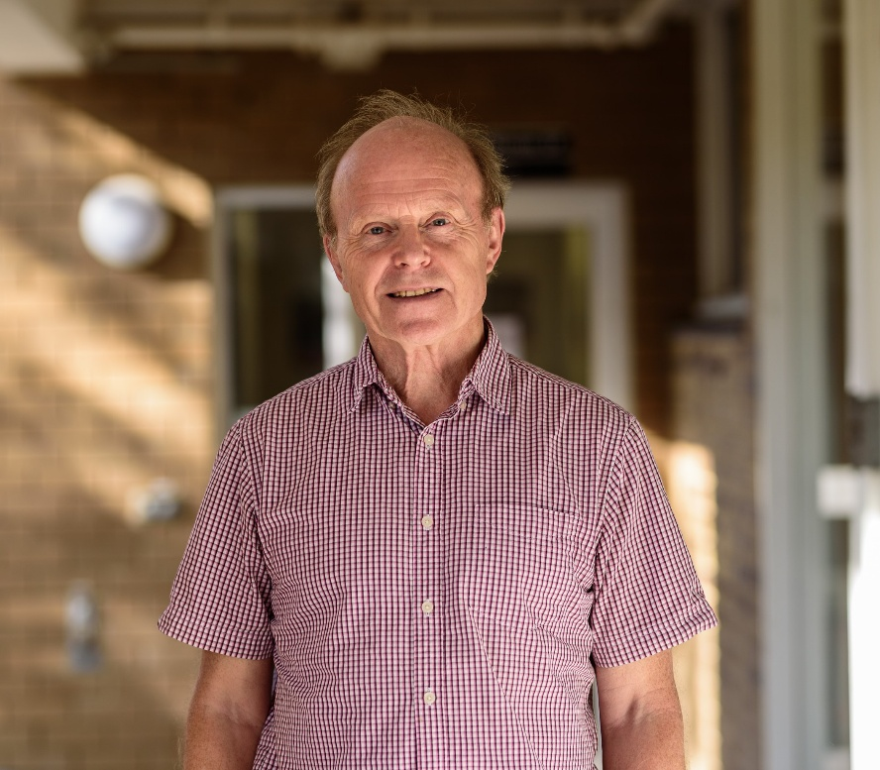
David Miller
  Defends National Responsibility
  Justice stronger within nations
  Global duties are limited
Emphasizes:
  National identity
  Self-determination

Slide 10
Major Theoretical Approaches
Cosmopolitanism
All humans equal moral worth
Borders morally irrelevant
Supports:
  Global redistribution
  International human rights
  Global democracy
Thinkers: Pogge, Nussbaum

Slide 11
Communitarianism / Statism
Justice applies within political communities
Shared culture & institutions matter
States are primary units of justice
Thinkers: Rawls (partly), Miller
Marxist Perspective on Global Justice
Global capitalism creates exploitation
Core vs Periphery (Dependency theory)
Multinational corporations exploit Global South
Example:
  Unequal trade relations
  Resource extraction

Slide 12
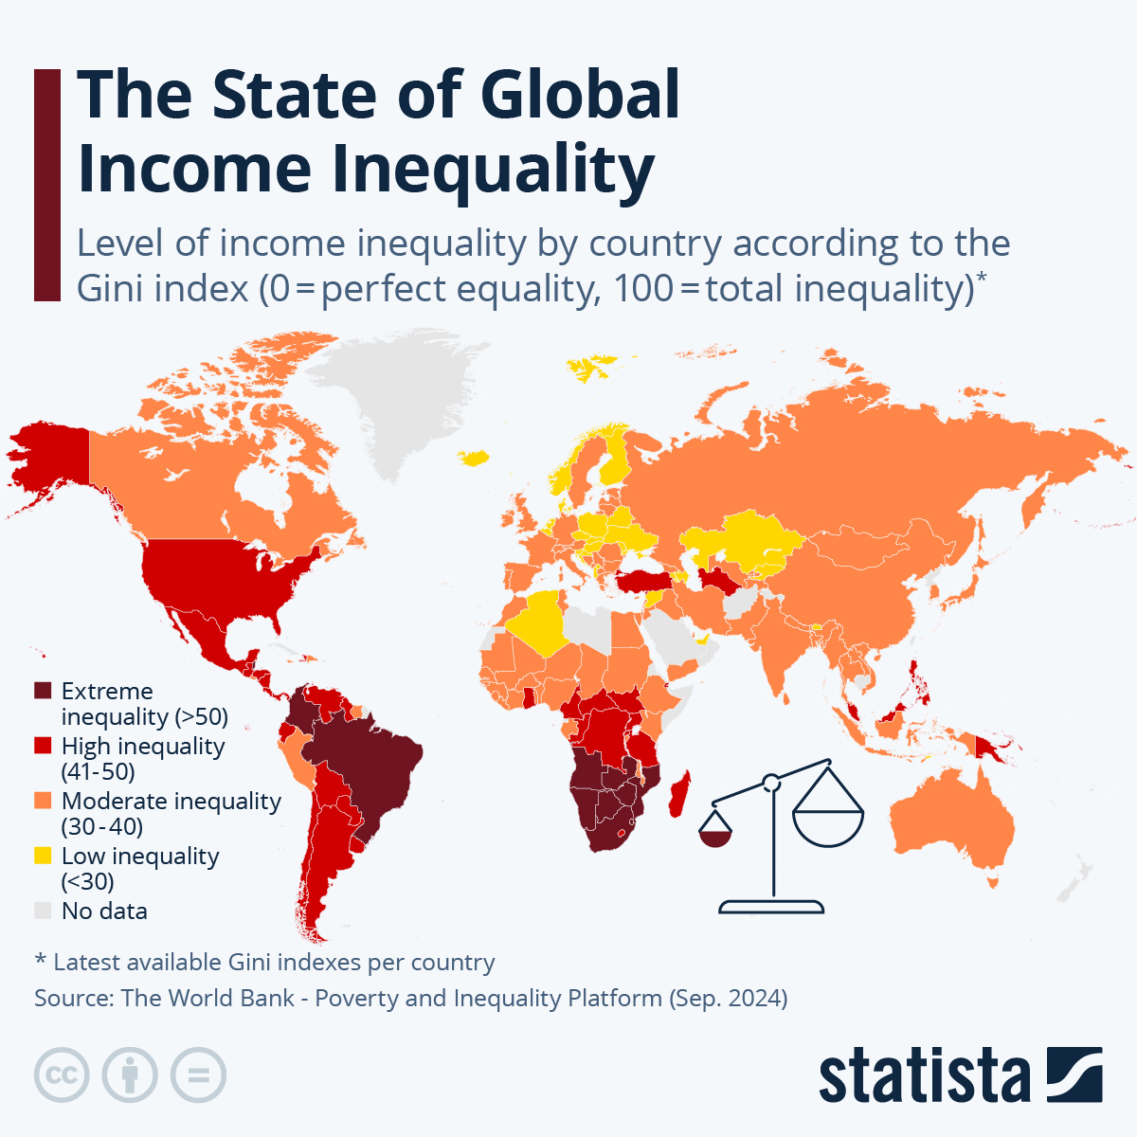
Global Inequality (Data Slide)
1% owns significant global wealth
Unequal access to:
  Healthcare
  Education
  Clean water
Discussion:
Is global inequality unjust or just unfortunate?

Slide 13
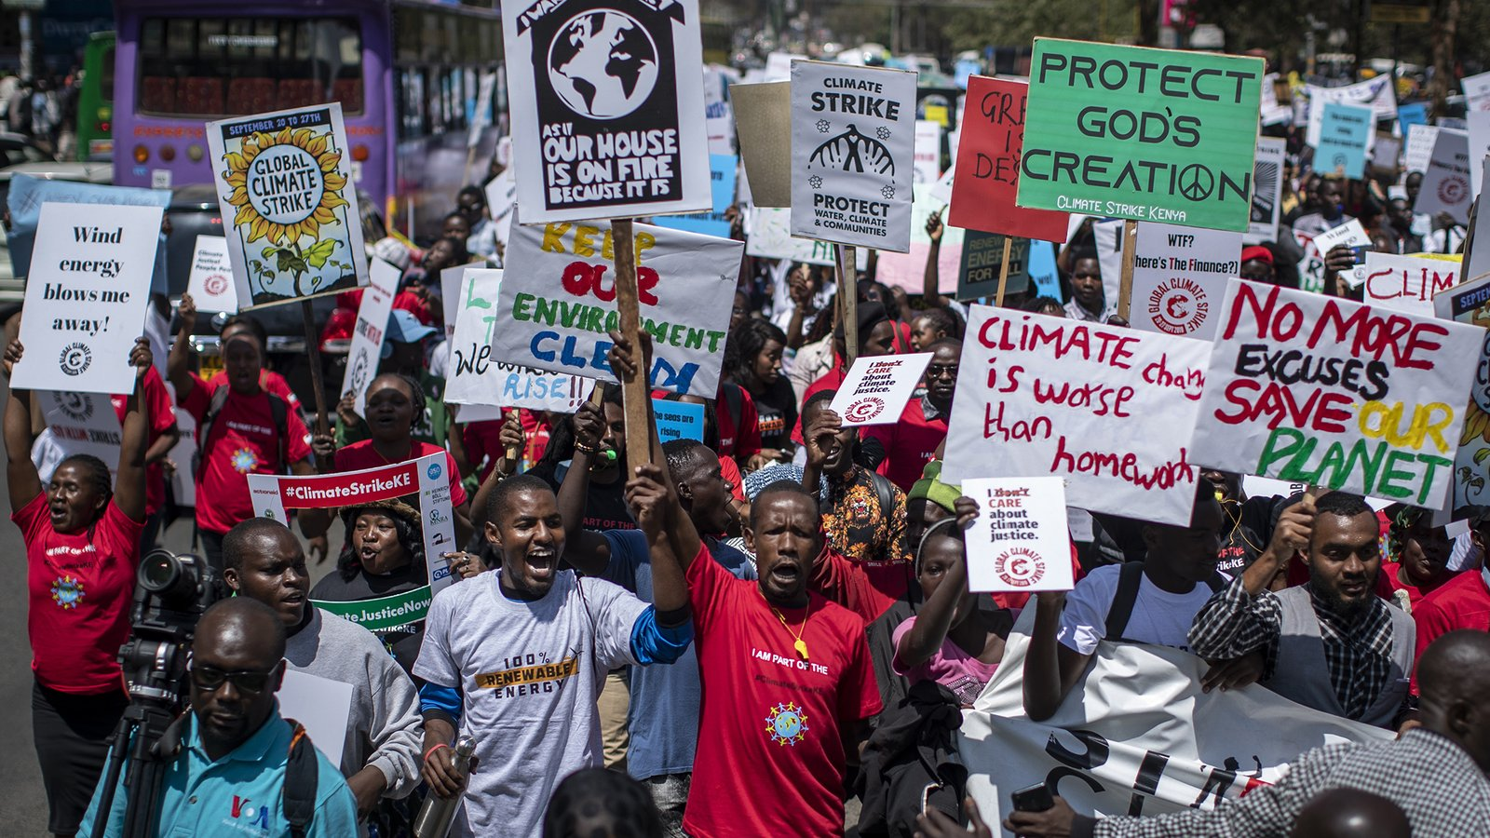
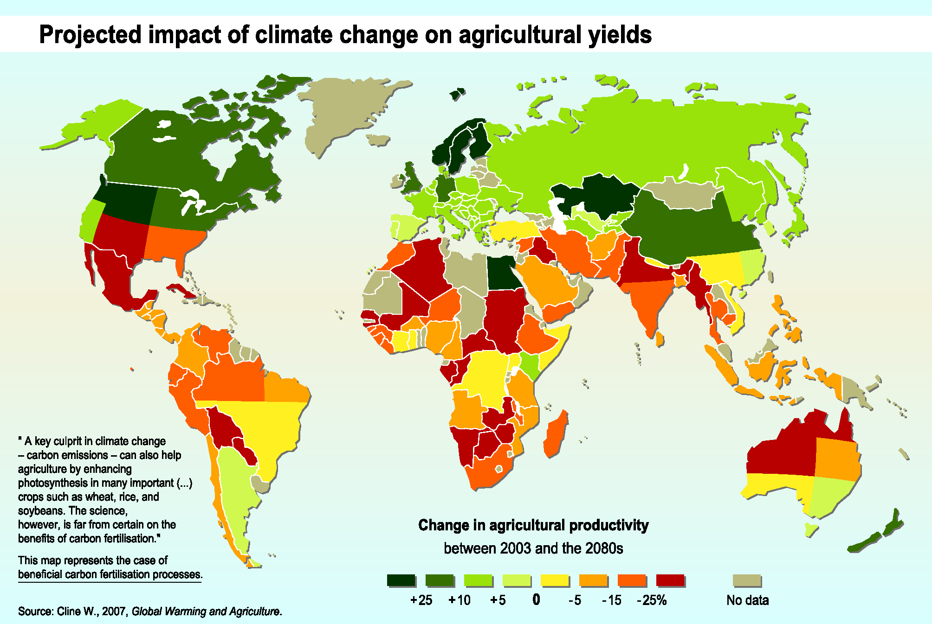
Climate Justice
Developed nations caused most emissions
Developing nations suffer most
Key principle:
Common but Differentiated Responsibility (CBDR)

Slide 14
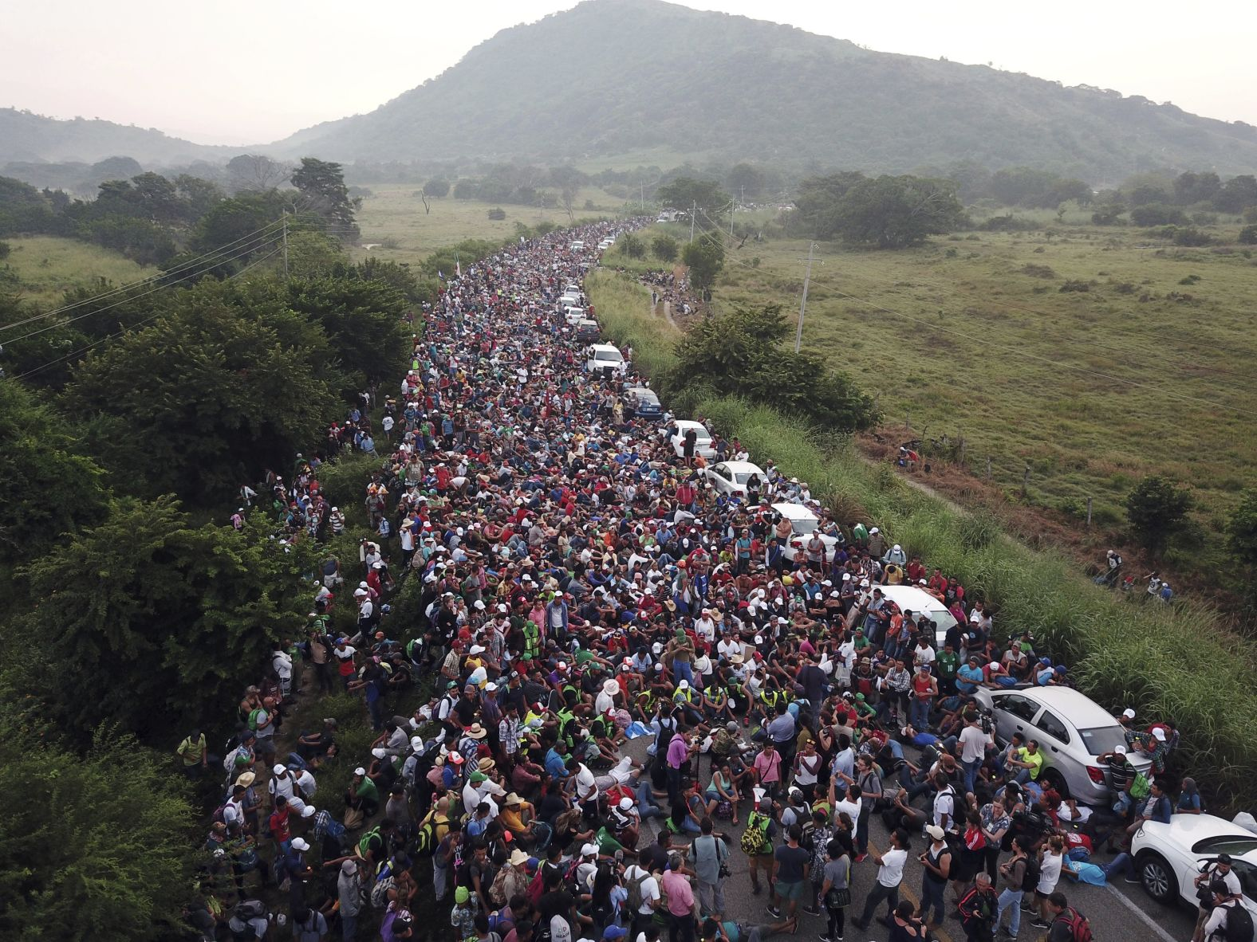
Migration and Refugees
Questions:
  Do states have right to close borders?
  Should there be open borders?
  What about refugee rights?
Example: Syrian refugee crisis

Slide 15
Global Institutions and Justice
  United Nations
  IMF
  World Bank
  WTO
Criticism:
  Democratic deficit
  Dominance of powerful states

Slide 16
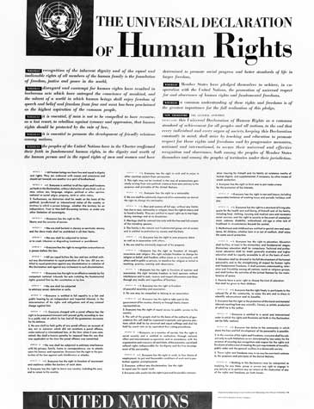
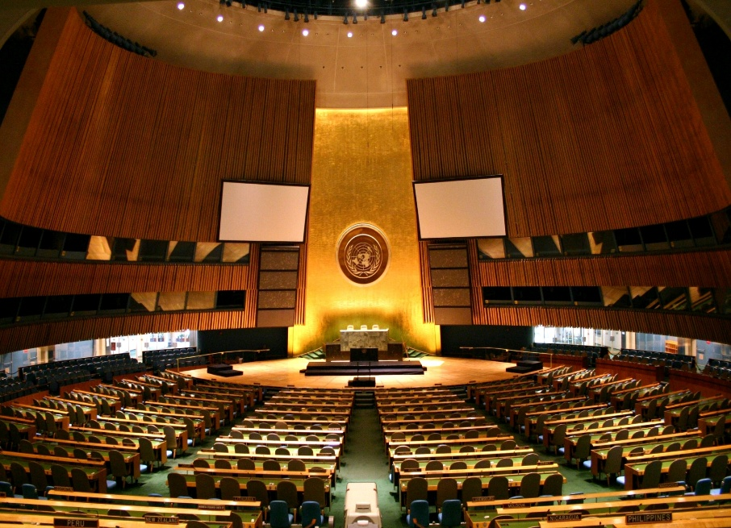
Global Justice and Human Rights
Universal Declaration of Human Rights (1948)
Are human rights universal or Western?

Slide 17
Key Debates
Debate | Question
Equality vs Sufficiency | Equal distribution or minimum standard?
Open Borders vs State Sovereignty | Free movement or control?
Aid vs Structural Reform | Charity or justice?
Global Taxation? | Should there be global wealth tax?

Slide 18
Case Study (Indian Context)
  Climate responsibility
  WTO agricultural subsidies
  Vaccine inequality (COVID-19)
Discussion Question:
Should India prioritize national interest or global justice?

Slide 19
Criticisms of Global Justice Theory
Too idealistic
Difficult to implement
Cultural relativism
State sovereignty concerns
Conclusion
Global Justice forces us to rethink:
  Borders
  Responsibility
  Equality
  Human dignity
📌 Final Question for Students:
Are we citizens of a country, or citizens of the world?

Slide 20


Slide 21
Surprise Test
Explain John Locke’s concept of Negative Freedom and critically examine Amartya Sen’s idea of “Development as Freedom.” How do these two perspectives differ in their understanding of freedom in modern societies?
Discuss the concepts of Procedural Equality and Substantive Equality. Critically analyse why substantive equality is considered necessary for addressing social and economic inequalities.
What is Egalitarianism? Explain the idea of background inequalities and differential treatment in the context of egalitarian theory. Evaluate its relevance in contemporary democratic societies like India.
Explain John Rawls’ theory of Distributive Justice. Critically examine libertarian critiques of distributive justice with reference to F. A. Hayek’s theory of justice and discuss their implications for global justice.

