Slide 1

POL040204: Political Theory: Concepts and Debates
Aniruddha Kumar Baro

Slide 2
Libertarian theories of Justice: F. A. Hayek

Slide 3
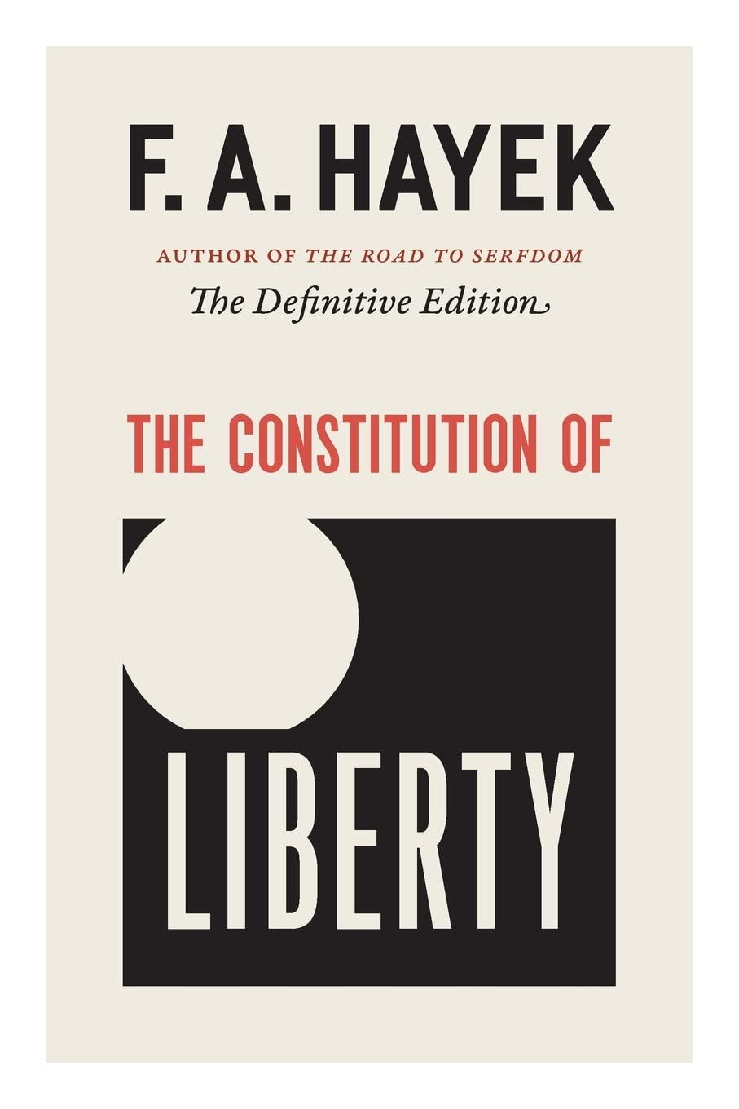
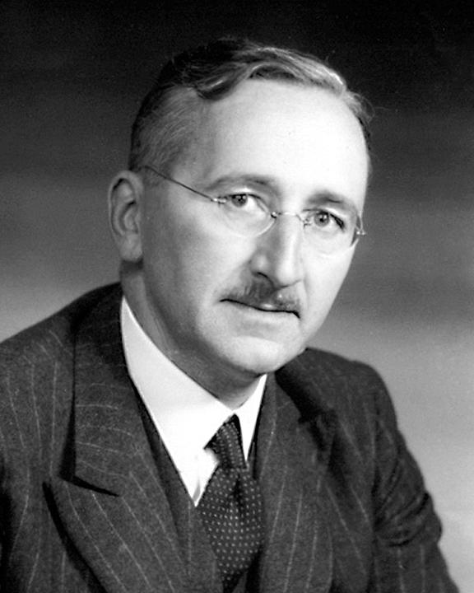
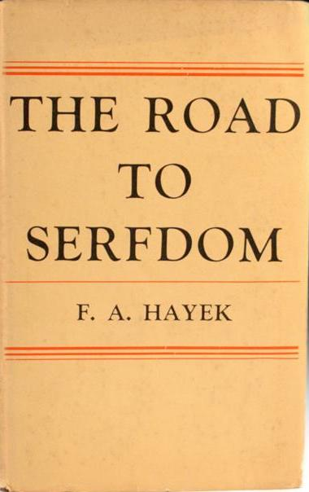

Slide 4
Who was F. A. Hayek?
F. A. Hayek (1899–1992)
  Austrian-British economist & political philosopher
  Nobel Prize in Economics (1974)
  Major critic of socialism and central planning
  Key works:
    The Road to Serfdom
    The Constitution of Liberty
    Law, Legislation and Liberty

Slide 5
What is Libertarianism?
Core Principles:
  Individual liberty is supreme
  Minimal state intervention
  Free market economy
  Private property rights
👉 Justice = Protection of individual freedom

Slide 6
Hayek’s View of Justice
Hayek rejects the idea of “Social Justice”.
Why?
  Market outcomes are not “designed”
  No central authority distributes rewards
  Therefore, results cannot be called “just” or “unjust”
📌 Key Statement:
  “Social justice is a mirage.” – Hayek

Slide 7
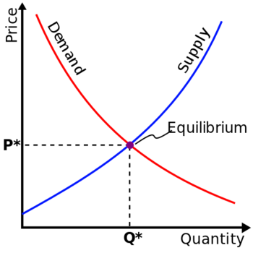

Spontaneous Order
Hayek’s central idea: Spontaneous Order
  Society evolves naturally
  Markets coordinate knowledge
  No central planner needed
Example:
  Price of rice rises during shortage → encourages supply.

Slide 8
Rule of Law
Hayek supports:
  General and abstract laws
  Equality before law
  Predictability
Justice = Rule-based system, not outcome-based redistribution.

Slide 9
Critique of Redistribution
Hayek argues:
  Redistribution destroys incentives
  Central planning reduces freedom
  Welfare state may lead to authoritarianism
From:
  The Road to Serfdom

Slide 10
Example 1: Government fixing prices of onions
Hayek would say:
  Distorts market signals
  Creates black markets
Example 2: Reservation Policy
Hayek’s position:
  May violate equality before law
  Justice should be procedural, not distributive

Slide 11
Hayek vs John Rawls
Hayek
Rawls
Justice = Freedom
No redistribution
Market outcomes neutral
Justice = Fairness
Redistribution justified
Inequalities must benefit least advantaged

Slide 12
Hayek and Modern India
Discussion Points:
  Economic Liberalization (1991 reforms)
  Privatization
  Reduced state control
Question:
  Does India follow Hayekian principles today?

Slide 13
Criticisms of Hayek
Ignores structural inequalities
Overestimates market fairness
Neglects social justice
Weak concern for marginalized groups
Critics include:
  John Rawls
  Amartya Sen

Slide 14


