Slide 1

POL040204: Political Theory: Concepts and Debates
Aniruddha Kumar Baro

Slide 2
POL040204: Political Theory: Concepts and Debates
Unit-I: Freedom and Equality
  Freedom: Lockean notion of Negative Freedom & Amartya Sen’s notion of Development as Freedom
  Equality: Procedural Equality and Substantive Equality
  Egalitarianism: Background inequalities and differential treatment
Unit-II: Justice
  Distributive Justice: John Rawls
  Libertarian theories of Justice: F. A. Hayek
  Global Justice

Slide 3
Unit-III: Rights and Obligation
  The Universality of Rights and Differentiated Rights
  Rights, Obligation and Civil Disobedience
  Theories of Political Obligation: Conservatism, Consent Theory, Anarchism
Unit-IV: Major Debates
  Whatever happens to nation-state? Sovereignty under Globalization.
  How do we accommodate diversity in plural society? Diversity and Multiculturalism.
  How do we deal with the climate changes? Ecological Rights as human rights

Slide 4
Unit-II: Justice
  Distributive Justice: John Rawls
  Libertarian theories of Justice: F. A. Hayek
  Global Justice

Slide 5
Distributive Justice: John Rawls

Slide 6
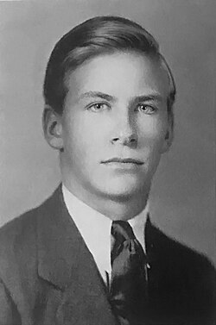
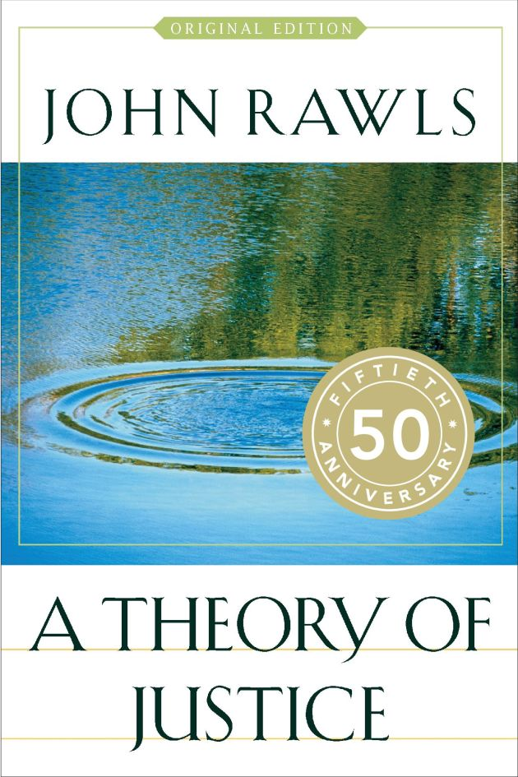
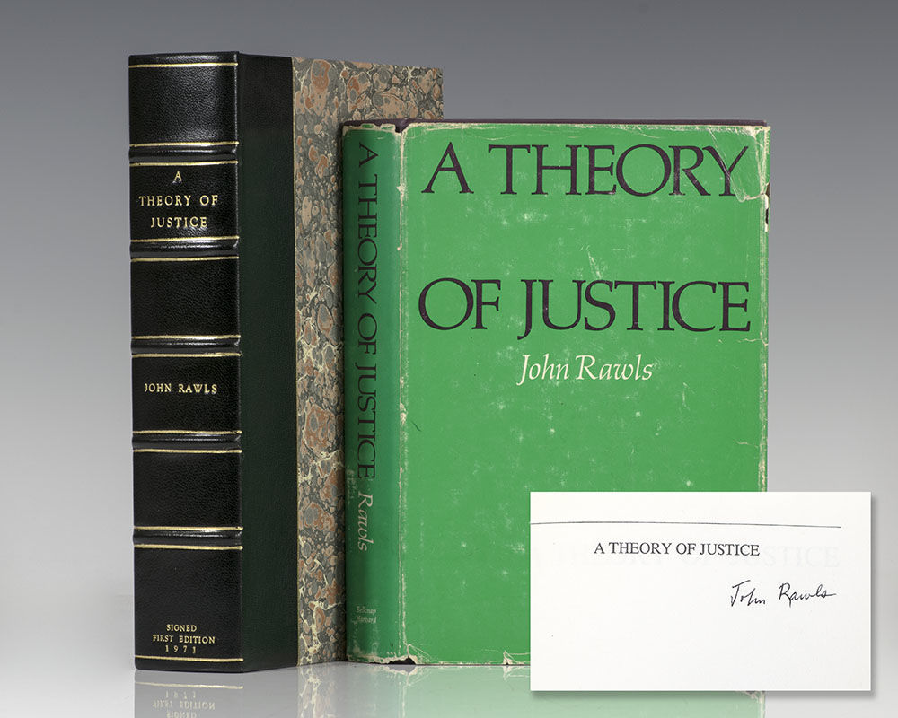

Slide 7
What is Distributive Justice?
Meaning
Distributive justice concerns:
  How benefits and burdens of society should be distributed
  Distribution of:
    Income
    Wealth
    Opportunities
    Rights
    Offices
Core Question:
  👉 Who should get what, and why?
Philosophical Background:
  Aristotle – Proportionate equality
  Karl Marx – From each according to ability…
  Robert Nozick – Entitlement theory

Slide 8
Historical Context of Rawls
20th Century Context
  World War II
  Rise of Welfare State
  Cold War: Capitalism vs Socialism
  Civil Rights Movement (USA)
Major Work:
  📘 A Theory of Justice (1971)
Rawls tried to:
  Reconcile liberty and equality
  Offer an alternative to utilitarianism

Slide 9
Rawls Against Utilitarianism
Utilitarianism:
  Jeremy Bentham
  John Stuart Mill
  "Greatest happiness of the greatest number“
Rawls’ Criticism:
  Sacrifices minority rights
  Allows inequality if majority benefits
  Ignores fairness
💡 Rawls says: Justice must protect the least advantaged.

Slide 10
Justice as Fairness
Rawls’ theory = Justice as Fairness
Two key ideas:
  Original Position
  Veil of Ignorance
Justice = What rational people would choose under fair conditions.

Slide 11
The Original Position
Imagine:
  People choosing principles of justice
  Before entering society
  Without knowing their status
It is a hypothetical social contract situation.
Inspired by:
  Thomas Hobbes
  John Locke
  Jean-Jacques Rousseau

Slide 12
Veil of Ignorance
Core Idea
You do NOT know:
  Your caste
  Your religion
  Your gender
  Your class
  Your talents
  Your social status
Question:
  👉 What kind of society would you choose?

Slide 13
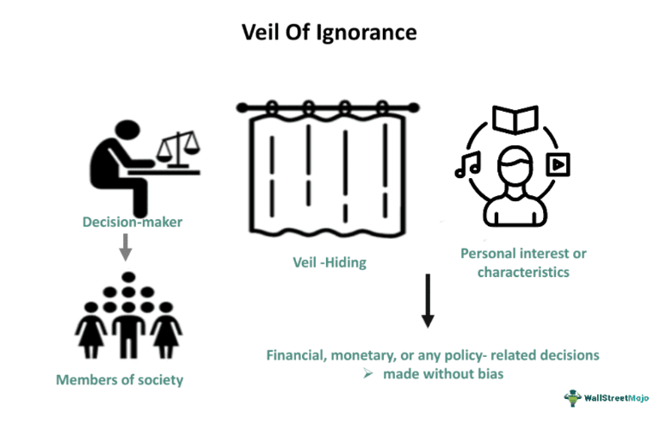
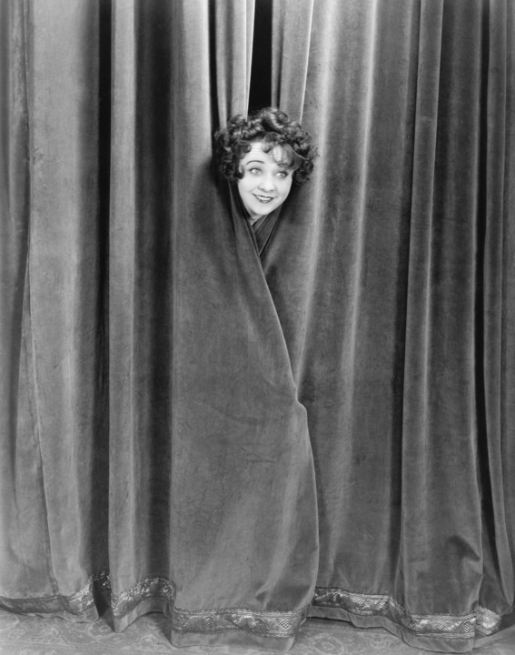


Slide 14
Why Veil of Ignorance?
Because:
  It ensures impartiality
  Removes bias
  Promotes fairness
People will choose:
  Safe principles
  Protection for worst-off
  Equal rights
Rawls calls this the Maximin Rule
(Maximize the minimum position)

Slide 15
Two Principles of Justice
Rawls proposes TWO principles:
1️⃣ First Principle (Liberty Principle)
  Equal basic liberties for all.
2️⃣ Second Principle
Social & economic inequalities are justified only if:
  They benefit the least advantaged
  Offices are open to all (fair equality of opportunity)

Slide 16
First Principle – Equal Liberty
Includes:
  Freedom of speech
  Freedom of religion
  Political participation
  Right to vote
  Rule of law
Similar to:
  Indian Constitution: Articles 14–19
  Fundamental Rights

Slide 17
Second Principle Explained
Two parts:
(a) Fair Equality of Opportunity
  Not just formal equality
  But real access (education, health)
(b) Difference Principle
  Inequality is allowed only if it benefits the poorest.
Example:
  If a doctor earns more,
  Society benefits only if:
    Medical services improve
    Poor get better healthcare

Slide 18
The Difference Principle (Deep Understanding)
It does NOT demand complete equality.
It says:
Inequality is acceptable if:
  👉 It improves the condition of the least advantaged.
Example:
  Reservation policy in India
  Welfare schemes
  MNREGA

Slide 19
Rawls and Indian Context
Application in India:
  Reservation Policy
  Right to Education
  Welfare schemes
  SC/ST Act
  Affirmative action
Link with:
  Social justice
  Constitutional morality

Slide 20
Basic Structure of Society
Rawls focuses on:
The Basic Structure of society:
  Constitution
  Economic system
  Legal system
  Political institutions
Justice must regulate institutions, not individual morality.
Primary Goods
Rawls says people want:
  Rights
  Liberties
  Income
  Wealth
  Opportunities
  Self-respect
These are called Primary Goods.

Slide 21
Criticism of Rawls
1️⃣ Libertarian Critique – Robert Nozick
  Redistribution violates property rights.
2️⃣ Communitarian Critique – Michael Sandel
  Too individualistic
  Ignores community values
3️⃣ Marxist Critique
  Does not abolish capitalism
  Accepts inequality

Slide 22
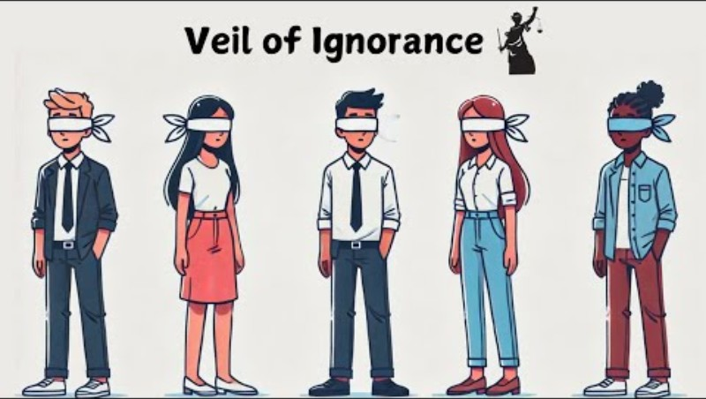
Video

Slide 23
Rawls vs Nozick (Comparison Table)
Rawls
Nozick
Justice as fairness
Redistribution allowed
Focus on equality
Protect least advantaged
Entitlement theory
No redistribution
Focus on liberty
Protect property rights

Slide 24
Libertarian theories of Justice: F. A. Hayek

Slide 25
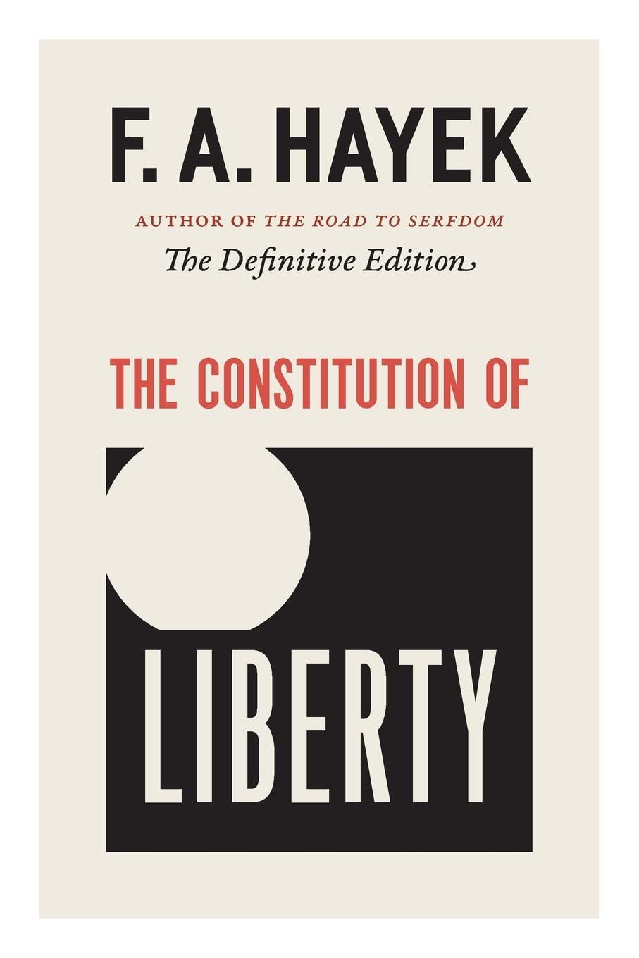
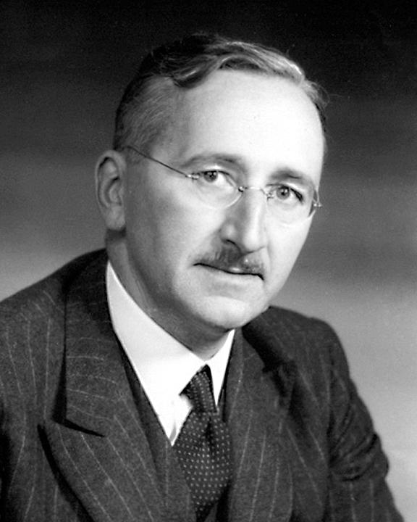
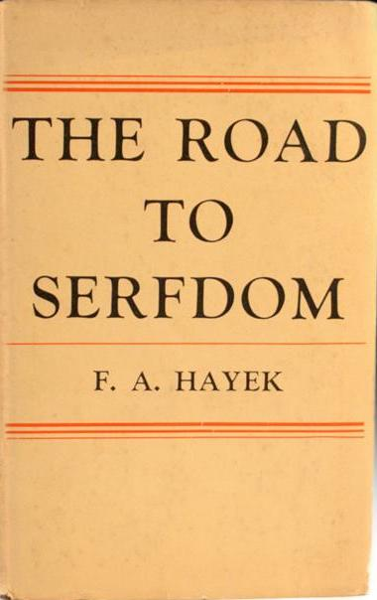

Slide 26
Who was F. A. Hayek?
F. A. Hayek (1899–1992)
  Austrian-British economist & political philosopher
  Nobel Prize in Economics (1974)
  Major critic of socialism and central planning
  Key works:
    The Road to Serfdom
    The Constitution of Liberty
    Law, Legislation and Liberty

Slide 27
What is Libertarianism?
Core Principles:
  Individual liberty is supreme
  Minimal state intervention
  Free market economy
  Private property rights
👉 Justice = Protection of individual freedom

Slide 28
Hayek’s View of Justice
Hayek rejects the idea of “Social Justice”.
Why?
  Market outcomes are not “designed”
  No central authority distributes rewards
  Therefore, results cannot be called “just” or “unjust”
📌 Key Statement:
  “Social justice is a mirage.” – Hayek

Slide 29
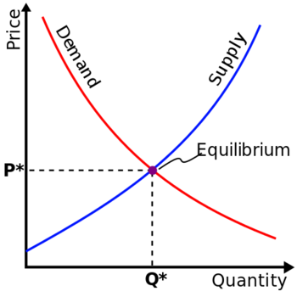
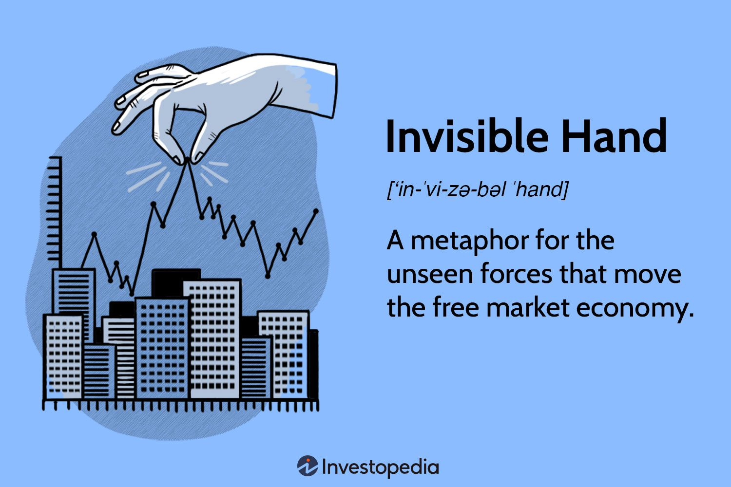
Spontaneous Order
Hayek’s central idea: Spontaneous Order
  Society evolves naturally
  Markets coordinate knowledge
  No central planner needed
Example:
  Price of rice rises during shortage → encourages supply.

Slide 30
Rule of Law
Hayek supports:
  General and abstract laws
  Equality before law
  Predictability
Justice = Rule-based system, not outcome-based redistribution.

Slide 31
Critique of Redistribution
Hayek argues:
  Redistribution destroys incentives
  Central planning reduces freedom
  Welfare state may lead to authoritarianism
From:
  The Road to Serfdom

Slide 32
Example 1: Government fixing prices of onions
Hayek would say:
  Distorts market signals
  Creates black markets
Example 2: Reservation Policy
Hayek’s position:
  May violate equality before law
  Justice should be procedural, not distributive

Slide 33
Hayek vs John Rawls
Hayek
Rawls
Justice = Freedom
No redistribution
Market outcomes neutral
Justice = Fairness
Redistribution justified
Inequalities must benefit least advantaged

Slide 34
Hayek and Modern India
Discussion Points:
  Economic Liberalization (1991 reforms)
  Privatization
  Reduced state control
Question:
  Does India follow Hayekian principles today?

Slide 35
Criticisms of Hayek
Ignores structural inequalities
Overestimates market fairness
Neglects social justice
Weak concern for marginalized groups
Critics include:
  John Rawls
  Amartya Sen

Slide 36
Global Justice

Slide 37
What is Global Justice?
Justice beyond the boundaries of the nation-state
Concerns fairness in global distribution of:
  Wealth
  Resources
  Opportunities
  Rights
Linked with globalization, inequality, climate change, migration
📌 Core Question:
Do we owe justice only to fellow citizens, or to all human beings?

Slide 38
Why Study Global Justice?
Rising global inequality
Climate crisis
Refugee crisis
Global capitalism
International institutions (UN, IMF, WTO)
Example: Wealth gap between Global North & Global South

Slide 39
Background – From National to Global Justice
Traditional theories (Plato, Aristotle, Rawls) focused on justice within a state.
Modern globalization challenges this:
  Economic interdependence
  International trade
  Transnational corporations
  Global governance institutions

Slide 40
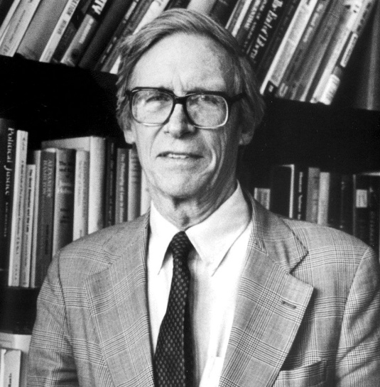
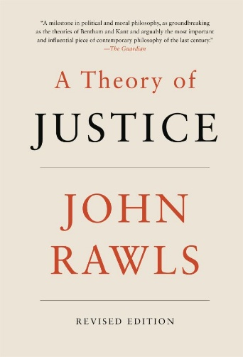
🧠 Key Thinkers of Global Justice
John Rawls
Major Work: The Law of Peoples (1999)
Justice applies primarily within states
International society should be governed by:
  Human rights
  Non-aggression
  Duty of assistance
🔎 Rawls rejects strong global redistribution.
He supports helping "burdened societies" but not global equality.

Slide 41
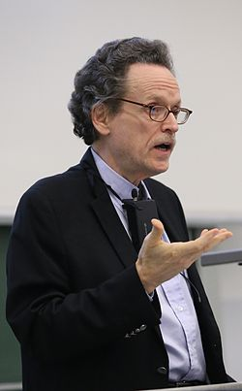
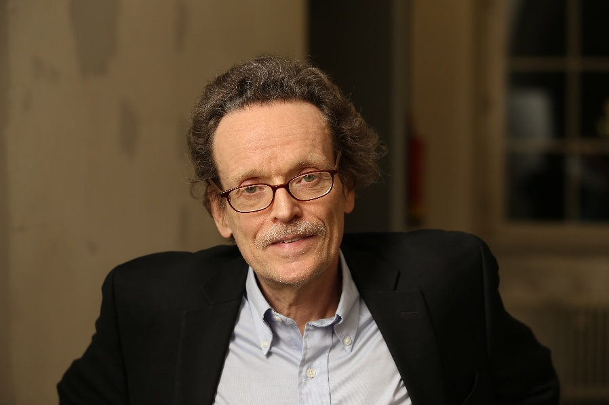
Thomas Pogge
Critic of Rawls
Argues global institutions harm the poor
Wealthy countries contribute to poverty
📌 Idea:
We have negative duties not to harm others through unjust global systems.

Slide 42
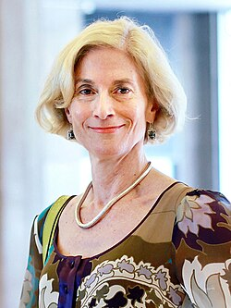
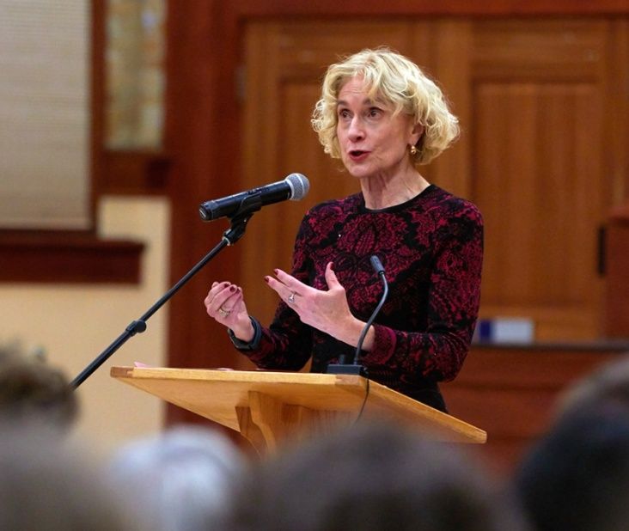
Martha Nussbaum
apabilities Approach
Justice means ensuring:
  Education
  Health
  Political participation
  Dignity
Justice should be universal and human-centered.

Slide 43
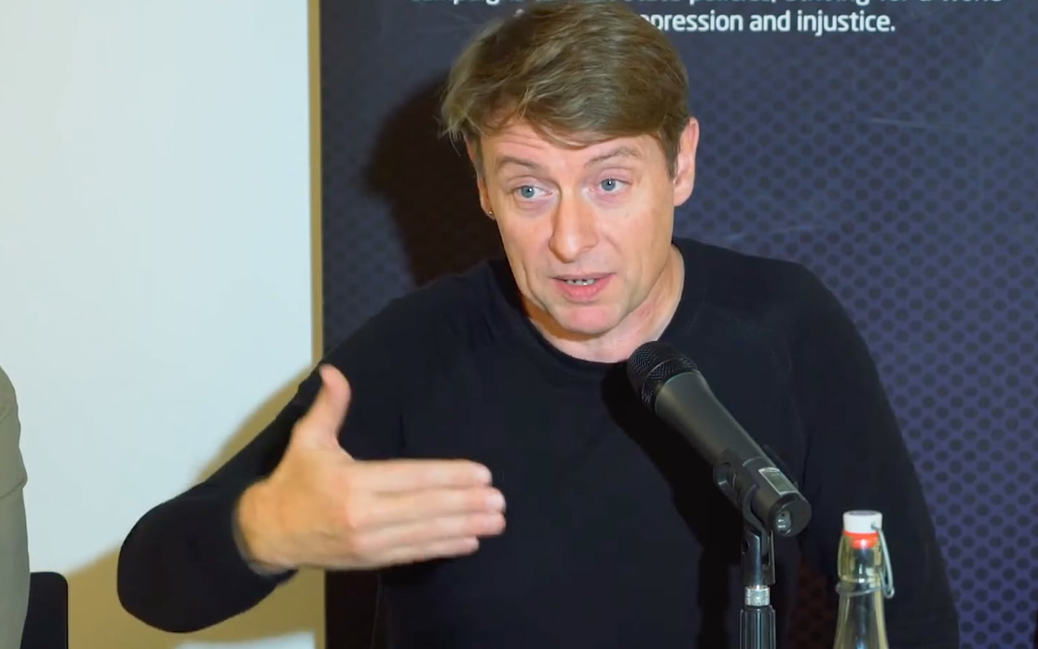
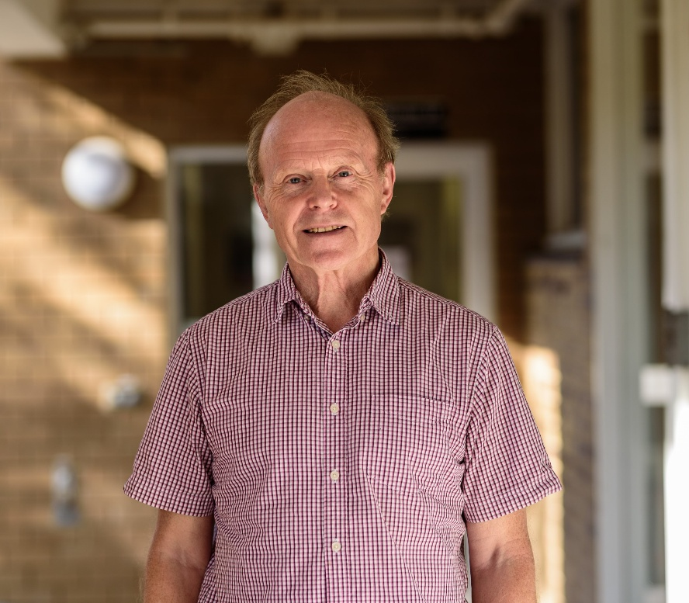
David Miller
  Defends National Responsibility
  Justice stronger within nations
  Global duties are limited
Emphasizes:
  National identity
  Self-determination

Slide 44
Major Theoretical Approaches
Cosmopolitanism
All humans equal moral worth
Borders morally irrelevant
Supports:
  Global redistribution
  International human rights
  Global democracy
Thinkers: Pogge, Nussbaum

Slide 45
Communitarianism / Statism
Justice applies within political communities
Shared culture & institutions matter
States are primary units of justice
Thinkers: Rawls (partly), Miller
Marxist Perspective on Global Justice
Global capitalism creates exploitation
Core vs Periphery (Dependency theory)
Multinational corporations exploit Global South
Example:
  Unequal trade relations
  Resource extraction

Slide 46
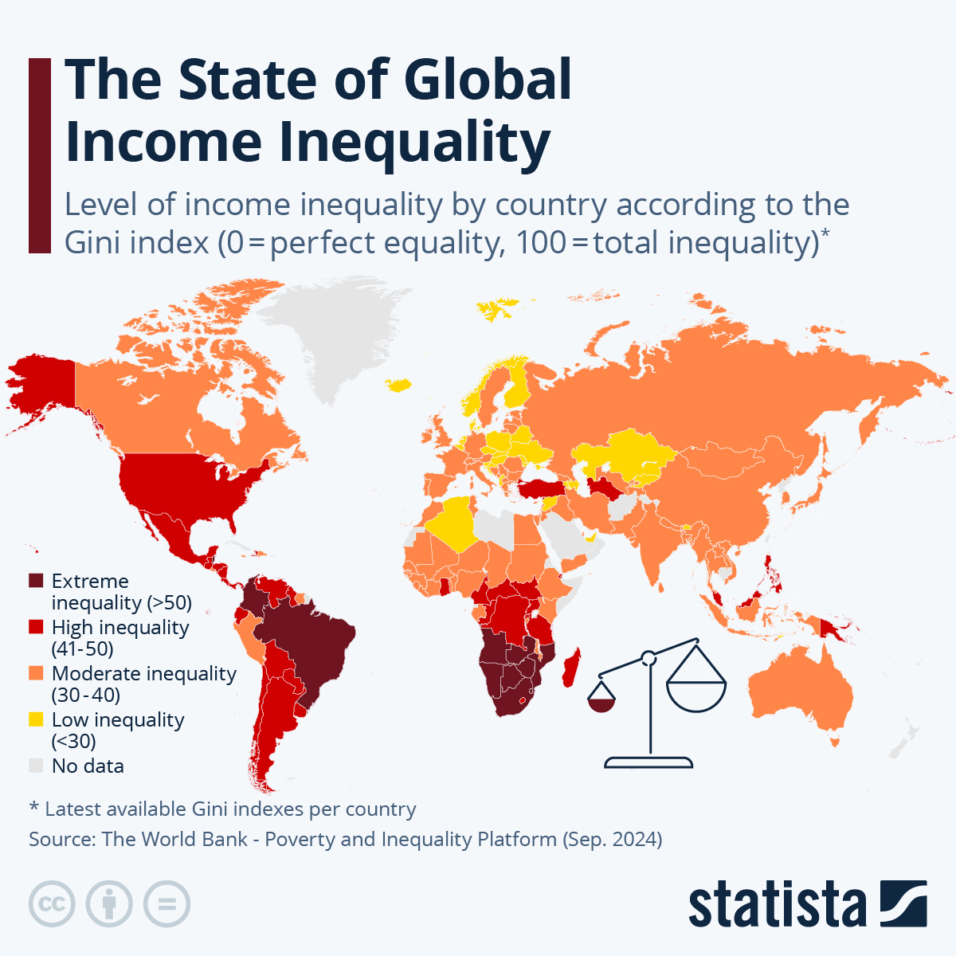
Global Inequality (Data Slide)
1% owns significant global wealth
Unequal access to:
  Healthcare
  Education
  Clean water
Discussion:
Is global inequality unjust or just unfortunate?

Slide 47
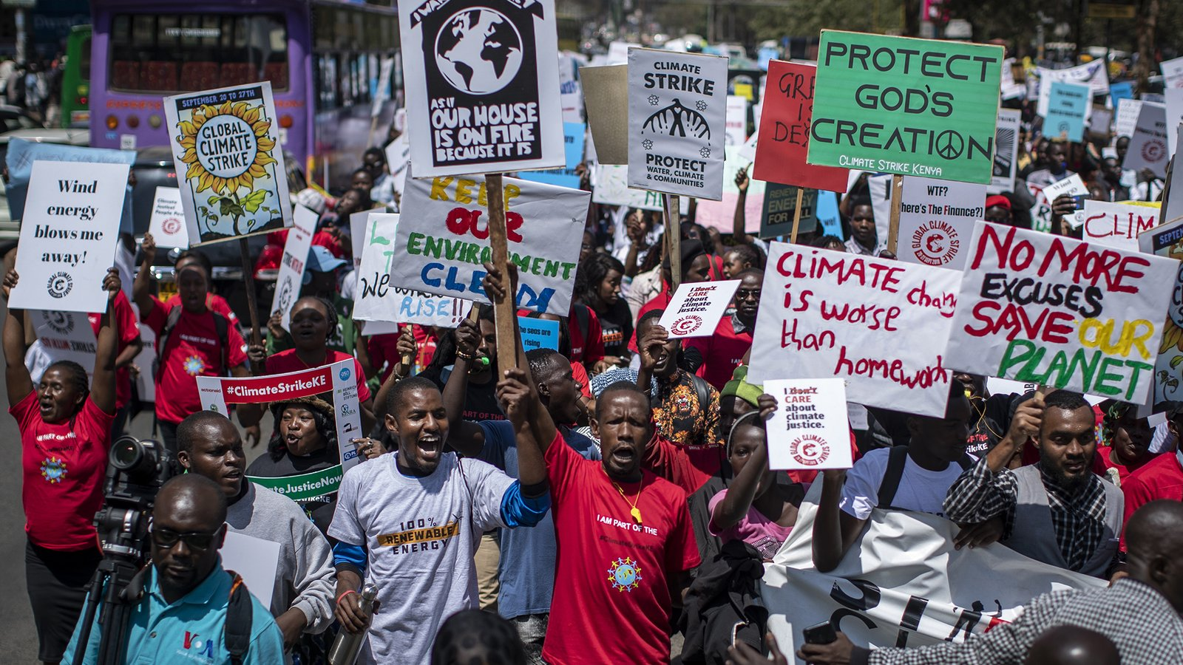
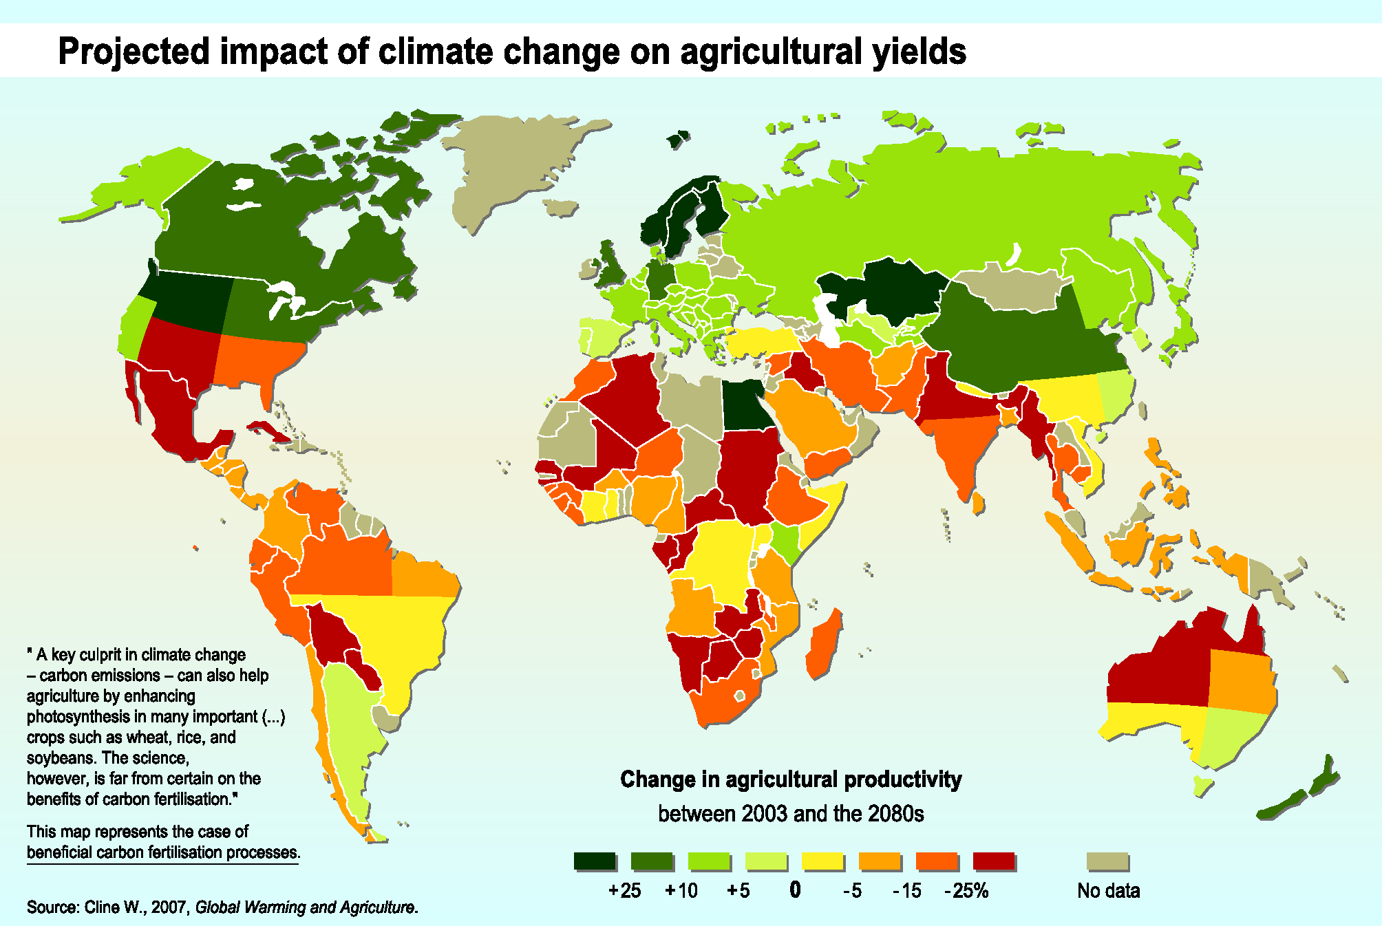
Climate Justice
Developed nations caused most emissions
Developing nations suffer most
Key principle:
Common but Differentiated Responsibility (CBDR)

Slide 48
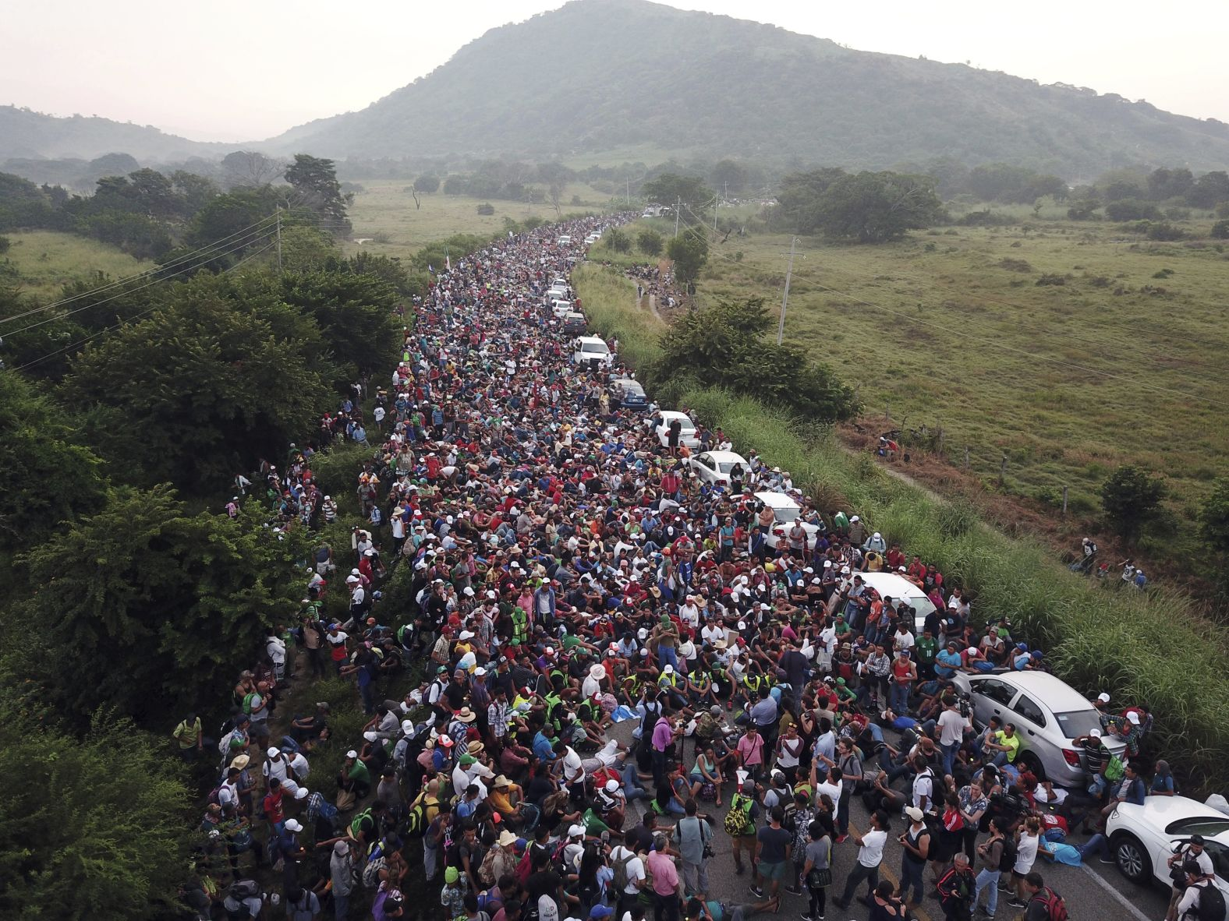
Migration and Refugees
Questions:
  Do states have right to close borders?
  Should there be open borders?
  What about refugee rights?
Example: Syrian refugee crisis

Slide 49
Global Institutions and Justice
  United Nations
  IMF
  World Bank
  WTO
Criticism:
  Democratic deficit
  Dominance of powerful states

Slide 50
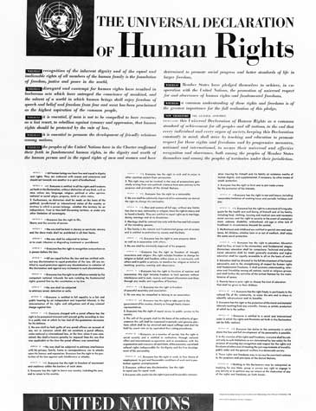
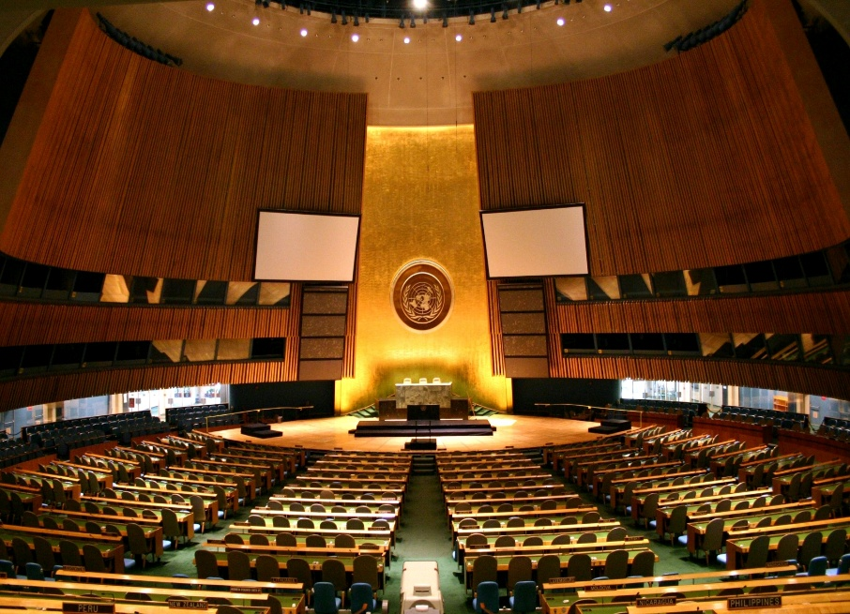
Global Justice and Human Rights
Universal Declaration of Human Rights (1948)
Are human rights universal or Western?

Slide 51
Key Debates
Debate | Question
Equality vs Sufficiency | Equal distribution or minimum standard?
Open Borders vs State Sovereignty | Free movement or control?
Aid vs Structural Reform | Charity or justice?
Global Taxation? | Should there be global wealth tax?

Slide 52
Case Study (Indian Context)
  Climate responsibility
  WTO agricultural subsidies
  Vaccine inequality (COVID-19)
Discussion Question:
Should India prioritize national interest or global justice?

Slide 53
Criticisms of Global Justice Theory
Too idealistic
Difficult to implement
Cultural relativism
State sovereignty concerns
Conclusion
Global Justice forces us to rethink:
  Borders
  Responsibility
  Equality
  Human dignity
📌 Final Question for Students:
Are we citizens of a country, or citizens of the world?

Slide 54


Slide 55
Surprise Test
Explain John Locke’s concept of Negative Freedom and critically examine Amartya Sen’s idea of “Development as Freedom.” How do these two perspectives differ in their understanding of freedom in modern societies?
Discuss the concepts of Procedural Equality and Substantive Equality. Critically analyse why substantive equality is considered necessary for addressing social and economic inequalities.
What is Egalitarianism? Explain the idea of background inequalities and differential treatment in the context of egalitarian theory. Evaluate its relevance in contemporary democratic societies like India.
Explain John Rawls’ theory of Distributive Justice. Critically examine libertarian critiques of distributive justice with reference to F. A. Hayek’s theory of justice and discuss their implications for global justice.

