Slide 1
Concept of Feminism
Prepared by Dr. Parismita Bhagawati
(as digital teaching material for Semester: 6th Semester
Course Name: POL060204: Feminism: Theory and Practice; Unit II)

Slide 2
The question “What is feminism?” can be asked at two levels: content and nature. At the level of content, the question asks what feminism is about—its core concerns such as gender inequality, patriarchy, misogyny, and structural discrimination (for example, unequal pay, restricted access to education, or gender-based violence). At the deeper level of nature, the question asks what kind of thing feminism is—whether it is simply a set of ideas like a book or theory, or something more socially embedded.

Slide 3
Feminism as theory: a critical framework analysing oppression. In one sense, feminism is a theoretical perspective that identifies and critiques systems of sexism and patriarchy, explaining how social, political, and economic institutions reproduce gender hierarchy (e.g., analysing how law, media, or family structures privilege male authority). In academic philosophy, this dimension is often emphasised, with practice treated as the application of theoretical insights.

Slide 4
Feminism as practice: a lived struggle for liberation. Feminism is not only an intellectual critique but also an active movement that seeks to transform unjust social realities through activism, collective action, and everyday resistance (for example, campaigns against workplace harassment or movements for reproductive rights).
Bell hooks defines feminism as “a movement to end sexism and sexist oppression” and as a liberation movement, foregrounding its practical and transformative character (hooks, 2000a; 2000b).

Slide 5
Theory and practice in feminism are interconnected, not opposed. The debate is not simply about choosing theory over practice, but about recognising that feminist theory shapes activism, and activism in turn reshapes theory. For instance, grassroots movements often expose lived injustices that generate new theoretical concepts (such as intersectionality), showing that feminism is simultaneously analytical and action-oriented.

Slide 6
Theory itself can be a political action. Feminism is not divided into “writing” versus “activism,” because articulating a theory can itself intervene in the world. When a feminist text exposes patriarchy, it does not merely describe injustice; it challenges norms, reshapes consciousness, and mobilises readers.
Andrea Dworkin explicitly framed her book Woman Hating as a revolutionary act rather than detached scholarship, insisting that writing is part of a broader process of social transformation (Dworkin, 1974). Here, theory functions performatively—it aims to produce change, not just interpretation.

Slide 7
Action itself communicates ideas and arguments. Conversely, activism is not “mute” physical behaviour; it carries meaning and makes claims about justice and power. When women strike for equal pay or chain themselves to public buildings to protest exclusion, they are expressing an argument about rights and inequality through embodied action.
Catharine MacKinnon captures this fusion succinctly in the phrase “Speech acts. Acts speak,” highlighting that both language and political acts generate social meaning. Thus, theory and practice are mutually expressive: writing can be activism, and activism can be theoretical intervention.

Slide 8
Core ideological foundation of feminism. Feminism rests on two fundamental claims: first, that women are systematically disadvantaged because of their gender; and second, that this disadvantage is neither natural nor inevitable but can and should be dismantled. Feminists thus interpret relations between men and women as political—structured by power, privilege, and subordination—rather than merely biological or private. By doing so, they challenged what political theorists describe as a “mobilization of bias,” whereby traditional male-dominated political thought ignored women’s exclusion and normalised male privilege.

Slide 9
Diversity within feminist goals and movements. Despite shared foundational beliefs, feminism is not monolithic. The women’s movement has pursued varied objectives, from securing voting rights (e.g., campaigns associated with figures like
Emmeline Pankhurst) to advocating reproductive rights, combating sexual harassment, and increasing women’s representation in leadership roles. These goals reflect different strategies—reformist inclusion within existing systems versus structural transformation.

Slide 10
Three central concerns of feminist political thought. Feminist theory focuses on (i) explaining how social institutions—such as law, family, religion, labour markets, and the state—have historically subordinated women (e.g., exclusion from voting, property ownership, or higher education); (ii) identifying strategies to challenge this subordination (such as legal reform, social movements, or restructuring family roles); and (iii) revising political theory itself by exposing how canonical thinkers ignored or justified women’s exclusion and by developing a feminist way of doing political theory that centres gendered power relations.

Slide 11
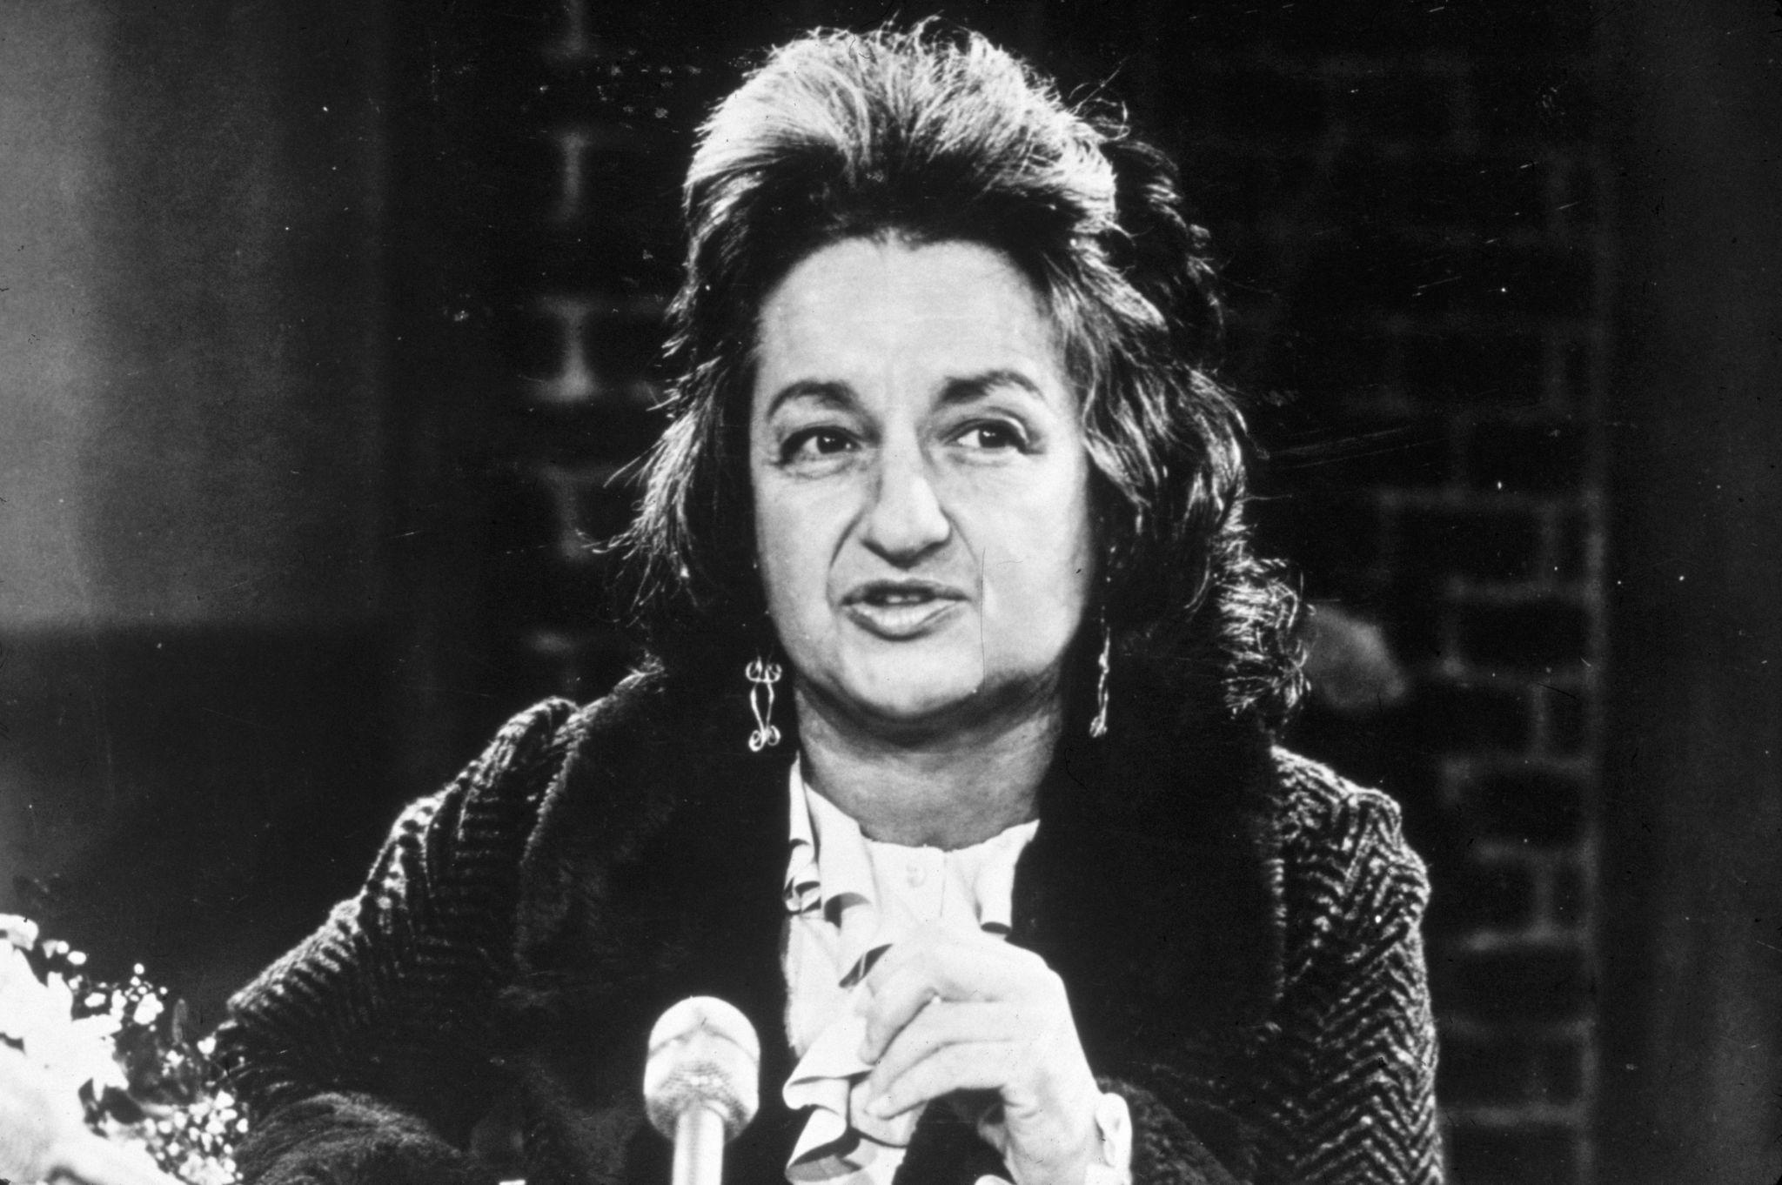
Betty Friedan (1921–2006)

Slide 12
Who She Was
U.S. political activist and writer; widely regarded as a key catalyst of second-wave feminism in the 1960s.
Brought mainstream attention to the dissatisfaction of middle-class suburban women confined to domestic roles.
Landmark Books
The Feminine Mystique (1963): Critiqued the post-war cultural ideal that women should find complete fulfillment in marriage, motherhood, and homemaking. She called this the “problem that has no name”—the silent frustration of women denied careers and intellectual growth.
The Second Stage (1983): Revisited feminism’s aims, arguing that women’s pursuit of autonomy (“personhood”) should not require rejecting family life; instead, social structures should enable balance between work and home.

Slide 13
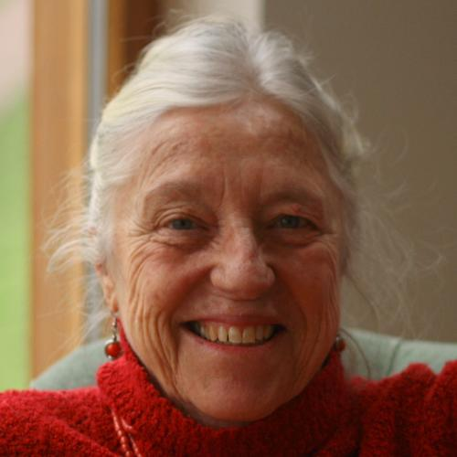
Juliet Mitchell (born 1940)

Slide 14
Who She Is
New Zealand–born British writer and a major theorist of socialist feminism.
Known for combining Marxism with psychoanalysis to explain women’s oppression.
Major Works
Women’s Estate (1971): Analysed women’s position through four structures—production (work), reproduction (childbearing), sexuality, and socialization of children.
Psychoanalysis and Feminism (1974; 2000 ed.): Argued that Freud’s theories, properly reinterpreted, help explain how gender identity and patriarchy are reproduced psychologically.
Feminine Sexuality (1985): Further explored female sexuality through psychoanalytic theory.

Slide 15
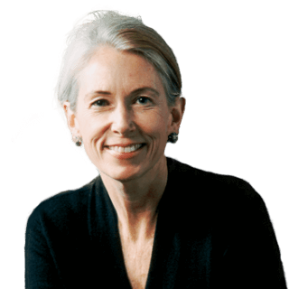
Catharine MacKinnon (born 1946)

Slide 16
Who She Is
U.S. academic, lawyer, and activist.
A central figure in feminist legal theory, especially radical feminism applied to law.
Major Works
Towards a Feminist Theory of the State (1989): Argues that the state and law institutionalize male dominance.
Only Words (1993): Contends that pornography is not mere speech but a practice that harms and subordinates women.
Are Women Human? (2006): Examines women’s status in international human rights law.

Slide 17
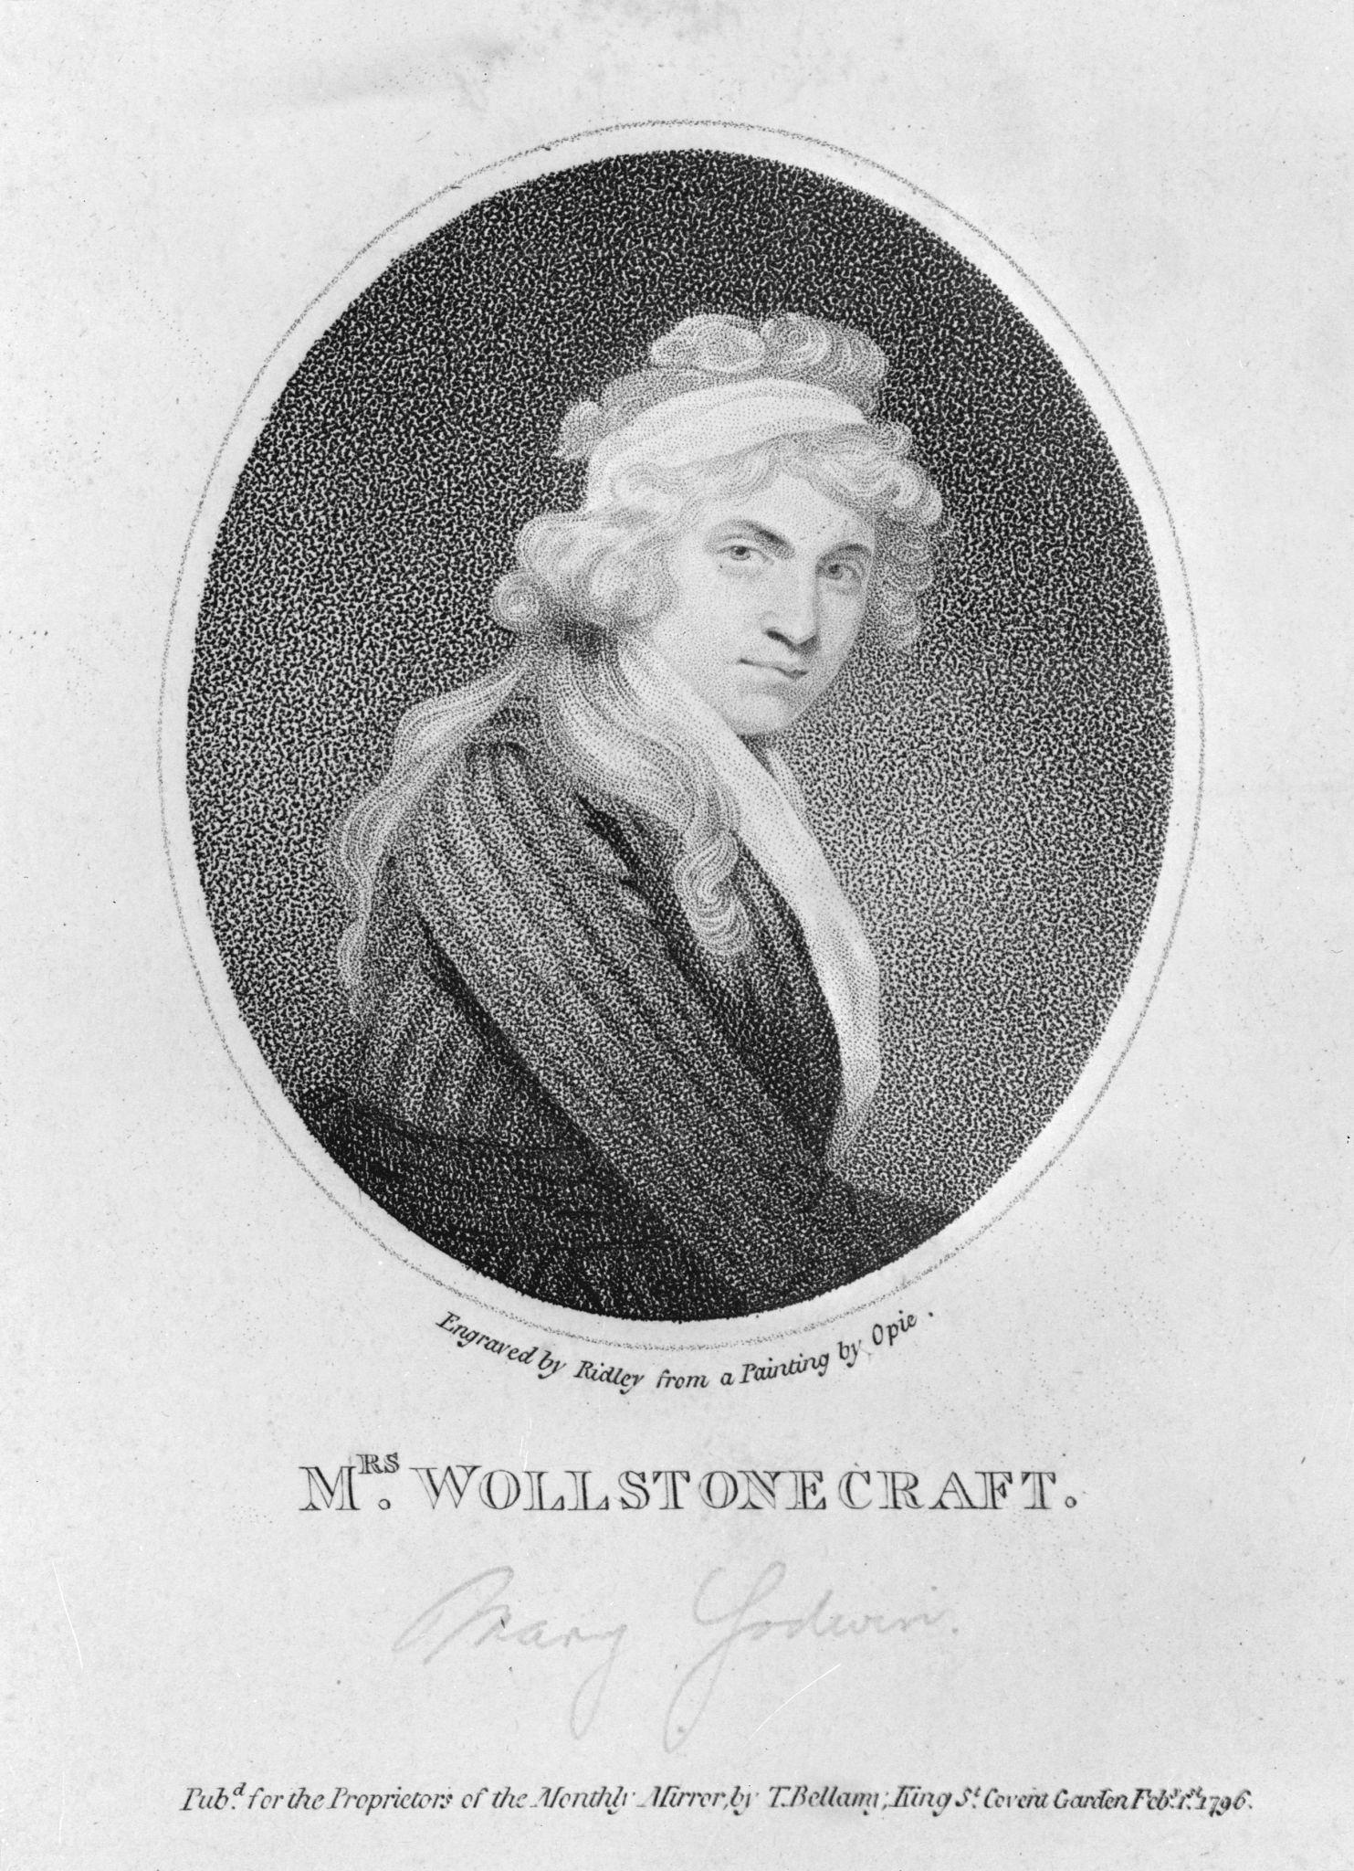
Mary Wollstonecraft (1759–1797)

Slide 18
Who She Was
British social theorist and one of the earliest systematic feminist thinkers.
Influenced by Enlightenment ideals and the radical political climate of the French Revolution.
Part of an intellectual circle that included her husband William Godwin.
Mother of Mary Shelley, author of Frankenstein.
Major Works
A Vindication of the Rights of Men (1790): Defended universal “rights of humanity” and criticised British political structures.
A Vindication of the Rights of Woman (1792): Argued that women are rational beings deserving equal rights, especially access to education.

Slide 19
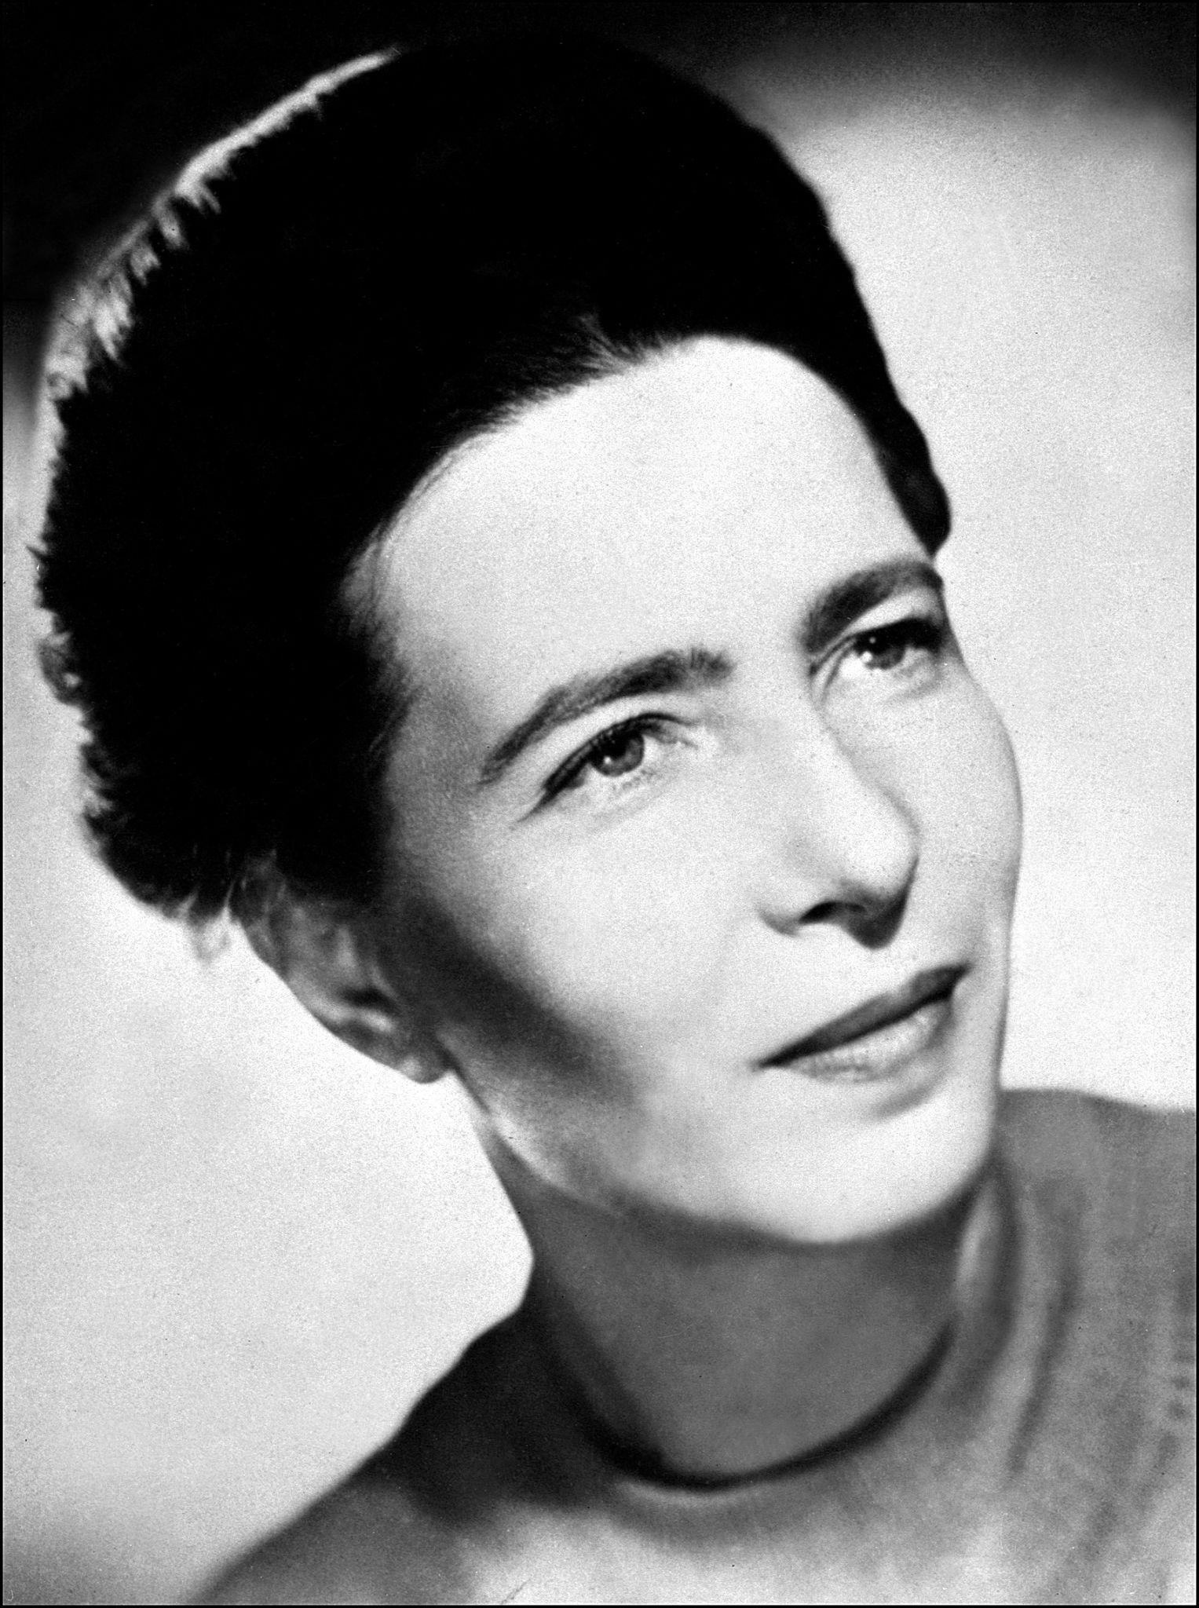
Simone de Beauvoir (1906–1986)

Slide 20
Who She Was
French philosopher, novelist, and social critic; a central figure in twentieth-century French intellectual life.
Youngest person at the time to pass the agrégation in philosophy in France.
Associated with existentialist philosophy and long-time intellectual partner of Jean-Paul Sartre.
Major Work
The Second Sex (1949): A foundational text of modern feminist theory examining the historical, cultural, and philosophical roots of women’s subordination.

Slide 21
Core Ideas of Simone de Beauvoir
“One is not born, but becomes, a woman.” Gender is not simply biological destiny; it is socially constructed through norms, expectations, and cultural conditioning. This insight laid the groundwork for the later sex/gender distinction in feminist theory.
Woman as “Other.” In Western thought, the male is treated as the norm or standard of humanity, while woman is defined in relation to man—as secondary or “other.” For example, “man” is often used to mean “human,” while “woman” is marked as deviation.

Slide 22
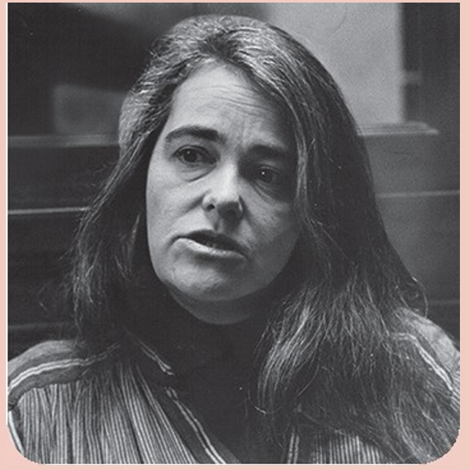
KATE MILLETT (BORN 1934)

Slide 23
A US feminist writer, political activist and artist, Millett developed a comprehensive critique of patriarchy in Western society and culture that had a profound impact on radical feminism. In Sexual Politics (1970), Millett analysed the work of male writers, from D. H. Lawrence to Norman Mailer, highlighting their use of sex to degrade and undermine women. In her view, such literature reflects deeply patriarchal attitudes that pervade culture and society at large, providing evidence that patriarchy is a historical and social constant

Slide 24
Core Themes of Feminist Political Theory:
Redefining ‘the political’
• sex and gender
• patriarchy
• equality and difference

Slide 25
Redefining “the Political”
Politics Exists Wherever Power Exists
Politics, they argue, is not limited to the state—it exists wherever power-structured relationships operate.
Following Kate Millett, politics can be understood as relationships in which one group exercises power over another.
This means politics operates in:
Workplaces (employer vs employee)
Families (husband vs wife; distribution of housework)
Sexual relationships
Parenting structures
Cultural norms about masculinity and femininity
Thus, the slogan “the personal is political” expresses the idea that everyday life reflects systems of power.

Slide 26
Why This Redefinition Matters
Sexual inequality persisted because:
Domestic labour was labelled “natural.”
Women’s caregiving role was treated as biological destiny.
Household inequality was dismissed as private choice.
By redefining politics, feminism:
Makes domestic labour a political issue.
Treats marital rape or domestic violence as public concerns.
Frames childcare and reproductive rights as matters of justice.

Slide 27
🔹 Equality and Difference
Although feminism seeks to end women’s oppression, there is deep disagreement about what liberation means.
1. Equality Feminism
Equality feminism argues that women should be treated the same as men.
Different versions:
Liberal feminism
Focus: legal equality.
Equal rights, anti-discrimination laws, political representation.
Example: equal pay legislation.

Slide 28
Socialist feminism
Focus: economic equality.
Address wage gaps, ownership of wealth, unpaid domestic labour.
Equal rights are meaningless without equal access to resources.
Radical feminism
Focus: equality in personal life.
Shared domestic labour.
Bodily autonomy.
Sexual freedom.
In all these, “difference” is seen as a source of subordination.
Liberation means removing gender-based hierarchy.

Slide 29
2. Difference Feminism
Difference feminists argue that striving to be “equal to men” can imply that male standards are the norm.
They argue:
Women should not aspire to be like men.
Feminism should celebrate women’s distinct traits.
Liberation means valuing female experience.
This view often includes:
Emphasis on care, empathy, creativity.
Celebration of childbirth, motherhood, sisterhood.
Cultural feminism (focus on women-centred art and spaces).

Slide 30
Difference feminism sometimes draws on essentialist ideas:
That biological or psycho-biological differences between sexes are real and meaningful.
That aggression may be more typical of male culture.
That cooperation and empathy may be strengths of female culture.

Slide 31
Thus the debate becomes:
Equality Feminism | Difference Feminism
Abolish difference | Celebrate difference
Gender equality | Women’s identity
Personhood | Sisterhood
Pro-human | Pro-woman
Transcend biology | Embrace biology

