Slide 1
Representation of People Act 1951
Prepared by Dr. Parismita Bhagawati
(as digital teaching material for Semester: 4th Semester
Course Name: POL040204: Political Processes in India; Unit I)

Slide 2
Purpose: Governs the conduct of elections to:
Lok Sabha and Rajya Sabha
State Legislative Assemblies and Legislative Councils
Legal Basis: Enacted under Article 327 of the Constitution of India, which empowers Parliament to make laws regarding elections.
Introduced by: Dr. B. R. Ambedkar, then Law Minister of India.
Enacted by: Provisional Parliament before the first General Elections (1951–52).
Significance: Forms the core statutory framework ensuring free, fair, and legally regulated elections in India.

Slide 3
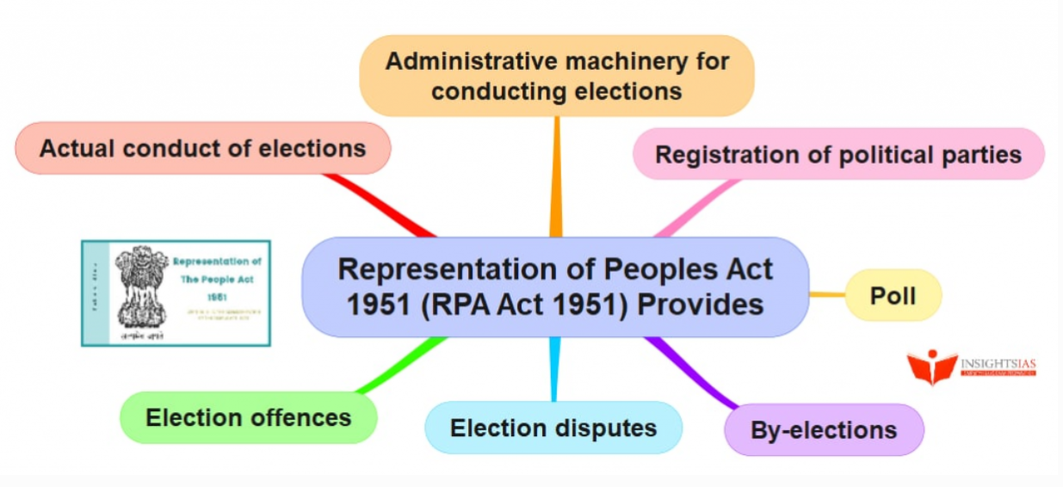

Slide 4
What the Representation of the People Act, 1951 Provides For (Provisions)
Conduct of Elections
Regulates elections to: Lok Sabha and Rajya Sabha, State Legislative Assemblies and Legislative Councils
Lays down nomination, scrutiny, withdrawal, polling, counting, and declaration procedures.
Election Administrative Machinery
Defines the roles of: Returning Officers, Presiding Officers, Electoral Officers
Provides the legal framework within which the Election Commission supervises and conducts elections.

Slide 5
Qualifications and Disqualifications
Specifies eligibility criteria (citizenship, age, etc.).
Lists grounds for disqualification such as:
  Conviction for certain offences
  Corrupt practices
  Holding an office of profit
  Failure to lodge election expense accounts
Corrupt Practices and Election Offences
Defines corrupt practices (bribery, undue influence, impersonation, booth capturing).
Prescribes penalties and electoral consequences.
Establishes procedures for filing election petitions and resolving disputes in High Courts.

Slide 6
Qualifications for Membership of the Lok Sabha
According to the Representation of the People Act, 1951, a person can contest for a seat in the Lok Sabha only if the following conditions are satisfied:
If the seat is reserved for the Scheduled Castes (SC), the person must belong to a Scheduled Caste and must be a registered voter (elector) in any Parliamentary constituency in India.
If the seat is reserved for the Scheduled Tribes (ST), the person must belong to a Scheduled Tribe and must be a registered voter (elector) in any Parliamentary constituency in India.
If the seat is a general (unreserved) seat, the person only needs to be a registered voter (elector) in any Parliamentary constituency in India. There is no caste requirement in this case.
In simple terms, every candidate must be a registered voter somewhere in India. However, for reserved seats, the candidate must also belong to the specific community (SC or ST) for which the seat has been reserved.

Slide 7
Qualifications for Membership of the Rajya Sabha
According to the Representation of the People Act, 1951:
A person cannot be elected as a member of the Rajya Sabha unless he or she is a registered voter (elector) in any Parliamentary constituency in India.
This means the person’s name must appear in the electoral roll (voter list) somewhere in India.
The candidate does not need to be a voter from the same State from which they are contesting.
In addition, under the Constitution of India (Article 84), the person must:
  Be an Indian citizen
  Be at least 30 years of age
  Not be disqualified under any law

Slide 8
Disqualifications for Membership under the Representation of the People Act, 1951
Disqualification for Corrupt Practices and Election Offences
If a candidate is found guilty of corrupt practices during elections, he or she can be disqualified.
Corrupt practices include:
Bribery
Undue influence on voters
Impersonation
Booth capturing
Use of religion or caste to seek votes improperly
If a High Court, while deciding an election petition, declares a person guilty of such practices, that person can be disqualified for a specified period.

Slide 9
Disqualification upon Criminal Conviction
A person becomes disqualified if convicted of certain criminal offences, especially when:
The conviction results in imprisonment of two years or more.
The offence involves promoting enmity between different groups on grounds such as religion, race, caste, language, etc.
In such cases, disqualification operates immediately

Slide 10
Failure to Lodge Election Expense Accounts
After contesting an election, a candidate must submit a detailed and accurate account of election expenses within the prescribed time.
If the candidate:
Fails to submit the account, or
Submits a false or incomplete account,
the Election Commission may disqualify the person.

Slide 11
Interest in Government Contracts
A person may be disqualified if he or she has a direct financial interest in government contracts, works, or services.
The reason is to avoid:
Conflict of interest
Misuse of legislative position for personal financial gain
Legislators must remain independent of executive financial control.

Slide 12
Dismissal from Government Service for Corruption or Disloyalty
If a person has been dismissed from government service on grounds of:
Corruption, or
Disloyalty to the State,
that person may be disqualified for a specified period.

Slide 13
Punishment for Social Offences
If a person has been convicted for practising or promoting social evils that are constitutionally prohibited, such as:
Sati
Untouchability
Other similar social crimes
they can be disqualified.

Slide 14
Election Offences and Corrupt Practices under the Representation of the People Act, 1951

Slide 15
Bribery and Gratification
Any form of gratification (money, gifts, favours, promises, liquor, etc.) given to voters to influence their vote is treated as a corrupt practice.
Similarly, offering benefits to a candidate to:
Withdraw nomination, or
Not withdraw nomination
is also illegal.
Elections must be based on free choice, not financial inducement.

Slide 16
Undue Influence
If a candidate or election agent directly or indirectly interferes with the free exercise of electoral rights, it becomes an offence.
This includes:
Threats
Intimidation
Coercion
Social pressure
Voters must be able to vote without fear.

Slide 17
Appeal on Religious or Caste Grounds
Seeking votes or asking voters to refrain from voting on the basis of:
Religion
Race
Caste
Community
Language
is prohibited.

Slide 18
Propagation or Glorification of Sati
Encouraging, justifying, or glorifying the practice of sati is treated as an election offence.
This aligns electoral law with constitutional commitments against social evils.
Publication of False Statements
Publishing or spreading false statements about the personal character or conduct of another candidate to damage their reputation is prohibited.
The law protects candidates from defamatory and misleading propaganda.
Booth Capturing
If a candidate, their agent, or any other person seizes a polling booth or interferes with voting through force or fraud, it constitutes booth capturing — a serious electoral offence.
This can lead to re-polling, criminal prosecution, and disqualification.

Slide 19
Misuse of Government Machinery
A candidate cannot seek assistance from government servants (such as police officers, district officials, or other public servants) to improve their election prospects.
The administrative machinery must remain neutral.

Slide 20
Election Expenses under Section 77 of the Representation of the People Act, 1951
Section 77 of the Representation of the People Act, 1951 deals with the obligation of candidates to maintain proper records of their election expenditure.
According to this provision:
Every candidate contesting an election to the Lok Sabha or to a State Legislative Assembly must maintain a separate and accurate account of all election-related expenses.
The account may be maintained either by the candidate personally or by the candidate’s election agent.
The record must include all expenses:
  Actually incurred by the candidate, and
  Authorised by the candidate or the election agent.
In simple terms, the law requires that all money spent for campaigning — such as on rallies, posters, advertisements, vehicles, public meetings, and publicity materials — must be properly recorded.

Slide 21
Provisions Related to Political Parties under the Representation of the People Act, 1951
Registration with the Election Commission of India (ECI)
Any association or body that wishes to function as a political party must apply for registration with the Election Commission of India (ECI).
Registration is done under Section 29A of the Act.
The decision of the ECI regarding registration is final (subject to judicial review by courts).
The party must declare its allegiance to the Constitution of India, and its commitment to democracy, secularism, socialism, and national integrity.

Slide 22
Recognition as State Party or National Party
After registration, a political party may, over time, become recognised as a State Party or a National Party.
Recognition is based on electoral performance, such as:
  Percentage of valid votes secured, and/or
  Number of seats won in Legislative Assemblies or Lok Sabha.
Recognition provides benefits like:
  Reserved election symbol
  Free broadcast time on public media
  Consultation rights with the ECI on electoral matters

Slide 23
Change in Name or Address
If a registered political party changes its:
  Name, or
  Address,
it must formally inform the ECI.
Derecognition by the ECI
The ECI cannot cancel the registration of a political party merely for poor electoral performance.
However, it can withdraw recognition (State or National status) if the party fails to meet the required criteria in future elections.

Slide 24
Section 126 of the RPA, 1951
48 hours before the polling ends or concludes, displaying of any election matter by television or similar apparatus in a constituency is prohibited.
Section 126 is not applicable to the print media, news portals and social media
Section 126A of the RPA, 1951 prohibits the conduct and publication of exit polls during the period notified by the Election Commission (generally from the beginning of polling in the first phase until polling ends in the last phase), meaning that no survey conducted after voters cast their vote asking them whom they voted for can be disseminated during this period, in order to prevent influencing voters in subsequent phases and to ensure free and fair elections.

Slide 25
Voluntary Contributions
Registered political parties are permitted to accept voluntary contributions from any individual or company within India, except government companies, thereby allowing private persons and corporate entities to financially support political activities.
Companies may donate any amount to political parties, as there is no statutory upper ceiling on corporate political contributions under the current legal framework.
A company making such political donations is not legally obligated to separately disclose these contributions in its profit and loss account, which has raised debates about transparency in political funding.

Slide 26
Political parties are required to submit to the Election Commission of India a detailed report of all donations received above ₹2,000, ensuring some degree of financial disclosure and accountability.
Political parties are prohibited from accepting more than ₹2,000 in cash from a single donor, a measure intended to reduce untraceable cash funding in elections.
Following amendments aligned with the Foreign Contribution (Regulation) Act, 2010, political parties are allowed to receive contributions from certain foreign companies as defined under that Act, expanding the scope of permissible funding sources.

Slide 27
Declaration of Assets and Liabilities under Election Law
Every candidate contesting an election is required to file a sworn affidavit along with the nomination paper, disclosing details of any pending criminal cases or convictions, movable and immovable assets, liabilities (including loans and dues), and educational qualifications, so that voters can make an informed choice.
After being elected, Members of Parliament must submit a formal declaration of their assets and liabilities to the Speaker of the Lok Sabha or the Chairman of the Rajya Sabha, as applicable.
Such declarations must be made within 90 days of taking their seat in Parliament, ensuring continued transparency and accountability in public office.

