Slide 1
Vulva Formation in Caenorhapditis elegans
M.Sc. 2nd Semester Zoology
Paper code: ZOO-2034
Bandita Talukdar
Assistant Professor, Department of Zoology, Pandu College

Slide 2
What is C. elegans?
C. elegans are multicellular nematode.
It has two sexes:
    Hermaphrodite (both male and female sex organs in single body)
    Male
    In their early development, they are male, and the gonad produces sperm, which is stored for later use. As they grow older, they develop ovaries.
    Hermaphrodite can be viewed most simply as a female that produce a limited number of sperms, so she can reproduce either by self fertilization by using own sperms or by cross fertilization, after the transfer of male sperm by mating.

Slide 3
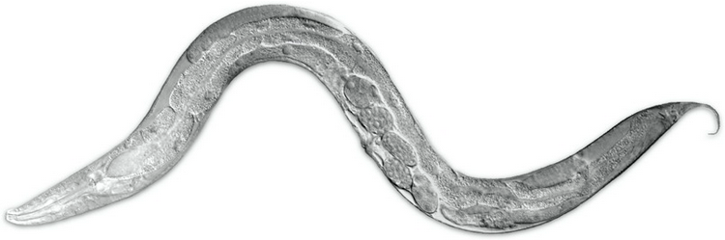
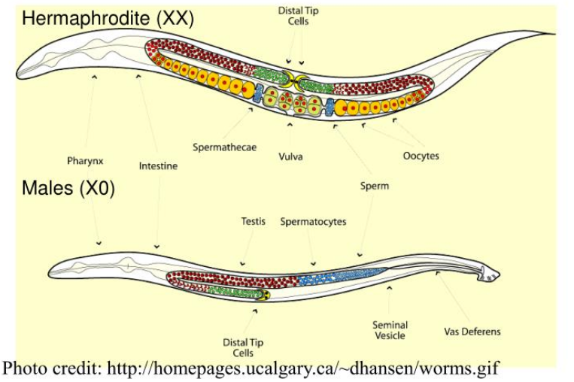
C. elegans
worms.zoology.wisc.edu
C. elegans known as round worm and regarded as model organism.
The eggs "roll" through the region of sperm storage, are fertilized inside the nematode, and then pass out of the body through the vulva.

Slide 4
C. elegans
(1) They're simple: The adult hermaphrodite has just a little over 1000 somatic nuclei (a few cells fuse together into multinucleate cells called syncytia). At the time most morophogenesis takes place, there are only several hundred cells in the embryo.
(2) They're transparent: Living C. elegans embryos can be imaged using Nomarski microscopy, or by imaging transgenic embryos expressing fluorescent proteins such as GFP.
(3) They're reproducible: Embryonic development is incredibly reproducible from embryo to embryo. Largely through the work of Nobel laureate John Sulston and colleagues, this allowed the determination of the complete lineage of every cell in C. elegans, i.e., the "history" of each cell in the embryo can be traced back to the one-celled zygote

Slide 5
What is Vulva?
The vulva is part of female sex organ that consist of 22 cells and serves as a structure through which the sperm enter and fertilized eggs leaves the gonads.
Vulva is necessary for egg laying
Vulva present at midventrally
Vulva is a part of female sex apparatus
Adult vulva has 22 cells

Slide 6
Life Cycle of C.elegans
Life cycle is temperature dependent
at 16 degree c—2-3 days
at 20 degree c- 3-4 days
at 25 degree c—5-6 days

Slide 7
Vulva development
Vulva development in c. elegans involves a network of intercellular signaling, signaling transduction and transcriptional regulation
Generation of VPCs: six vulval precursor cells (VPCs) are specified among the 11 cells, which are located in the ventral epidermis
Vulval precursor patterning: a signal from the gonad and signaling among the VPCs specify three VPCs to generate vulval cells.

Slide 8
The vulval lineages are of two types 1degree (primary ) and 2 degree (secondary) and Uninduced VPCs generate 3 degree(tertiary) lineage which make epidermal cells.
Generation of the adult cells: the adult vulva comprise 22 cells
The vulva of Caenorhabditis elegans represents a case in which one inductive signal generates a variety of cell types. This organ forms during the larval stage from six cells called the vulval precursor cells (VPCs).

Slide 9
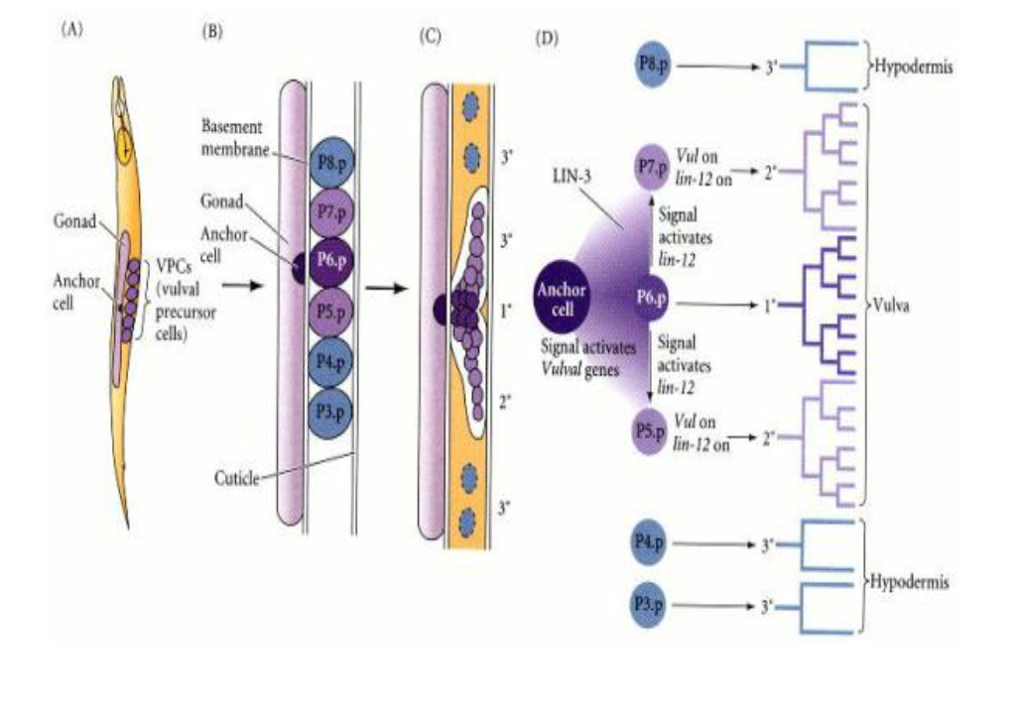
littleflowercollege.edu.in

Slide 10
Anchor cell
The cell connecting the overlying gonad to the vulval precursor cells is called the anchor cell.
The anchor cell have lin-3 gene which produce the LIN-3 protein, a relative of epidermal growth factor (EGF) and the Boss protein (Hill and Sternberg 1992)
The cell straight beneath the anchor cell divides to form the central vulval cells.
The two cells adjoining that central cell divide to become the lateral vulval cells, while the three cells farther away from the anchor cell generate hypodermal cells.

Slide 11
If the anchor cell is destroyed (or if the lin-3 gene is mutated), the VPCs can not form a vulva; they will instead become part of the hypodermis (skin) (Kimble 1981).
The six VPCs influenced by the anchor cell form an equivalence group. Each member of this group is capable to become induced by the anchor cell and can take up any of three fates, depending on its juxtaposition to the anchor cell.

Slide 12
If the anchor cell is destroyed, all six cells of the correspondence group divide once and subsidize to the hypodermal tissue.
If the three central VPCs are destroyed, the three outer cells, which usually form hypodermal cells, produce vulval cells instead.

Slide 13
The LIN-3 protein is received by the LET-23 receptor tyrosine kinase on the VPCs, and the signal is transferred to the nucleus through the RTK-Ras pathway.
The target of the kinase cascade is the LIN-31 protein.

Slide 14
The LIN-3 protein forms a concentration gradient. Here, the VPC closest to the anchor cell (i.e., the P6.p cell) receives the highest concentration of LIN-3 protein and generates the central vulval cells.
The two VPCs adjacent to it (P5.p and P7.p) receive a lower amount of LIN-3 and become the lateral vulval cells.
The VPCs farther away from the anchor cell do not receive enough LIN-3 to have an effect, so they become hypodermis.

Slide 15
In addition to forming the central vulval lineage, the VPC closest to the anchor cell also signals laterally to the two adjacent cells and instructs them to generate the lateral vulval lineages.

